Slide 1
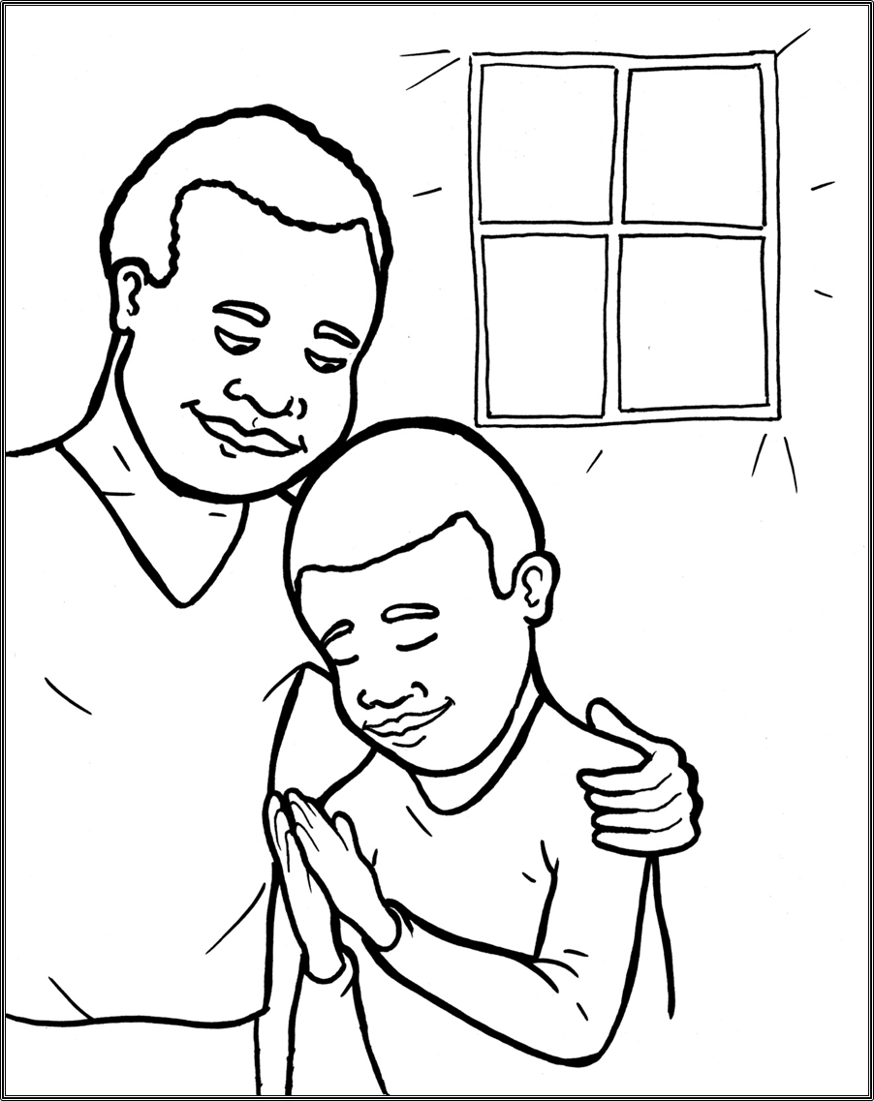
Part 2
50. I Am Alive:
Prayer
New Words
Rule Breakers

Slide 2
Other Sounds – Soft C
ce, ci, cy make the soft sound
cent
city
fancy

Slide 3
rejoice
voice

Slide 4
Silent Letters
answers
listen
talk
honesty

Slide 5
Contractions
The word “contraction” means “the thing pulled together.”
The first word stays the same,
and the apostrophe takes the place of the
missing letters in the second word.
’m
=
am
I
I

Slide 6
let’s
=
let us

Slide 7
New Words
Christian
honesty
praise

Slide 8
Rule Breakers
Words like these do not follow phonetic patterns.
to
you
said
could
two
f
from

Slide 9
is
the
to
you
his
your

Slide 10
from
been
sure
what
give
wants

Slide 11
would
sorry
friend
listen
into
water

Slide 12
Father
answers
Christian

