Slide 1
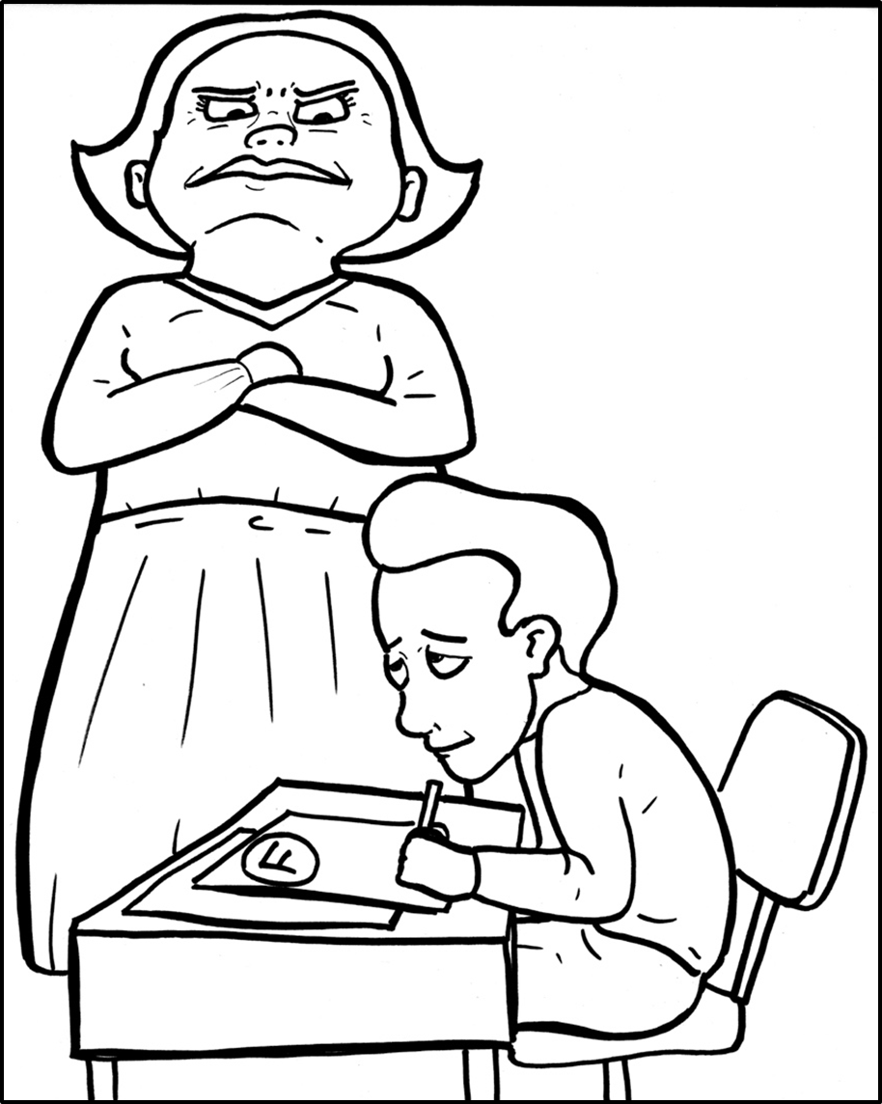
Part 2
46. First, the Bad News
– Sin Separates
New Words
Rule Breakers
You cheated!

Slide 2
Other Sounds – Soft G
ge, gi, gy often make the soft sound
gentle
giant
gym

Slide 3
huge

Slide 4
Silent Letters
whole

Slide 5
wrong

Slide 6
Contractions
The word “contraction” means “the thing pulled together.”
The first word stays the same,
and the apostrophe takes the place of the
missing letters in the second word.
’m
=
am
I
I

Slide 7
don’t
=
do not
there’s
there is
=
can’t
=
can not

Slide 8
we’ve
we have
=
it’s
it is
=

Slide 9
New Words
disobeyed
disappoint

Slide 10
separates
trouble

Slide 11
Rule Breakers
These words do not follow phonetic patterns.

Slide 12
is
do
together
his
of
has

Slide 13
the
you
who
your
everyone
said

Slide 14
love
have
want
does
sometimes
from

Slide 15
been
there
what
friendship
forgive
Father

Slide 16
brother
always
trouble
heart

