Slide 1
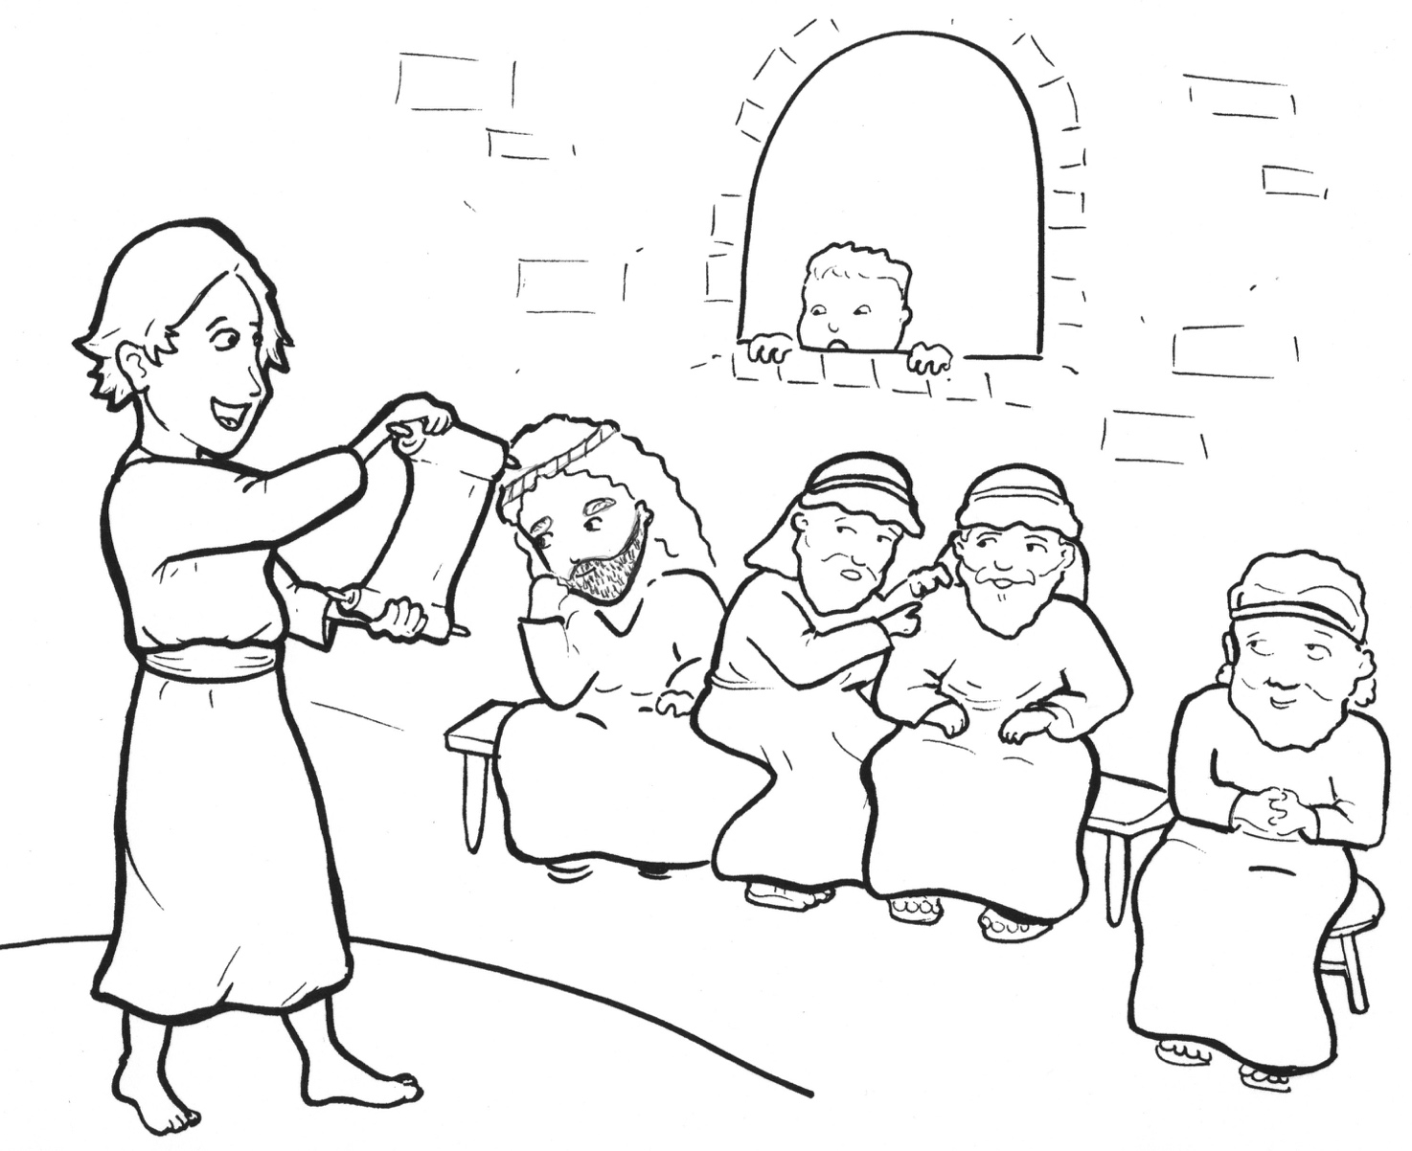
7. Jesus Gets Lost!
Part 2
New Words
Rule Breakers

Slide 2
Other Sounds – Soft C
ce, ci, cy make the soft sound
cent
city
fancy

Slide 3
city

Slide 4
Silent Letters
know

Slide 5
Contractions
The first word stays the same,
and the apostrophe takes the place
of the missing letters in the second word.
do
n’t
=
do
not

Slide 6
didn’t =
did not

Slide 7
New Words
Jerusalem
Scriptures
worshipped
Nazareth

Slide 8
Rule Breakers
These words do not follow phonetic patterns.
the
of

Slide 9
to
was
what
from
many
they

Slide 10
is
his
where
said
you
were

Slide 11
young
son
have
been
obeyed
other

Slide 12
father
everywhere

