Slide 1
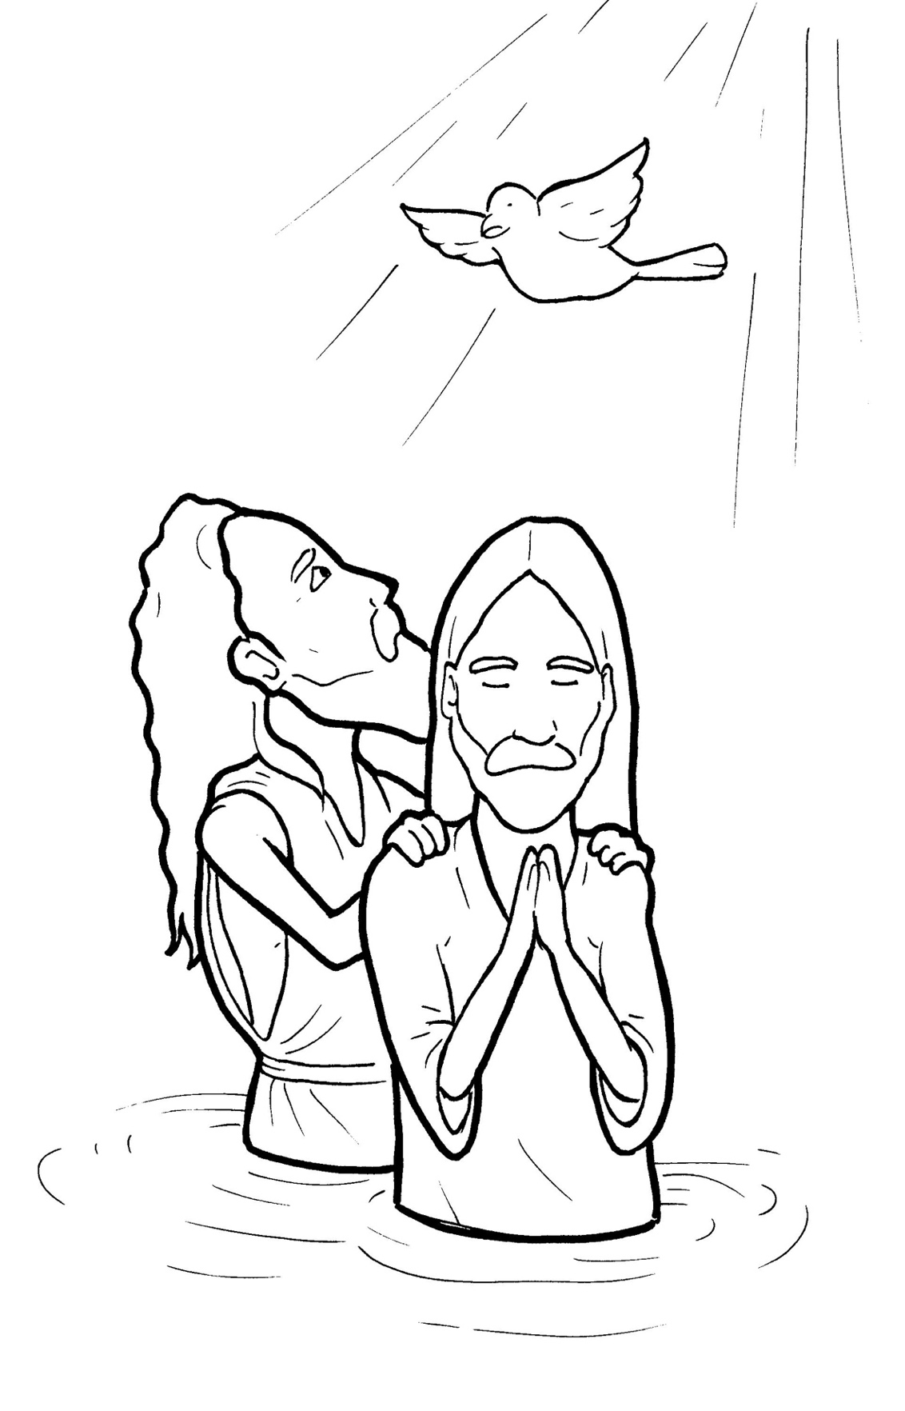
9. Jesus Gets Baptized
Part 2
New Words
Rule Breakers

Slide 2
Other Sounds – Soft C
ce, ci, cy make the soft sound
cent
city
fancy

Slide 3
voice

Slide 4
Silent Letters
lamb

Slide 5
John

Slide 6
Possessives
God’s plan
God’s greatest work
God’s Chosen One

Slide 7
New Words
Lamb of God
Spirit of God
Chosen One

Slide 8
mission
baptized
fulfill

Slide 9
Christ
Nazareth
Bethlehem

Slide 10
Rule Breakers
These words do not follow phonetic patterns.

Slide 11
to
his
into
was
is
are

Slide 12
you
said
from
whom
they
walked

Slide 13
love
coming
dove
Spirit
covered
water

Slide 14
greatest
were
saw
Son
one

