Slide 1
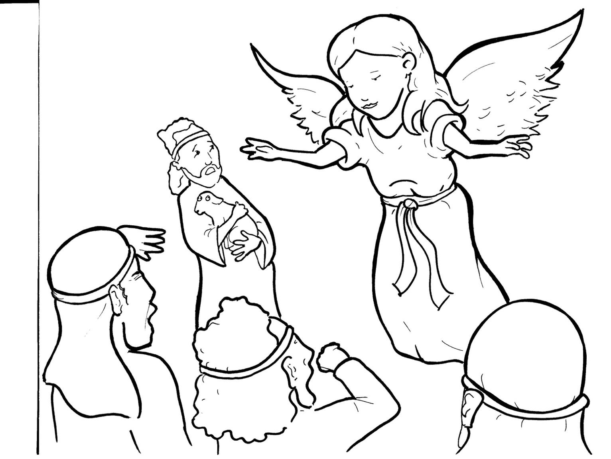
3. Shepherds Share the Good News
Part 4
Story in Easy Read English
Questions
Story in Phrases

Slide 2
All was quiet outside of Bethlehem.

Slide 3
In the dark fields, shepherds petted their soft, sleeping sheep.

Slide 4
A fire kept them warm.

Slide 5
An angel of the Lord appeared.

Slide 6
The shepherds shook with fear.

Slide 7
Many angels joined in.

Slide 8
It was like an army from heaven.

Slide 9
The angels glowed brightly in the night.

Slide 10
They sang the joyful news about Jesus.

Slide 11
“A Savior has been born!

Slide 12
He is Christ the Lord.”

Slide 13
The angels praised God, saying, “Glory to God in the highest.

Slide 14
On earth, let there be peace.”

Slide 15
The angels flew back to heaven.

Slide 16
“Let’s see what happened,” the shepherds said.

Slide 17
They ran to Bethlehem.

Slide 18
There, they found Mary, Joseph, and baby Jesus.

Slide 19
It was all true!

Slide 20
The shepherds told everyone, everywhere the good news of great joy.

Slide 21
“A Savior has been born!

Slide 22
He is Christ the Lord.”

Slide 23
All who heard it were amazed.

Slide 24
Question 1
What did the shepherds do with the good news?

Slide 25
Question 2
What ways do people hear about Jesus today?

Slide 26
Question 3
How did you hear the good news about Jesus?

Slide 27
Question 4
How can you share the good news?

Slide 28
Prayer
Dear Jesus,
You are my Savior. I give you glory. Help me spread this wonderful news. I would like to share the joyful news like the brave shepherds did. Help me tell it to the people I care about.
Amen

Slide 29
Shepherds Share
the Good News
Phrased for Fluency

Slide 30
All
was quiet
outside of Bethlehem.

Slide 31
In the dark fields,
shepherds
petted
their soft, sleeping sheep.

Slide 32
A fire
kept them warm.

Slide 33
An angel
of the Lord
appeared.

Slide 34
The shepherds
shook with fear.

Slide 35
Many angels
joined in.

Slide 36
It was like
an army from heaven.

Slide 37
The angels
glowed brightly
in the night.

Slide 38
They sang
the joyful news
about Jesus.

Slide 39
“A Savior
has been born!”

Slide 40
He is Christ
the Lord.”

Slide 41
The angels
praised God,
saying,
“Glory to God
in the highest.

Slide 42
On earth,
let there be peace.”

Slide 43
The angels
flew back
to heaven.

Slide 44
“Let’s see
what happened,”
the shepherds said.

Slide 45
They ran
to Bethlehem.

Slide 46
There,
they found Mary,
Joseph,
and baby Jesus.

Slide 47
It was all true!

Slide 48
The shepherds
told everyone,
everywhere
the good news
of great joy.

Slide 49
“A Savior
has been born!

Slide 50
He is
Christ the Lord.”

Slide 51
All
who heard it
were amazed.

