Slide 1
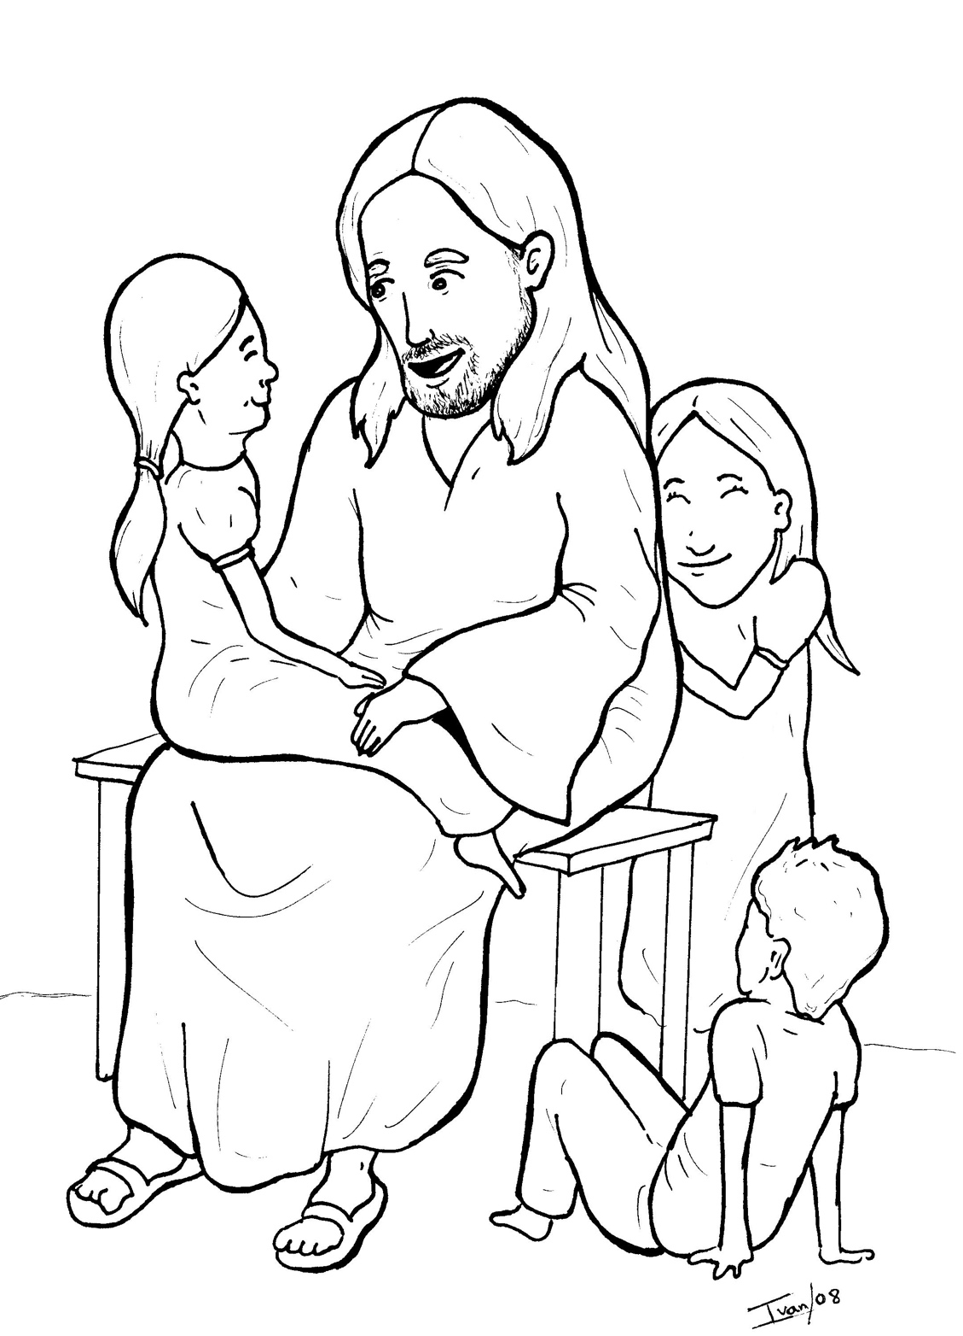
12. Jesus Loves the Little Children
Part 4
Story in Easy Read English
Questions
Story in Phrases

Slide 2
Parents ran to Jesus with their babies and children.

Slide 3
Many moms and dads pushed close to Jesus.

Slide 4
“Jesus, bless our children,” they said.

Slide 5
“Jesus, lay your hands on my little boy,” said a mother.

Slide 6
“Jesus, pray for my little girl,” said a father.

Slide 7
The disciples saw this.

Slide 8
They scolded the parents.

Slide 9
“Go away!” the disciples said.

Slide 10
Jesus was upset.

Slide 11
“Let the little children come to me,” Jesus said. “Do not stop them.

Slide 12
God’s kingdom belongs to them.

Slide 13
People who are like children are mine.

Slide 14
You must be like them.

Slide 15
Accept God’s kingdom or you will never enter it.”

Slide 16
Then, Jesus took the children in his arms.

Slide 17
He laid his hands on them and blessed them.

Slide 18
The moms and dads smiled.

Slide 19
The boys and girls gave Jesus a big hug.

Slide 20
Everyone went home happy.

Slide 21
Question 1
What did Jesus say about children?

Slide 22
Question 2
How does Jesus feel about children?

Slide 23
Question 3
How does Jesus feel about you?

Slide 24
Prayer
Dear Jesus,
Thank you for thinking that I am so important. I know that you love me.
Amen

Slide 25
Jesus Loves the
Little Children
Phrased for Fluency

Slide 26
Parents
ran
to Jesus
with their babies
and children.

Slide 27
Many moms and dads
pushed
close to Jesus.

Slide 28
"Jesus,
bless our children,"
they said.

Slide 29
"Jesus,
lay your hands
on my little boy,"
said a mother.

Slide 30
"Jesus,
pray for
my little girl,"
said a father.

Slide 31
The disciples
saw this.

Slide 32
They
scolded
the parents.

Slide 33
"Go away!"
the disciples said.

Slide 34
Jesus was
upset.

Slide 35
"Let the little children
come to me,"
Jesus said.

Slide 36
"Do not stop them.

Slide 37
God's kingdom
belongs
to them.

Slide 38
People
who are like children
are mine.

Slide 39
You must
be like them.

Slide 40
Accept God's kingdom
or you
will never
enter it."

Slide 41
Then,
Jesus
took the children
in his arms.

Slide 42
He laid
his hands
on them
and blessed them.

Slide 43
The moms and dads
smiled.

Slide 44
The boys and girls
gave Jesus
a big hug.

Slide 45
Everyone
went home
happy.

