Slide 1
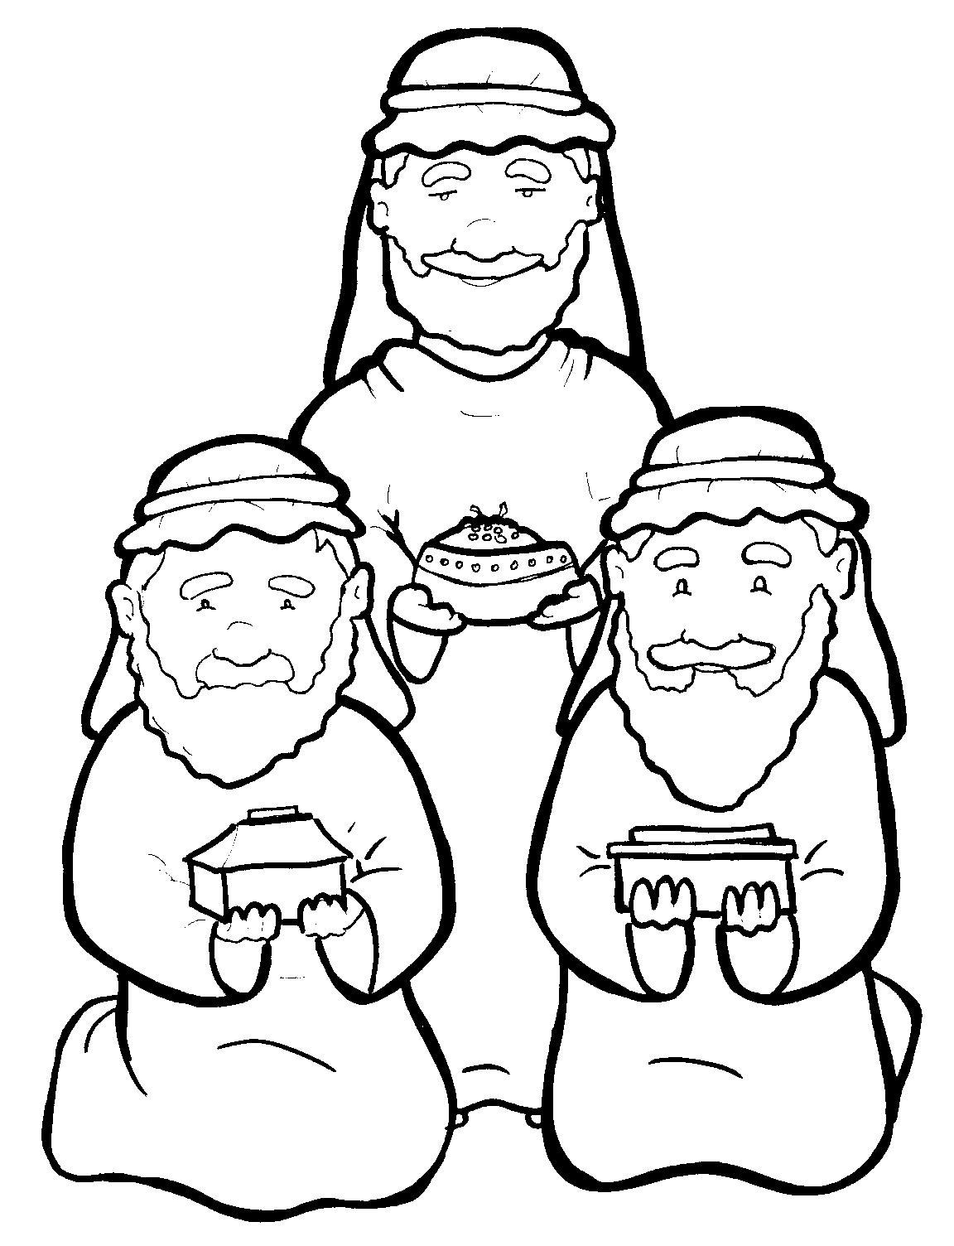
4. Wise Men Give Gifts to Jesus
Part 4
Story in Easy Read English
Questions
Story in Phrases

Slide 2
Men in the East read God’s Word.

Slide 3
It said, “A star will rise when my King is born.”

Slide 4
They said, “We will follow this star.”

Slide 5
These wise men were kings.

Slide 6
They put gifts onto their camels.

Slide 7
They traveled hundreds of miles - up and down hills, over deserts, past towns.

Slide 8
In Jerusalem, they asked, “Where is the child King?

Slide 9
We saw his star.

Slide 10
We have come to worship him.”

Slide 11
In Bethlehem, the big, bright star shone down upon Jesus.

Slide 12
The men felt they would burst with joy.

Slide 13
They found Jesus with Mary.

Slide 14
The mighty kings bowed low.

Slide 15
They worshipped Jesus and said, “We bring you treasures from our land.”

Slide 16
“Take my gold to welcome your birth.”

Slide 17
Gold is the gift of kings.

Slide 18
“Take my frankincense.”

Slide 19
This perfume is strong
and sweet.

Slide 20
“Take my myrrh.

Slide 21
Save this oil for your death.”

Slide 22
After all, Jesus was born to die.

Slide 23
The kings went home.

Slide 24
Their bags were empty, but their hearts were full.

Slide 25
Jesus grew.

Slide 26
He was indeed strong and sweet.

Slide 27
Question 1
What did the wise men do when they found Jesus?

Slide 28
Question 2
If you are wise, what will you do with Jesus?

Slide 29
Question 3
What gifts did the kings give Jesus?

Slide 30
Question 4
What gifts can you give him?

Slide 31
Prayer
Dear King Jesus,
I worship you. Thank you for coming to earth to be born, to live a sweet life, and then to die for me.
Make me wise, too!
I want to honor you with gifts.
Amen

Slide 32
Story in Phrases
Wise Men Give Gifts to Jesus
Phrased for Fluency

Slide 33
Men
in the East
read God’s Word.

Slide 34
It said,
“A star
will rise
when my King
is born.”

Slide 35
They said,
“We
will follow
this star.”

Slide 36
These
wise men
were kings.

Slide 37
They
put gifts
onto their camels.

Slide 38
They traveled
hundreds of miles -
up and down hills,
over deserts,
past towns.

Slide 39
In Jerusalem,
they asked,
“Where
is the child king?

Slide 40
We saw his star.

Slide 41
We have come
to worship him.”

Slide 42
In Bethlehem,
the big, bright star
shone down
upon Jesus.

Slide 43
The men
felt
they would burst
with joy.

Slide 44
They found Jesus
with Mary.

Slide 45
The mighty kings
bowed low.

Slide 46
They worshipped Jesus
and said,
“We bring you
treasures
from our land.”

Slide 47
“Take my gold
to welcome your birth.”

Slide 48
Gold
is the gift
of kings.

Slide 49
“Take
my frankincense.”

Slide 50
This perfume
is strong and sweet.

Slide 51
“Take
my myrrh.

Slide 52
Save this oil
for your death.”

Slide 53
After all,
Jesus
was born
to die.

Slide 54
The kings
went home.

Slide 55
Their bags
were empty,
but their hearts
were full.

Slide 56
Jesus grew.

Slide 57
He was indeed
strong and sweet.

