Slide 1
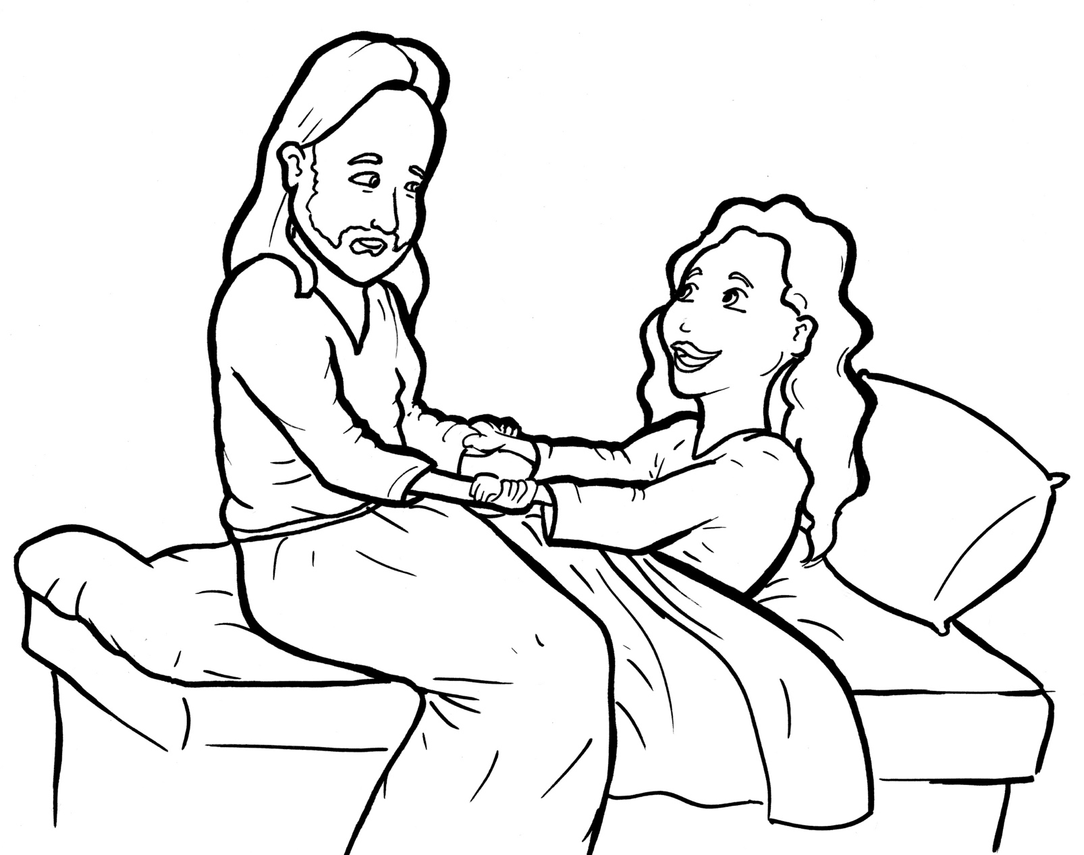
Part 4
30. Jesus Raises a Dead Girl to Life
Story in Easy Read English
Questions
Story in Phrases

Slide 2
“My only daughter is dying!”
Jairus cried.

Slide 3
He fell at the feet of Jesus.

Slide 4
This father was a Jewish leader.

Slide 5
"Please come,"
he begged Jesus.

Slide 6
"Put your hands on her.
If you do, she will live."

Slide 7
Some people came up.

Slide 8
"Your daughter is dead,"
they said.

Slide 9
"Don't bother Jesus anymore."

Slide 10
But Jesus said to him,
"Don’t be afraid.

Slide 11
Just believe, and she will be healed."

Slide 12
Jesus went to Jairus’ home.

Slide 13
Since the little girl had died,
many people came to the
home.

Slide 14
They cried loudly.
Tears fell down faces.

Slide 15
Sad music filled the air.

Slide 16
Jesus said, "Stop crying.

Slide 17
The child is not dead.
She is asleep."

Slide 18
But they laughed at him.

Slide 19
"Of course, she is dead,"
they said.

Slide 20
Jesus went inside.

Slide 21
The 12-year-old girl
was on the bed.

Slide 22
Jesus took her hand.

Slide 23
"Little girl, I say to you, get up."

Slide 24
Right away, she got up
and walked around!

Slide 25
All were amazed!

Slide 26
They told everyone the happy
news.

Slide 27
Question 1
What miracle did Jesus perform?

Slide 28
Question 2
When the father was told that his daughter had died, what did Jesus say to the father?

Slide 29
Question 3
When you come to Jesus with your sadness and fears, what would he say to you?

Slide 30
Question 4
Faith brings miracles. What are you afraid of? How can faith in Jesus help you?

Slide 31
Prayer
Dear Jesus,
You can do the impossible. You raised a dead girl to life. You love to heal. Children never bother you. Even death does not stop you. Help me to fall at your feet. Help me to not be afraid. Help me to believe that you can do anything.
Amen

Slide 32
Jesus Raises
a Dead Girl
to Life
Phrased for Fluency

Slide 33
"My only daughter
is dying!"
Jairus cried.

Slide 34
He fell
at the feet
of Jesus.

Slide 35
This father
was
a Jewish leader.

Slide 36
"Please come,"
he begged Jesus.
on her.
"Put your hands

Slide 37
she will live."
If you do,

Slide 38
Some people
came up.
"Your daughter
is dead,"
they said.

Slide 39
"Don't bother Jesus
anymore."

Slide 40
But Jesus said
to him,
"Don't be afraid.

Slide 41
Just believe,
and she will
be healed."

Slide 42
Jesus went
to Jairus’ home.

Slide 43
Since the little girl
had died,
many people
came
to the home.

Slide 44
They cried
loudly.
Tears
fell down faces.

Slide 45
Sad music
filled the air.

Slide 46
Jesus said,
"Stop crying.

Slide 47
The child
is not dead.
She is asleep."

Slide 48
But they laughed
at him.

Slide 49
"Of course
she is dead,"
they said.

Slide 50
Jesus went inside.
The 12-year-old girl
was on the bed.

Slide 51
Jesus took
her hand.
"Little girl,
I say to you,
get up."

Slide 52
Right away,
she got up
and walked around!

Slide 53
All were amazed!

Slide 54
They told everyone
the happy news.

