Slide 1
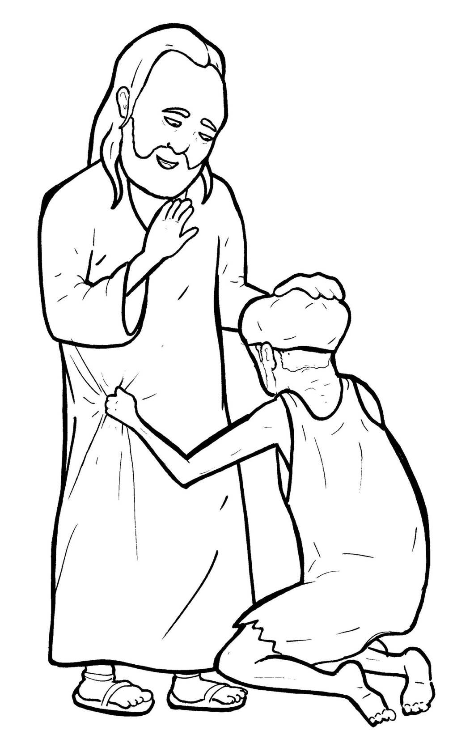
Part 2
31. A Blind Man Asks to See
New Words
Rule Breakers

Slide 2
Other Sounds – Soft C
ce, ci, cy make the soft sound
cent
city
fancy

Slide 3
face
voices

Slide 4
mercy

Slide 5
Possessives
Timing
Box
Bartimaeus’ dark world

Slide 6
New Words
Bartimaeus
stumbled
mercy

Slide 7
Rule Breakers
Words like these do not follow phonetic patterns.
to
you
said
could
two
f
from

Slide 8
is
do
of
his
to
has

Slide 9
the
your
one
have
you
some

Slide 10
said
they
poor
saw
many
also

Slide 11
what
could
want
women
eyes

