Slide 1
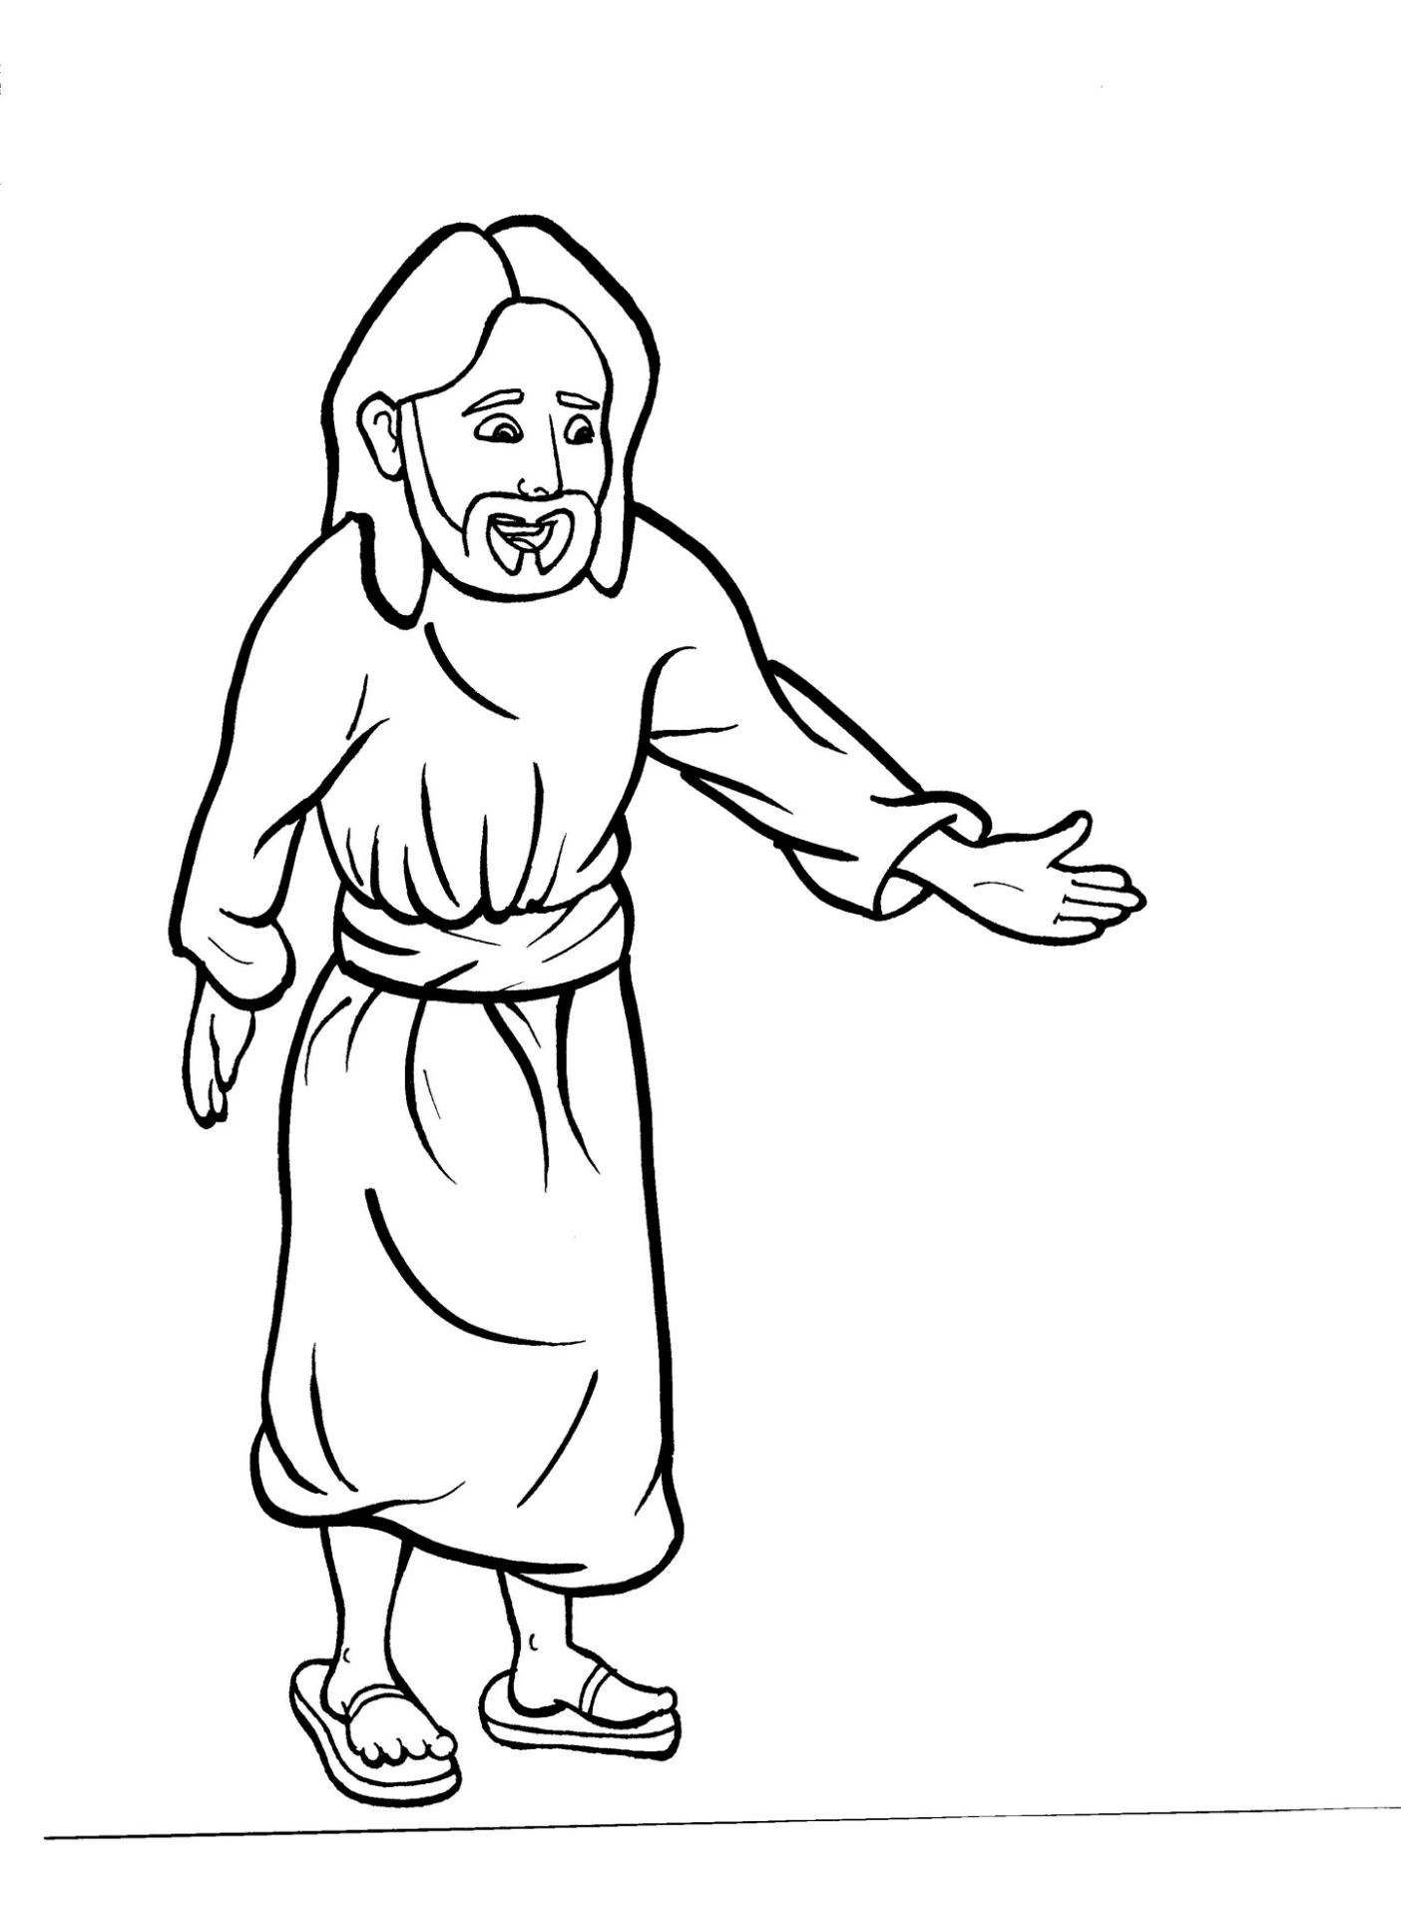
Part 1
42. Jesus Appears to His Disciples
Syllable Charts

Slide 2
Words in Syllable Types

Slide 3
Closed – Short Vowel
A closed syllable has one vowel
followed by one or more consonants,
and the vowel is short.
st
o
p
˘

Slide 4
Timing
Box
that
and
back
hands

Slide 5
Timing
Box
men
-pen
Tes-
Mes-
tells
them

Slide 6
Timing
Box
then
-en
step
when
flesh
-ment

Slide 7
Timing
Box
it
hid
dis-
did
sil-
him

Slide 8
Timing
Box
vil-
-ship
ris-
with

Slide 9
Timing
Box
not
lock
fol-

Slide 10
Timing
Box
us
-sus
but
just

Slide 11
Open – Long Vowel
An open syllable has one vowel
with no consonant after it,
and the vowel is long.
−
go

Slide 12
Timing
Box
he
me
be
be lieve
Je sus

Slide 13
Timing
Box
I
Messi ah
disci ple

Slide 14
Timing
Box
no
go ing
o pen

Slide 15
Timing
Box
why
cry ing

Slide 16
Timing
Box
sil ly
stor y
heav y

Slide 17
Silent e – Long Vowel
A silent e syllable has one vowel,
followed by one consonant
and a silent e at the end.
The vowel is long.
−
ca
e
v

Slide 18
Timing
Box
take
came
a maze

Slide 19
Timing
Box
life
a live

Slide 20
Timing
Box
bones

Slide 21
Other Sounds – Long Vowel
These syllables or words are closed,
so the vowel should be short,
but the vowel is long.
−
cold

Slide 22
Timing
Box
old
told

Slide 23
Timing
Box
ghost

Slide 24
Vowel Teams – Long Vowel
Many vowel teams follow this rule:
When two vowels get together,
the first one names its letter.
So the first vowel will make its long sound,
and the second vowel is silent.
−
e
a
t

Slide 25
Timing
Box
pray ing

Slide 26
Timing
Box
they

Slide 27
Timing
Box
see
feet

Slide 28
Timing
Box
each
peace
scream
disap pear

Slide 29
Timing
Box
be lieve

Slide 30
Timing
Box
tight

Slide 31
Timing
Box
die

Slide 32
Timing
Box
road

Slide 33
Timing
Box
fol low er
know

Slide 34
Timing
Box
room

Slide 35
Timing
Box
true

Slide 36
Vowel Teams – Other Sounds
Sometimes vowel teams make other sounds.
oil

Slide 37
Timing
Box
our
sound

Slide 38
Timing
Box
joy

Slide 39
Timing
Box
stood

Slide 40
Timing
Box
heav y

Slide 41
R - Controlled
R-controlled syllables have one or more vowels
followed by an “r.”
The “r” changes the sound of the vowel.
o
r
ange

Slide 42
Timing
Box
hard

Slide 43
Timing
Box
follow ers

Slide 44
Timing
Box
burn ing

Slide 45
Timing
Box
stor y
Lord

Slide 46
Timing
Box
words
wor ship

Slide 47
Consonant – l-e
When you see consonant l-e at the end of a word,
count back three.
The “l-e” makes the /–le/ sound.
pur
p
l
e

Slide 48
Timing
Box
disci ples

Slide 49
Other Sounds – -nk/-ng
The “-nk” and “-ng”
change the sound of the vowel.
bank
thing

Slide 50
Timing
Box
a long

Slide 51
Timing
Box
go ing
pray ing
cry ing
burn ing
talk ing

Slide 52
Other Sounds – schwa
The schwa syllable has an “a” that sounds
like the /u/ in banana.
The banana is even shaped like a short u.
ba nan a

Slide 53
Timing
Box
a live
a long
a maze

Slide 54
Timing
Box
Messi ah
Tes ta ment
dis a ppear

Slide 55
Timing
Box
vil lage

