Slide 1
54. I am Alive: Loving My World
Part 1
Syllable Charts

Slide 2
Words in Syllable Types

Slide 3
Closed – Short Vowel
A closed syllable has one vowel
followed by one or more consonants,
and the vowel is short.
st
o
p
˘

Slide 4
ac-
land
that
back
Acts
-bands

Slide 5
ev-
-mem-
tell
-pen
help
-dren

Slide 6
with
this
will
spill
chil-

Slide 7
God
lost

Slide 8
hus-

Slide 9
Open – Long Vowel
An open syllable has one vowel
with no consonant after it,
and the vowel is long.
−
go

Slide 10
me
Pe ter
he
be lievers
re member

Slide 11
o ver
o bey
o pen
clo ser

Slide 12
ear ly
lone ly
hung ry
ev er y

Slide 13
my

Slide 14
Silent e – Long Vowel
A silent e syllable has one vowel,
followed by one consonant
and a silent e at the end.
The vowel is long.
−
ca
e
v

Slide 15
gave
share
cares

Slide 16
these

Slide 17
like

Slide 18
those
close
lone ly

Slide 19
Vowel Teams – Long Vowel
Many vowel teams follow this rule:
When two vowels get together,
the first one names its letter.
So the first vowel will make its long sound,
and the second vowel is silent.
−
e
a
t

Slide 20
to day

Slide 21
they
o bey

Slide 22
sees
feel

Slide 23
heal
read
least
clean

Slide 24
be liev ers

Slide 25
grow

Slide 26
food

Slide 27
new

Slide 28
Vowel Teams – Other Sounds
Sometimes vowel teams make other sounds.
oil

Slide 29
call

Slide 30
our
a bout
with out

Slide 31
pow er

Slide 32
R - Controlled
R-controlled syllables have one or more vowels
followed by an “r.”
The “r” changes the sound of the vowel.
o
r
ange

Slide 33
start

Slide 34
or
for

Slide 35
o ver
Pe ter
clo ser
pow er

Slide 36
ev er
ev er y
believ ers
remem ber

Slide 37
hurt
church

Slide 38
ear ly

Slide 39
work
words
world

Slide 40
Other Sounds – Long Vowel
These syllables or words are closed,
so the vowel should be short,
but the vowel is long.
−
cold

Slide 41
sold
told

Slide 42
mind

Slide 43
Other Sounds – -nk/-ng
The “-nk” and “-ng”
change the sound of the vowel.
bank
thing

Slide 44
think

Slide 45
hung ry

Slide 46
Other Sounds – -ion,-ian, etc…
These common endings
change the word to a noun.

Slide 47
ac tion

Slide 48
mis sion

Slide 49
Chris tian

Slide 50
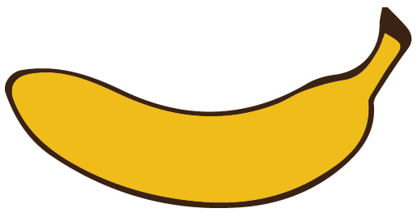
Other Sounds – schwa
The schwa syllable has an “a” that sounds
like the /u/ in banana.
The banana is even shaped like a short u.
ba nan a

Slide 51
a bout

