Slide 1
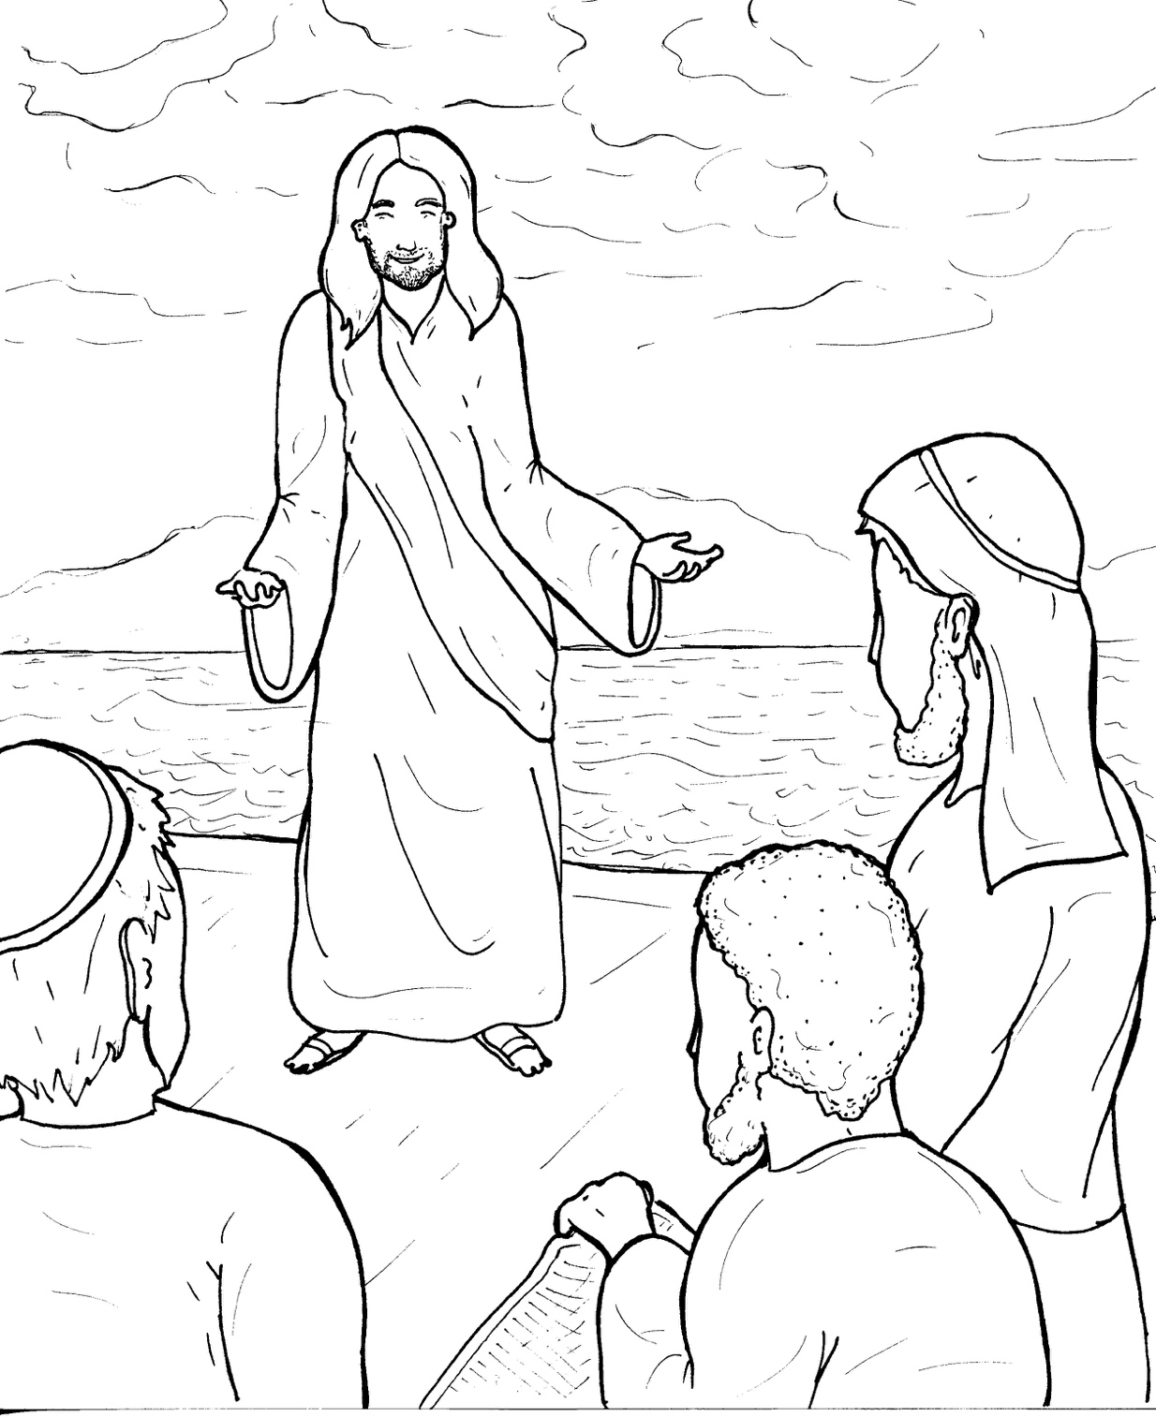
10. Jesus Calls Followers
Part 1
Syllable Charts

Slide 2
Words in Syllable Types

Slide 3
Closed – Short Vowel
A closed syllable has one vowel
followed by one or more consonants,
and the vowel is short.
st
o
p
˘

Slide 4
An-
Gal -
tax
Thad-

Slide 5
-lect-
mes-
then
spent

Slide 6
fish
-til
dis-
Phil-

Slide 7
got
John
col-
fol-

Slide 8
up
-sus
un-

Slide 9
Open – Long Vowel
An open syllable has one vowel
with no consonant after it,
and the vowel is long.
−
go

Slide 10
me
Le vi
e vil
Pe ter
be side
re turn

Slide 11
Le vi
Si mon
dis ci ple

Slide 12
Ju das

Slide 13
by

Slide 14
Silent e – Long Vowel
A silent e syllable has one vowel,
followed by one consonant
and a silent e at the end.
The vowel is long.
−
ca
e
v

Slide 15
lake
James

Slide 16
these

Slide 17
be side

Slide 18
whole

Slide 19
Vowel Teams – Long Vowel
Many vowel teams follow this rule:
When two vowels get together,
the first one names its letter.
So the first vowel will make its long sound,
and the second vowel is silent.
−
e
a
t

Slide 20
day
pray

Slide 21
Gal i lee

Slide 22
sea
heal
years

Slide 23
died

Slide 24
night

Slide 25
boat

Slide 26
throw
fol low

Slide 27
booth

Slide 28
An drew

Slide 29
Vowel Teams – Other Sounds
Sometimes vowel teams make other sounds.
oil

Slide 30
called

Slide 31
out
a round
moun tain

Slide 32
town

Slide 33
took

Slide 34
joy

Slide 35
R - Controlled
R-controlled syllables have one or more vowels
followed by an “r.”
The “r” changes the sound of the vowel.
o
r
ange

Slide 36
Barth-

Slide 37
for

Slide 38
Pe ter
fish er men

Slide 39
turn
re turn

Slide 40
years

Slide 41
world

Slide 42
Consonant – l-e
When you see consonant l-e at the end of a word,
count back three.
The “l-e” makes the /–le/ sound.
pur
p
l
e

Slide 43
peo ple
dis ci ple

Slide 44
Other Sounds – -nk/-ng
The “-nk” and “-ng”
change the sound of the vowel.
bank
thing

Slide 45
throw ing
sit ting
pray ing

Slide 46
Other Sounds – schwa
The schwa syllable has an “a” that sounds
like the /u/ in banana.
The banana is even shaped like a short u.
ba nan a

Slide 47
a round

Slide 48
Si mon

