Slide 1

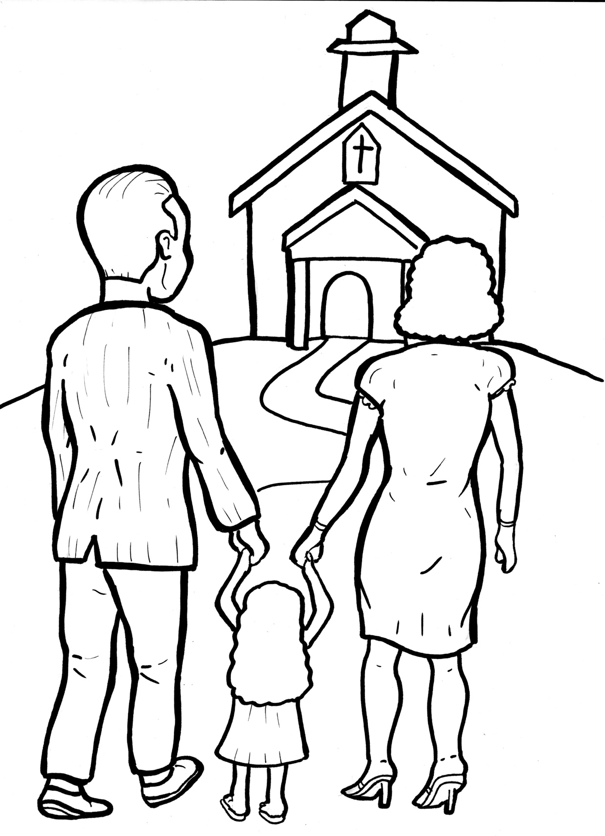
Timing
Box
Part 3
52. I Am Alive: Church
Syllable Divisions

Slide 2
Dividing Words
Into Syllables

Slide 3
Rabbit Words
When you see two consonants
between two vowels,
divide between the consonants.
ra it
bb
rab bit

Slide 4
Timing
Box
fol low
follow

Slide 5
Timing
Box
ex ci ted
excited

Slide 6
Timing
Box
sup per
supper

Slide 7
Timing
Box
mag net
magnet

Slide 8
Timing
Box
Chris tians
Christians

Slide 9

Tiger Words
When you see one consonant
between two vowels,
divide after the first vowel.
Try this pattern first.
ti er
g
ti ger

Slide 10
Timing
Box
be came
became

Slide 11
Timing
Box
e ven
even

Slide 12
Timing
Box
be lievers
believers

Slide 13
Timing
Box
o bey
obey

Slide 14
Timing
Box
o ver
over

Slide 15
Camel Words
When you see one consonant
between two vowels,
divide after the first consonant.
Try this pattern second.
ca el
m
cam el

Slide 16
Timing
Box
prom ise
promise

Slide 17
Timing
Box
ev er y
every

Slide 18
Timing
Box
fam il y
family

Slide 19
Turtle Words
When you see consonant-l-e,
count back three and divide.
tur
t
l
e
tur tle

Slide 20
Timing
Box
tem ple
temple

Slide 21
Timing
Box
peo ple
people

Slide 22
Timing
Box
mir a cle
miracle

Slide 23

Foxes Suffixes
Focus on your base word.
fox es
fox es

Slide 24
Timing
Box
sad ly
sadly

Slide 25
Timing
Box
secret ly
secretly

Slide 26
Timing
Box
believ ers
believers

Slide 27
Timing
Box
follow ers
followers

Slide 28
Timing
Box
church es
churches

Slide 29
Timing
Box
beauti ful
beautiful

Slide 30
Timing
Box
grow ing
growing

Slide 31
Timing
Box
teach ings
teachings

Slide 32
Timing
Box
exci ted
excited

Slide 33
Timing
Box
shared
shared

Slide 34
Timing
Box
prayed
prayed

Slide 35
Timing
Box
blessed
blessed

Slide 36
Timing
Box
promised
promised

Slide 37

Anteater Words
These compound words are made up of two smaller words.
ant
eater
1
2
ant eater

Slide 38
Timing
Box
it self
itself

Slide 39
Timing
Box
world wide
worldwide

Slide 40
Timing
Box
every thing
everything

Slide 41
Other Syllable Divisions
Timing
Box
Some words don’t fit so neatly
into standard syllable division patterns.

Slide 42
Timing
Box
a way
away

Slide 43
Timing
Box
a bout
about

Slide 44
Timing
Box
mir a cle
miracle

Slide 45
Timing
Box
gath er
gather

Slide 46
Timing
Box
de stroy
destroy

Slide 47
Hamster Words
When you see three consonants between two vowels,
divide after the first consonant.
ha
mst
er
ham ster

Slide 48
Timing
Box
coun tries
countries

