Slide 1

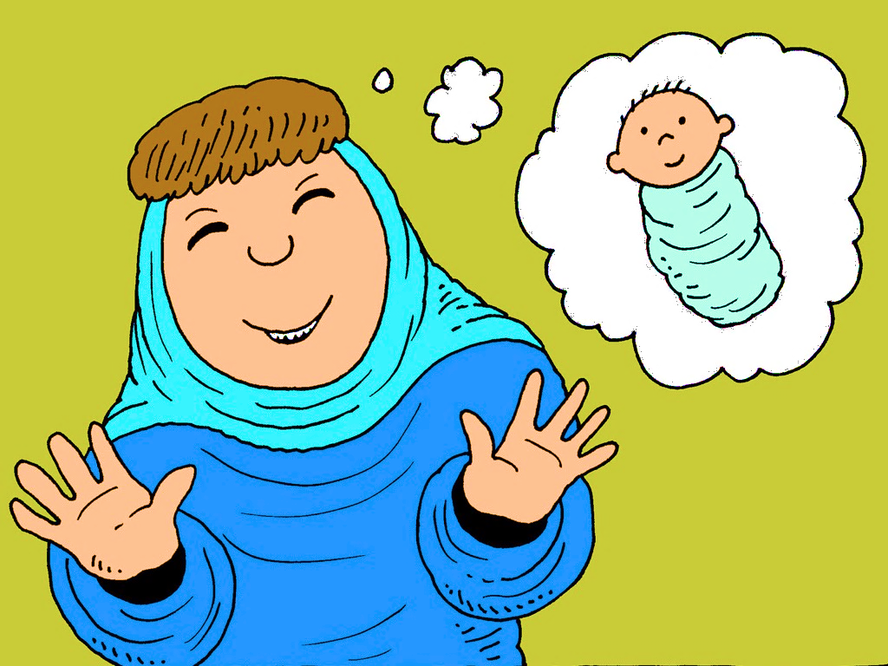
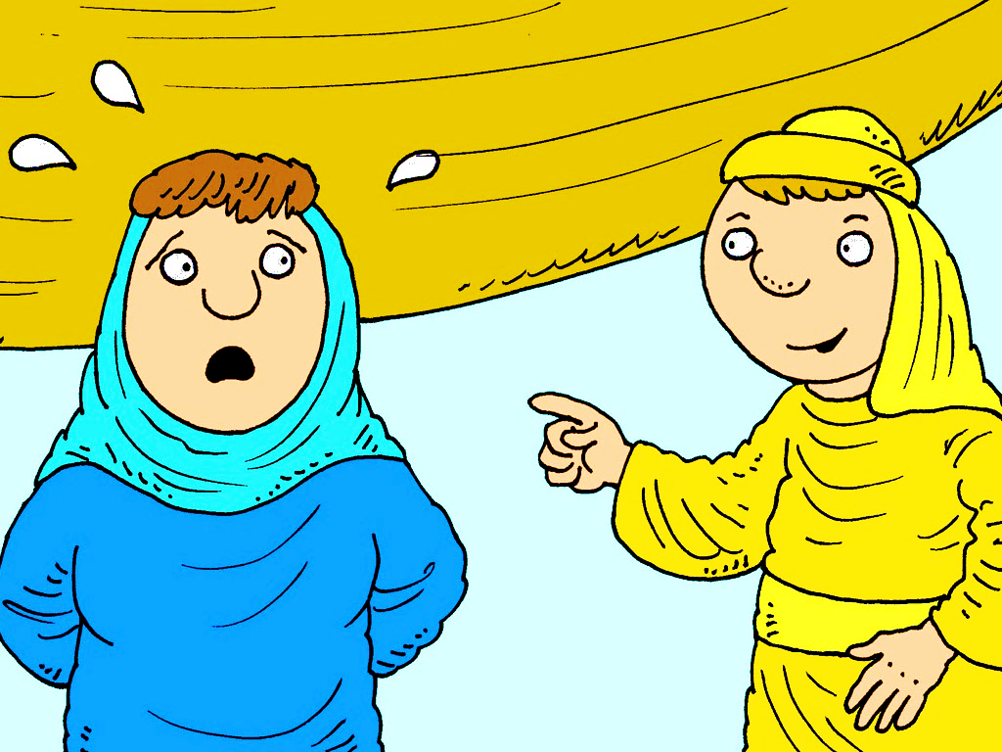
7 Level 2 Sad, Old Sarah
Part 3 ...AND....
Harder Words
Rule Breakers
Multi-Syllable Words

Slide 2
New Words
good
why
by

Slide 3
Hard Words
baby

Slide 4
SUPER Hard Words
Sarah
bread
laugh
love

Slide 5

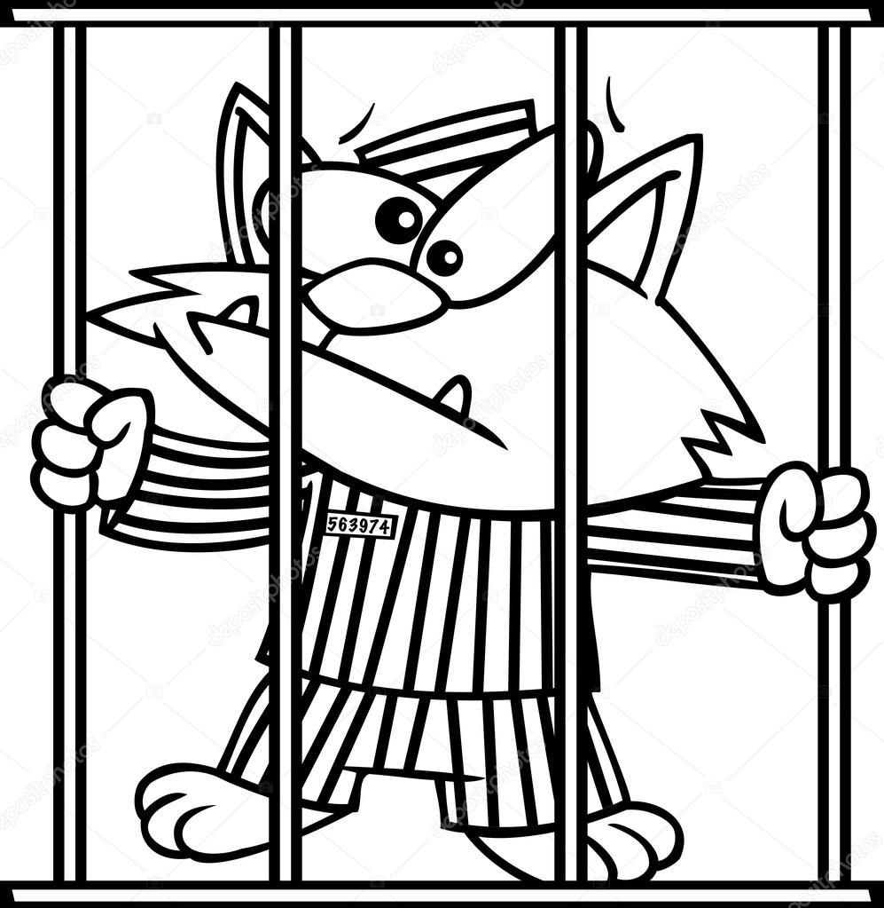
Rule Breakers
These words do not follow phonetic patterns.
some
who
of
was
two
do

Slide 6
a _ a
you _ _ _ you
the _ _ _ the

Slide 7
is _ _ is
love _ _ _ _ love
from _ _ _ _ from

Slide 8
come _ _ _ _ come
some _ _ _ _ some
have _ _ _ _ have

Slide 9
was _ _ _ was
to _ _ to
do _ _ do

Slide 10
give _ _ _ _ give
laugh _ _ _ _ _ laugh

Slide 11
Multi-Syllable
Words

Slide 12
Rabbit Words
When you see two consonants
between two vowels,
divide between the consonants.
ra it
bb
rab bit

Slide 13
hus band
husband

Slide 14

Anteater Words
These compound words are made up of two smaller words.
ant
eater
1
2
ant eater

Slide 15
some thing
something

