Slide 1

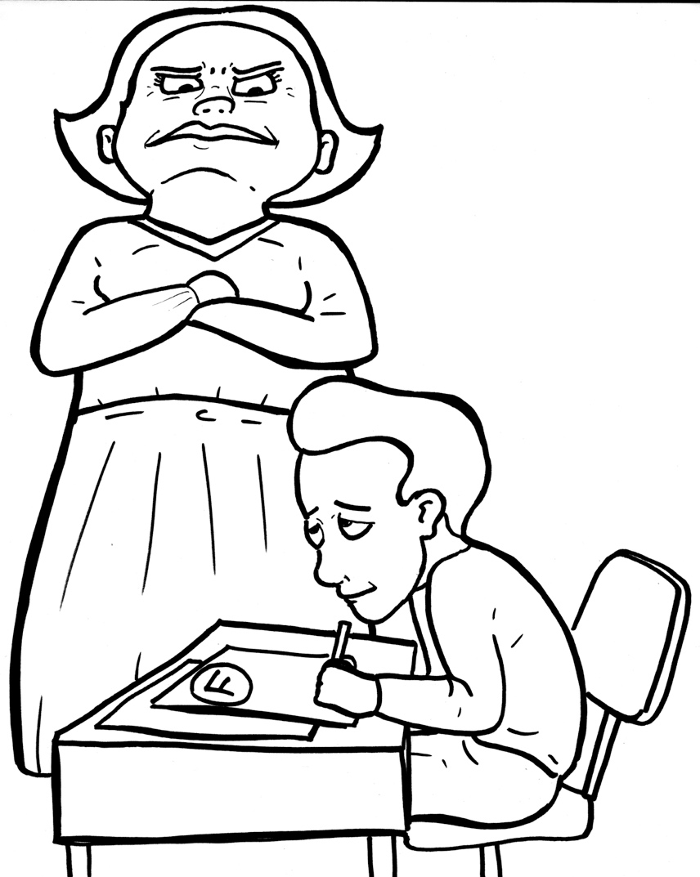
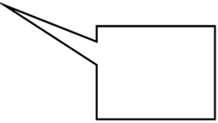
Part 3
46. First, the Bad News
– Sin Separates
Syllable Divisions
You cheated!

Slide 2
Dividing Words
Into Syllables

Slide 3
Rabbit Words
When you see two consonants
between two vowels,
divide between the consonants.
ra it
bb
rab bit

Slide 4
ug ly
ugly

Slide 5
aw ful
awful

Slide 6
per fect
perfect

Slide 7
prob lem
problem

Slide 8
dis ap point
disappoint

Slide 9

Tiger Words
When you see one consonant
between two vowels,
divide after the first vowel.
Try this pattern first.
ti er
g
ti ger

Slide 10
e ven
even

Slide 11
Je sus
Jesus

Slide 12
be cause
because

Slide 13
o bey
obey

Slide 14
ho ly
holy

Slide 15
Ro mans
Romans

Slide 16
bro ken
broken

Slide 17
Camel Words
When you see one consonant
between two vowels,
divide after the first consonant.
Try this pattern second.
ca el
m
cam el

Slide 18
ev er
ever

Slide 19
ev er y
every

Slide 20
pun ish
punish

Slide 21
glor y
glory

Slide 22
heav en
heaven

Slide 23
dis ap point
disappoint

Slide 24
sep a rates
separates

Slide 25
Turtle Words
When you see consonant-l-e,
count back three and divide.
tur
t
l
e
tur tle

Slide 26
peo ple
people

Slide 27
trou ble
trouble

Slide 28

Anteater Words
These compound words are made up of two smaller words.
ant
eater
1
2
ant eater

Slide 29
every one
everyone

Slide 30
for ever
forever

Slide 31
for gives
forgives

Slide 32
some times
sometimes

Slide 33

Foxes Suffixes
Focus on your base word.
fox es
fox es

Slide 34
aw ful
awful

Slide 35
self ish
selfish

Slide 36
heaven ly
heavenly

Slide 37
called
called

Slide 38
yelled
yelled

Slide 39
dis o beyed
disobeyed

Slide 40
friend ship
friendship

Slide 41
Other Syllable Divisions
Some words don’t fit so neatly
into standard syllable division patterns.

Slide 42
a bout
about

