Slide 1
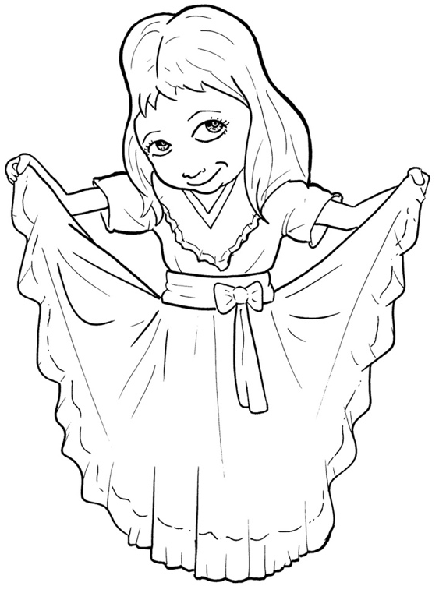
Part 5
47. Now, the Good
News – Jesus Saves
Vocabulary
Original Bible Story

Slide 2
Vocabulary

Slide 3
righteousness
(RIGHT – eous – ness):
being correct and good

Slide 4
confession
(con – FES – sion):
the act of admitting your sins

Slide 5
salvation
(sal – VA - tion):
being saved (from hell)

Slide 6
distinction
(dis – TINC - tion):
difference

Slide 7
disobedient
(dis – o – BE – di - ant):
to not do what you are told

Slide 8
contrary
(CON – trar - y):
stubbornly against

Slide 9
Now, the Good
News – Jesus Saves
Romans 10:1; 8 -13; 21
World English Bible (WEB)

Slide 10
Brothers, my heart's desire and my prayer to God is for Israel, that they may be saved.

Slide 11
But what does [God's Law] say?

Slide 12
"The word is near you, in your mouth, and in your heart;" that is, the word of faith which we preach: that if you will confess with your mouth that Jesus is Lord,

Slide 13
and believe in your heart that God raised him from the dead, you will be saved.
For with the heart, one believes resulting in righteousness; and with the mouth confession is made resulting in salvation.

Slide 14
For the Scripture says, "Whoever believes in him will not be disappointed."

Slide 15
For there is no distinction between Jew and Greek; for the same Lord is Lord of all, and is rich to all who call on him.

Slide 16
For, "Whoever will call on the name of the Lord will be saved."

Slide 17
But about Israel he says, "All day long I stretched out my hands to a disobedient and contrary people."

