Slide 1
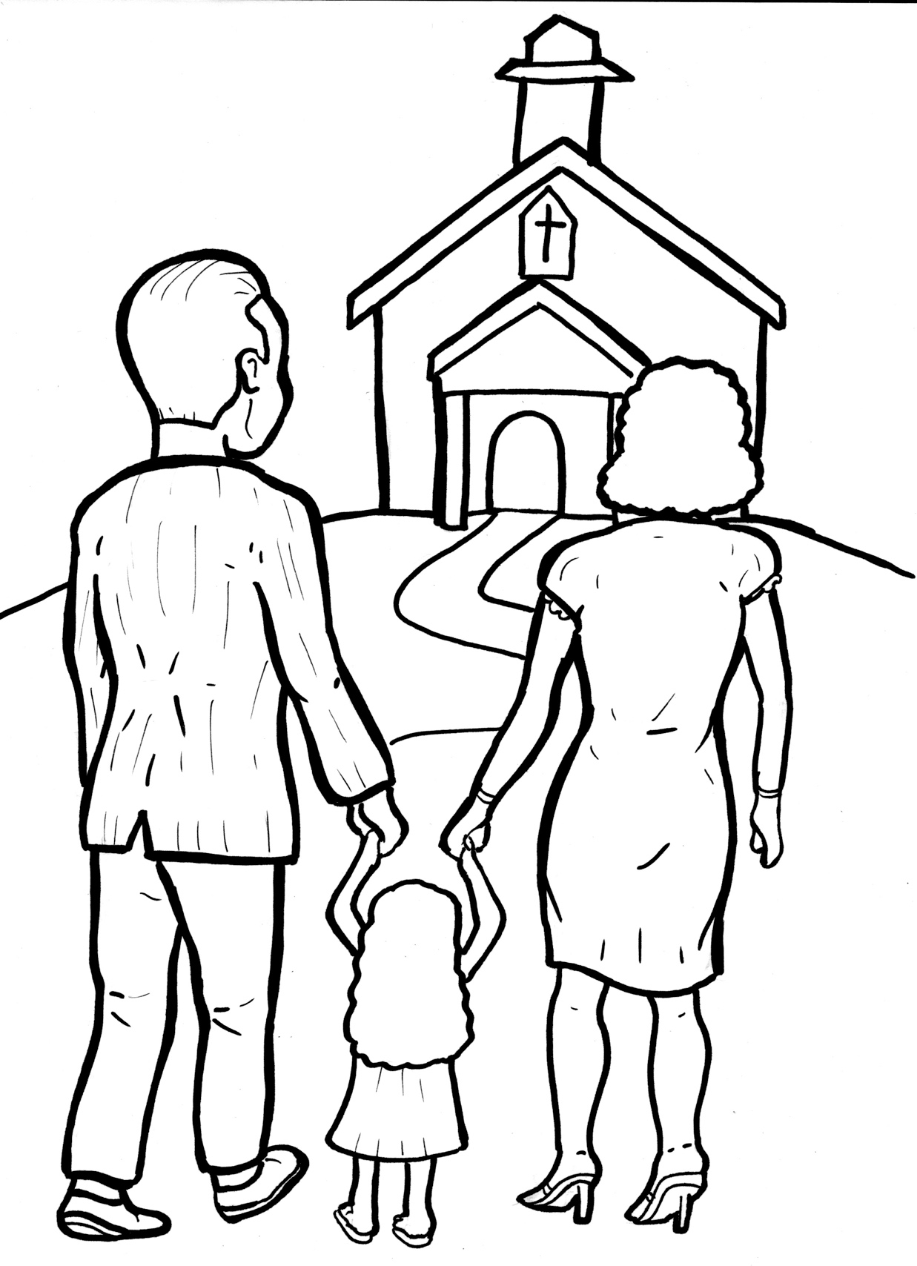
Timing
Box
52. I Am Alive: Church
Part 1
Syllable Charts

Slide 2
Words in Syllable Types

Slide 3
Closed – Short Vowel
A closed syllable has one vowel
followed by one or more consonants,
and the vowel is short.
st
o
p
˘

Slide 4
Timing
Box
fam-
sad
mag-
last
gath-
that

Slide 5
Timing
Box
hell
-cret
sent
when
bless

Slide 6
Timing
Box
ev-
ex-
met
-net
Tem-
-ven

Slide 7
Timing
Box
lis-
did
with
will
still
-il -

Slide 8
Timing
Box
not
got
fol-
God

Slide 9
Timing
Box
sup-
but

Slide 10
Open – Long Vowel
An open syllable has one vowel
with no consonant after it,
and the vowel is long.
−
go

Slide 11
Timing
Box
be
e ven
se cret ly

Slide 12
Timing
Box
de stroy
be came
be lievers

Slide 13
Timing
Box
ex ci ted

Slide 14
Timing
Box
o ver
o bey

Slide 15
Timing
Box
my

Slide 16
Timing
Box
ever y
famil y

Slide 17
Timing
Box
ear ly
sad ly
secret ly

Slide 18
Silent e – Long Vowel
A silent e syllable has one vowel,
followed by one consonant
and a silent e at the end.
The vowel is long.
−
ca
e
v

Slide 19
Timing
Box
name
caves
gates
share
be came

Slide 20
Timing
Box
these

Slide 21
Timing
Box
like
wide

Slide 22
Timing
Box
homes
more

Slide 23
Vowel Teams – Long Vowel
Many vowel teams follow this rule:
When two vowels get together,
the first one names its letter.
So the first vowel will make its long sound,
and the second vowel is silent.
−
e
a
t

Slide 24
Timing
Box
day
pray
stay

Slide 25
Timing
Box
o bey

Slide 26
Timing
Box
faith

Slide 27
Timing
Box
fields
coun tries
be liev ers

Slide 28
Timing
Box
meet
keep

Slide 29
Timing
Box
each
teach

Slide 30
Timing
Box
peo ple

Slide 31
Timing
Box
new

Slide 32
Timing
Box
grow
fol low

Slide 33
Vowel Teams – Other Sounds
Sometimes vowel teams make other sounds.
oil

Slide 34
Timing
Box
all

Slide 35
Timing
Box
bread

Slide 36
Timing
Box
al low

Slide 37
Timing
Box
de stroy

Slide 38
R - Controlled
R-controlled syllables have one or more vowels
followed by an “r.”
The “r” changes the sound of the vowel.
o
r
ange

Slide 39
Timing
Box
part

Slide 40
Timing
Box
or

Slide 41
Timing
Box
oth er
sup per
gath er
o ver
ev er y
believ er

Slide 42
Timing
Box
birth

Slide 43
Timing
Box
church

Slide 44
Timing
Box
ear ly

Slide 45
Timing
Box
word
world

Slide 46
Consonant – l-e
When you see consonant l-e at the end of a word,
count back three.
The “l-e” makes the /–le/ sound.
pur
p
l
e

Slide 47
Timing
Box
Bi ble

Slide 48
Timing
Box
peo ple

Slide 49
Timing
Box
mir a cles

Slide 50
Other Sounds – Long Vowel
These syllables or words are closed,
so the vowel should be short,
but the vowel is long.
−
cold

Slide 51
Timing
Box
most

Slide 52
Other Sounds – -nk/-ng
The “-nk” and “-ng”
change the sound of the vowel.
bank
thing

Slide 53
Timing
Box
sang

Slide 54
Timing
Box
strong

Slide 55
Timing
Box
every thing

Slide 56
Other Sounds – schwa
The schwa syllable has an “a” that sounds
like the /u/ in banana.
The banana is even shaped like a short u.
ba nan a

Slide 57
Timing
Box
a bout
a way
al low

Slide 58
Timing
Box
mir a cles

