Slide 1
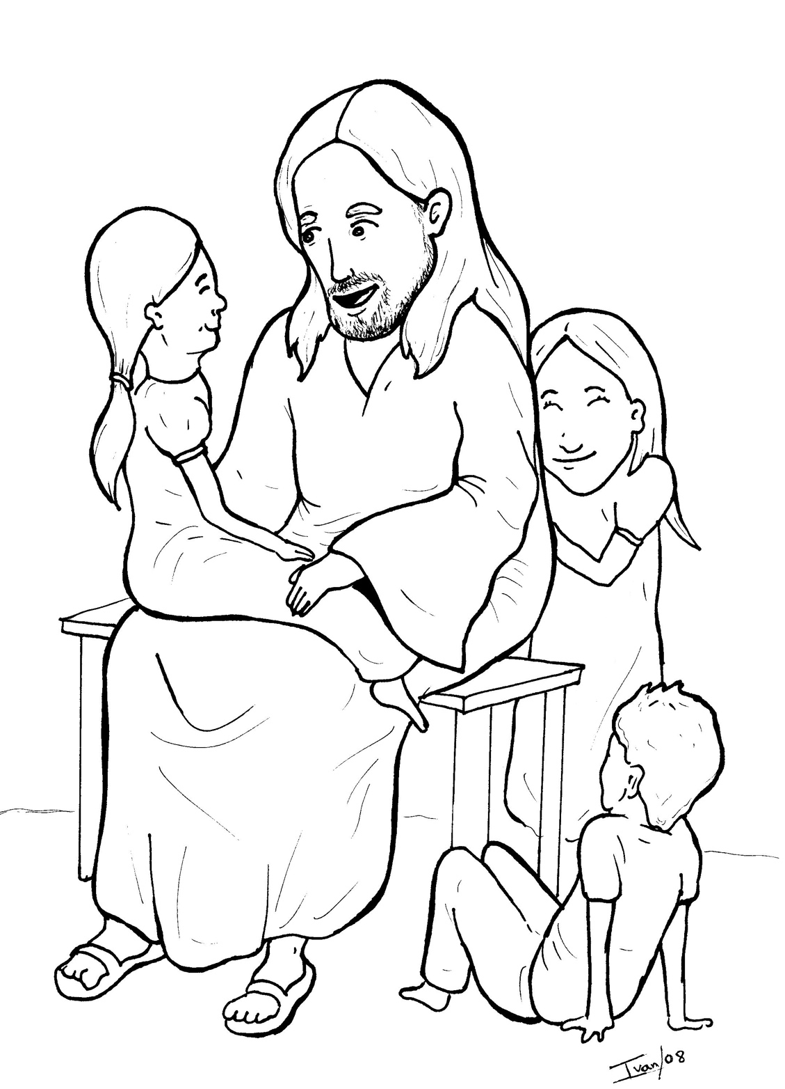
12. Jesus Loves the Little Children
Part 2
New Words
Rule Breakers

Slide 2
Other Sounds – Soft C
ce, ci, cy make the soft sound
cent
city
fancy

Slide 3
disciples

Slide 4
accept

Slide 5
Possessives
God’s kingdom

Slide 6
New Words
parents
kingdom
disciples

Slide 7
Rule Breakers
These words do not follow phonetic patterns.
said
come

Slide 8
are
his
to
was
do
they

Slide 9
their
who
you
everyone
your
father

Slide 10
many
push
mother
parents

