Slide 1

5. A Dream Come True:
Simeon and Anna
Part 1
Syllable Charts

Slide 2
Words in
Syllable Types

Slide 3
Closed – Short Vowel
A closed syllable has one vowel
followed by one or more consonants,
and the vowel is short.
st
o
p
˘

Slide 4
that
An-
lands
can

Slide 5
tem-
Mes-
-en
held
-dreds
-seph

Slide 6
-ish
Sim-
fists
-til

Slide 7
not
on
God

Slide 8
hun-
-sus
un-
but

Slide 9
Open – Long Vowel
An open syllable has one vowel
with no consonant after it,
and the vowel is long.
−
go

Slide 10
ba by
Ja cob

Slide 11
be
Sim e on
he
E li
Je sus

Slide 12
ti ny
E li
Mes si ah

Slide 13
no
Jo seph
O bed

Slide 14
cry
my

Slide 15
ba by
curl y
ti ny
Mar y

Slide 16
Silent e – Long Vowel
A silent e syllable has one vowel,
followed by one consonant
and a silent e at the end.
The vowel is long.
−
ca
e
v

Slide 17
came
named
save
a mazed

Slide 18
shone

Slide 19
time

Slide 20
Vowel Teams – Long Vowel
Many vowel teams follow this rule:
When two vowels get together,
the first one names its letter.
So the first vowel will make its long sound,
and the second vowel is silent.
−
e
a
t

Slide 21
hair

Slide 22
day

Slide 23
peace
years
dream

Slide 24
see
seen

Slide 25
die

Slide 26
tight
light

Slide 27
new
knew
Jew

Slide 28
true

Slide 29
Vowel Teams – Other Sounds
Sometimes vowel teams make other sounds.
oil

Slide 30
loud
a bout

Slide 31
now

Slide 32
boy

Slide 33
heav en

Slide 34
R - Controlled
R-controlled syllables have one or more vowels
followed by an “r.”
The “r” changes the sound of the vowel.
o
r
ange

Slide 35
arms

Slide 36
for
-born

Slide 37
ev er y

Slide 38
curl-

Slide 39
heard

Slide 40
words

Slide 41
Consonant – l-e
When you see consonant l-e at the end of a word,
count back three.
The “l-e” makes the /–le/ sound.
pur
p
l
e

Slide 42
tem ple
peo ple

Slide 43
lit tle

Slide 44
Other Sounds – Long Vowel
These syllables or words are closed,
so the vowel should be short,
but the vowel is long.
−
cold

Slide 45
told
old

Slide 46
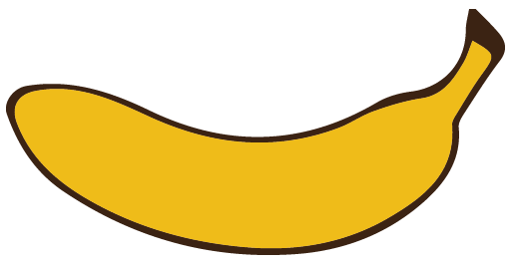
Other Sounds – schwa
The schwa syllable has an “a” that sounds
like the /u/ in banana.
The banana is even shaped like a short u.
ba nan a

Slide 47
a bout
An na
a mazed
Mes si ah

