Slide 1

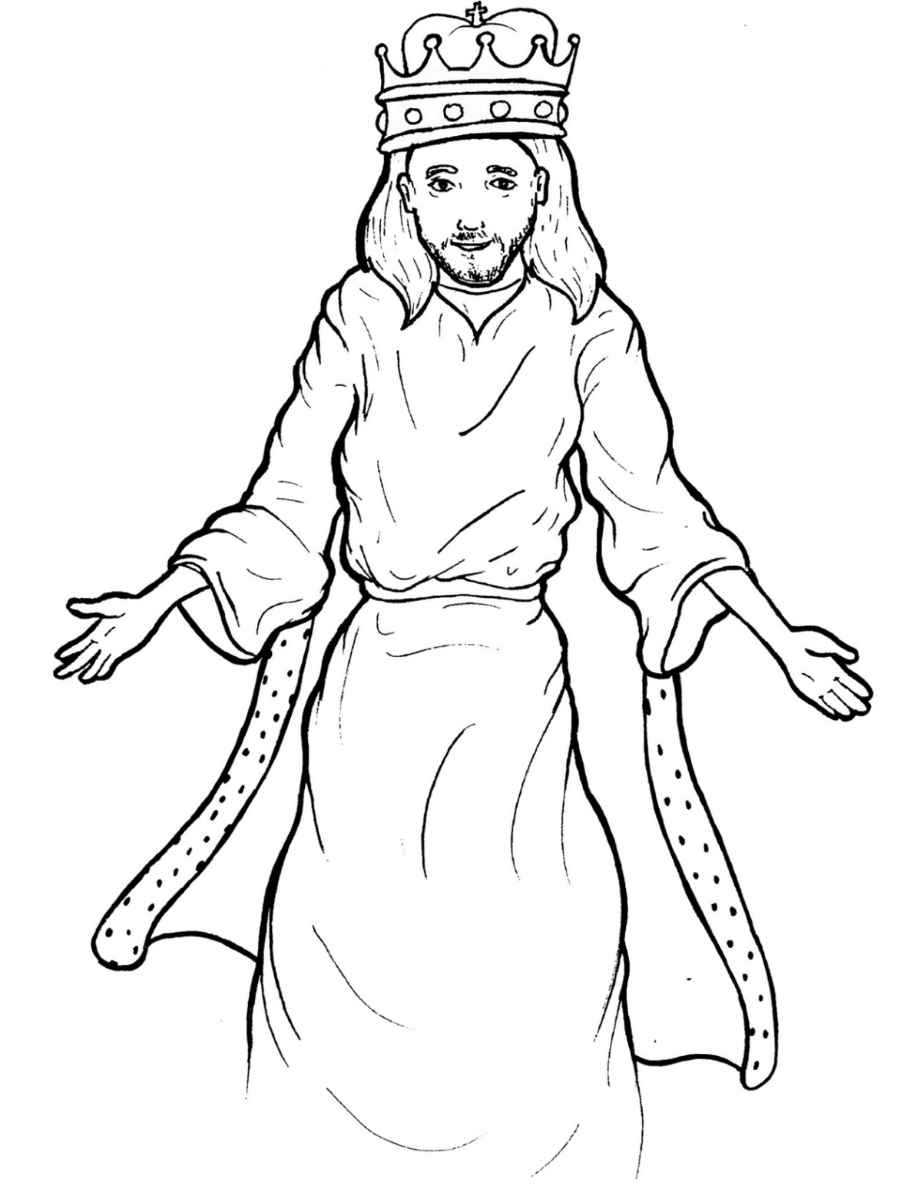
Part 5
45. Jesus Lives as King
Vocabulary
Original Bible Story

Slide 2

Vocabulary

Slide 3
equality
(e - QUAL - it - y)
being equal
(the same)

Slide 4
humbled
(HUM - bled)
made himself not important

Slide 5
obedient
(o - BE - di - ent)
someone who follows the rules

Slide 6
exalted
(ex - ALT - ed)
made himself very important

Slide 7
confess
(con - FESS)
to tell the truth

Slide 8
testify
(TES - ti - fy)
to say what is true

Slide 9
Jesus Lives
as King
Philippians 2:5 -11, Revelations 22:13, 20
World English Bible (WEB)

Slide 10
Have this in your mind,
which was also in Christ Jesus,
who, existing in the form of God,

Slide 11
didn’t consider equality with God
a thing to be grasped,
but emptied himself,

Slide 12
taking the form of a servant,
being made in the likeness of men.

Slide 13
And being found in human form,
he humbled himself,

Slide 14
becoming obedient to
the point of death,
yes, the death of the cross.

Slide 15
Therefore God also
highly exalted him,

Slide 16
and gave to him the name
which is above every name,

Slide 17
that at the name of Jesus
every knee should bow,

Slide 18
of those in heaven,
those on earth,
and those under the earth,

Slide 19
and that every tongue
should confess
that Jesus Christ is Lord,

Slide 20
to the glory of God the Father.

Slide 21
“I am the Alpha and the Omega,
the First and the Last,
the Beginning and the End.”

Slide 22
He who testifies these things says,
“Yes, I am coming soon.”

Slide 23
Amen!
Yes, come, Lord Jesus!

