Slide 1
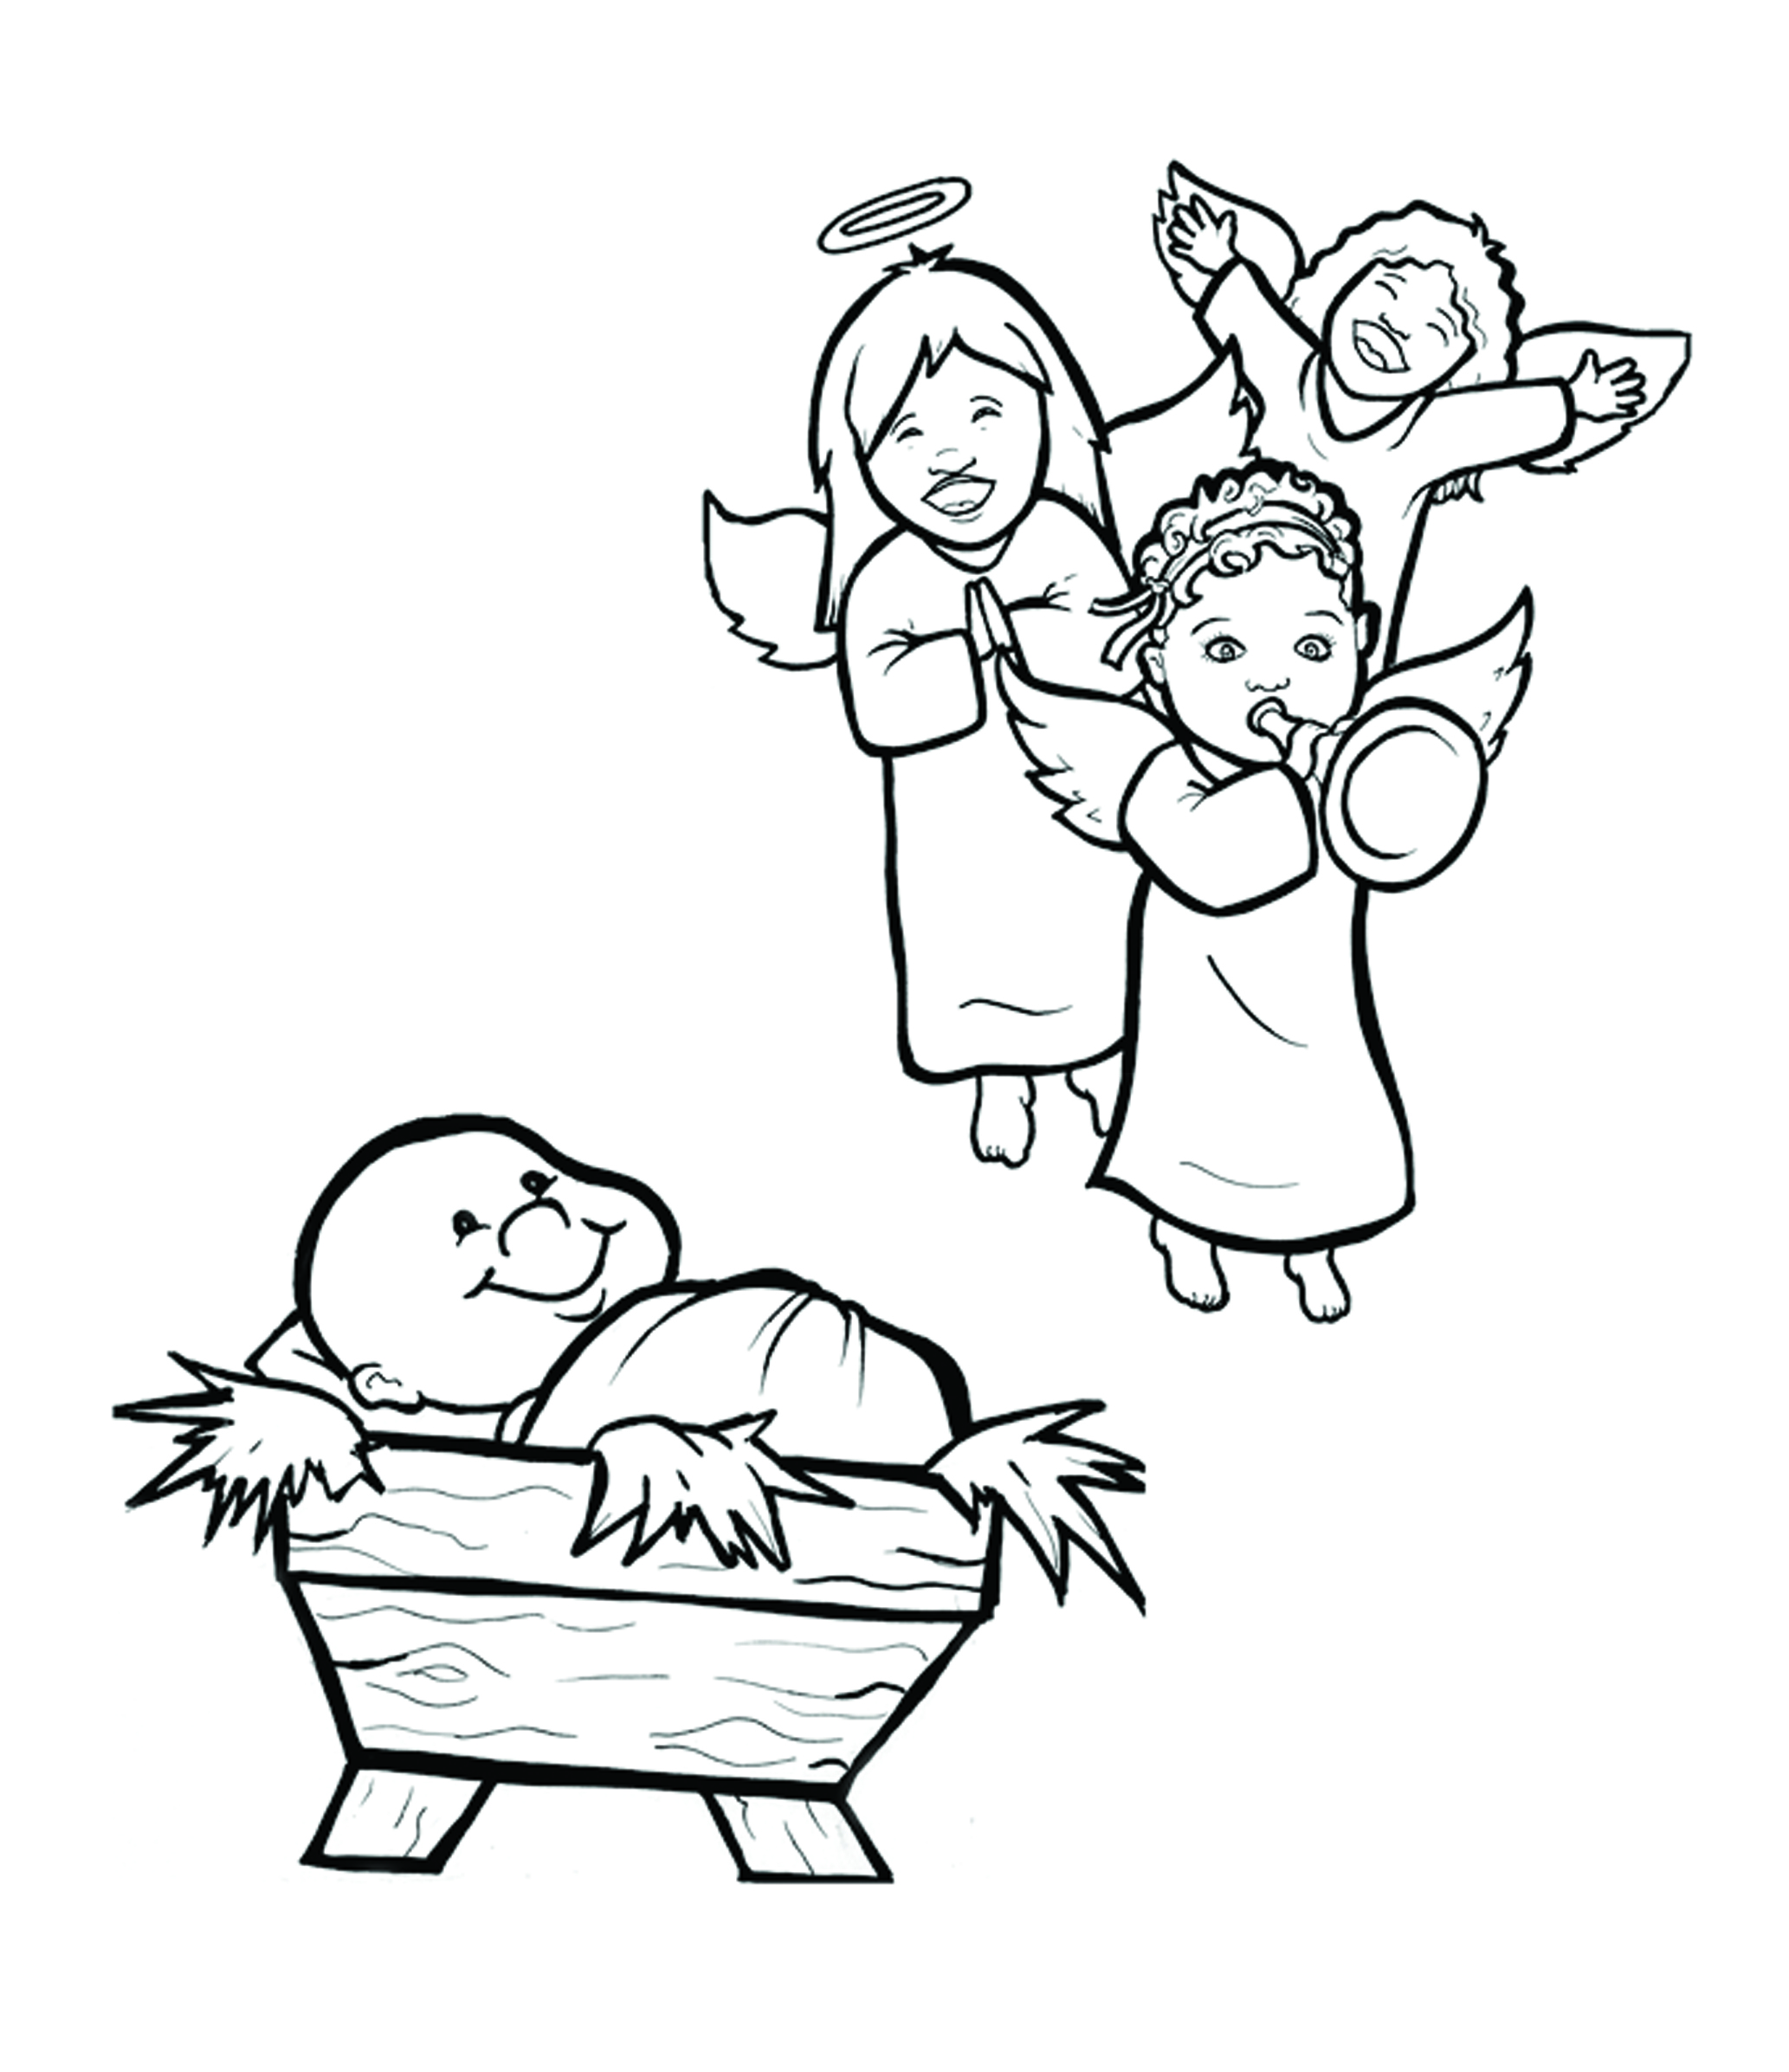
2. Happy Birthday, Jesus!
Part 2
New Words
Rule Breakers

Slide 2
Other Sounds – Soft G
ge, gi, gy often make the soft sound
gentle
giant
gym

Slide 3
angel

Slide 4
Silent Letters
wrapped
Christ mas

Slide 5
New Words
great
walked
Mary
angels

Slide 6
Christ
Nazareth
Bethlehem

Slide 7
Rule Breakers
These words do not follow phonetic patterns.
the
of

Slide 8
son
his
been
everyone
where
there

Slide 9
many
walk
was
were
you
your

