Slide 1
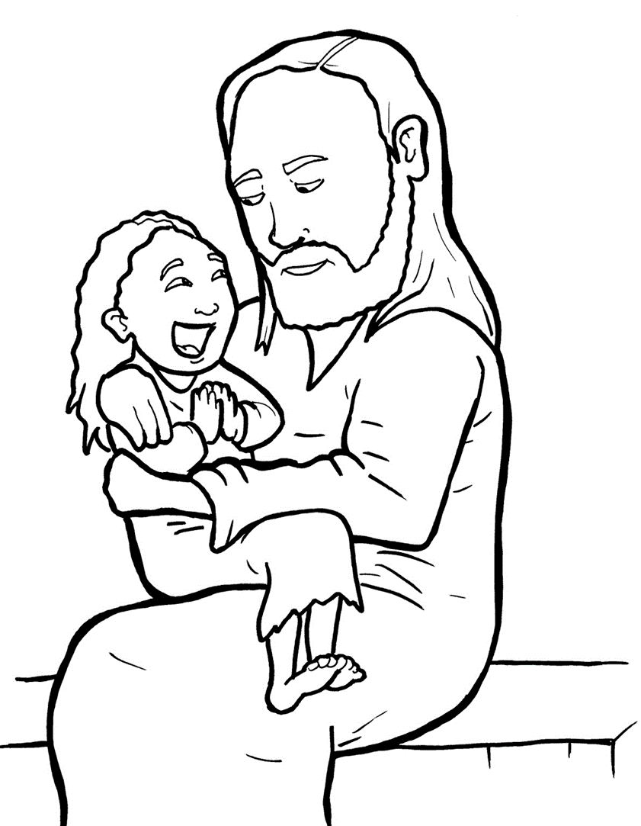
20. A Mother Begs and Believes
Part 1
Syllable Charts

Slide 2
Words in Syllable Types

Slide 3
Closed – Short Vowel
A closed syllable has one vowel
followed by one or more consonants,
and the vowel is short.
st
o
p
˘

Slide 4
had
land
ask
hap-

Slide 5
help
kept
left
fell
beg
-ment

Slide 6
lit-
-vil
vis-
-it
dis-
this

Slide 7
not
on
lost

Slide 8
suf-
-sus
but

Slide 9
Open – Long Vowel
An open syllable has one vowel
with no consonant after it,
and the vowel is long.
−
go

Slide 10
he
be lieves
Je sus
e vil

Slide 11
dis ci ples

Slide 12
go
mo ment

Slide 13
my
cry
ly ing

Slide 14
hap py

Slide 15
Silent e – Long Vowel
A silent e syllable has one vowel,
followed by one consonant
and a silent e at the end.
The vowel is long.
−
ca
e
v

Slide 16
take
save
scared

Slide 17
in side
smile
Gen tiles

Slide 18
home

Slide 19
Vowel Teams – Long Vowel
Many vowel teams follow this rule:
When two vowels get together,
the first one names its letter.
So the first vowel will make its long sound,
and the second vowel is silent.
−
e
a
t

Slide 20
faith

Slide 21
say
way

Slide 22
healed
please

Slide 23
feet

Slide 24
be lieves

Slide 25
Jews

Slide 26
Vowel Teams – Other Sounds
Sometimes vowel teams make other sounds.
oil

Slide 27
out

Slide 28
town
how

Slide 29
join

Slide 30
R - Controlled
R-controlled syllables have one or more vowels
followed by an “r.”
The “r” changes the sound of the vowel.
o
r
ange

Slide 31
her
suf fer

Slide 32
girl
first

Slide 33
Lord

Slide 34
Consonant – l-e
When you see consonant l-e at the end of a word,
count back three.
The “l-e” makes the /–le/ sound.
pur
p
l
e

Slide 35
dis ci ple

Slide 36
lit tle

Slide 37
Other Sounds – Long Vowel
These syllables or words are closed,
so the vowel should be short,
but the vowel is long.
−
cold

Slide 38
child

Slide 39
Other Sounds – -nk/-ng
The “-nk” and “-ng”
change the sound of the vowel.
bank
thing

Slide 40
suffer ing
cry ing
beg ging
ly ing

Slide 41
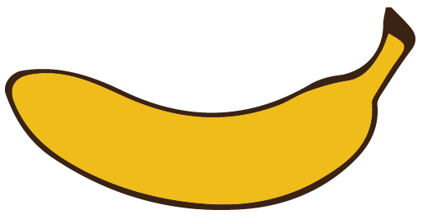
Other Sounds – schwa
The schwa syllable has an “a” that sounds
like the /u/ in banana.
The banana is even shaped like a short u.
ba nan a

Slide 42
a way

