Slide 1
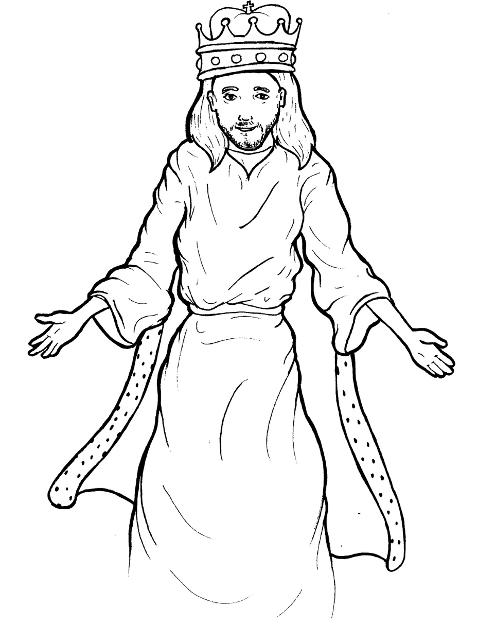
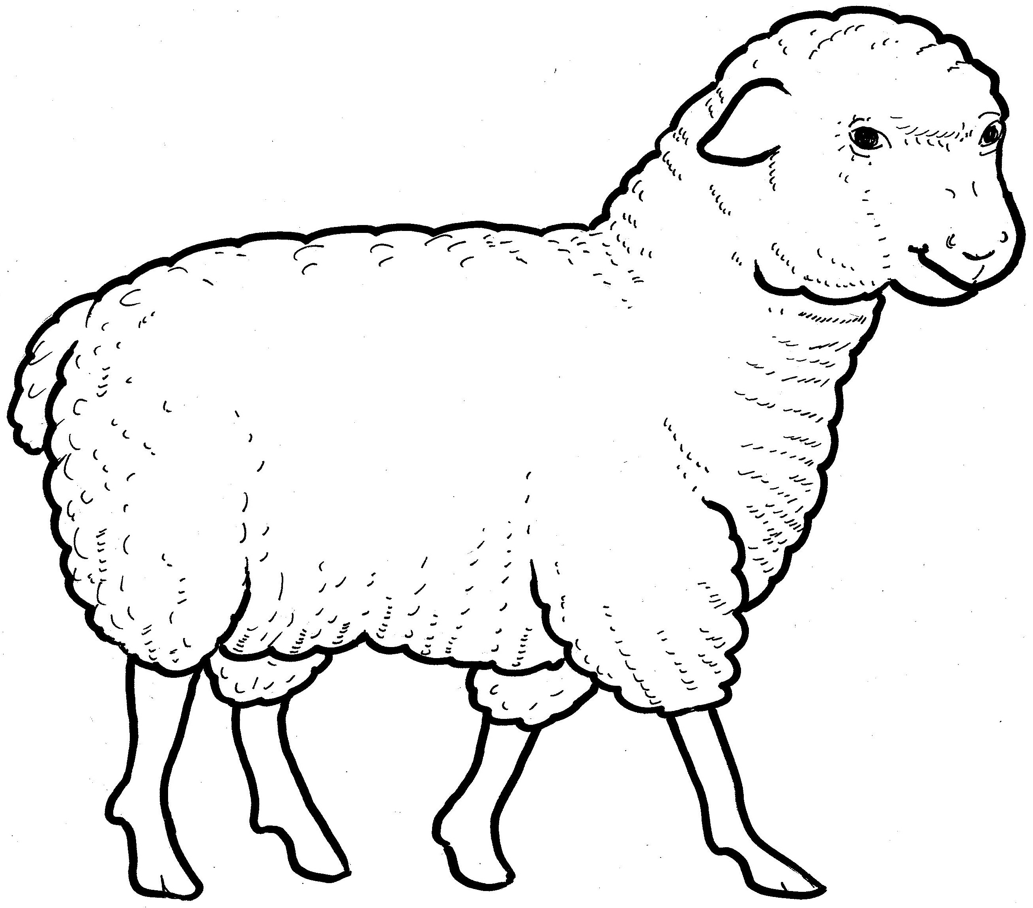
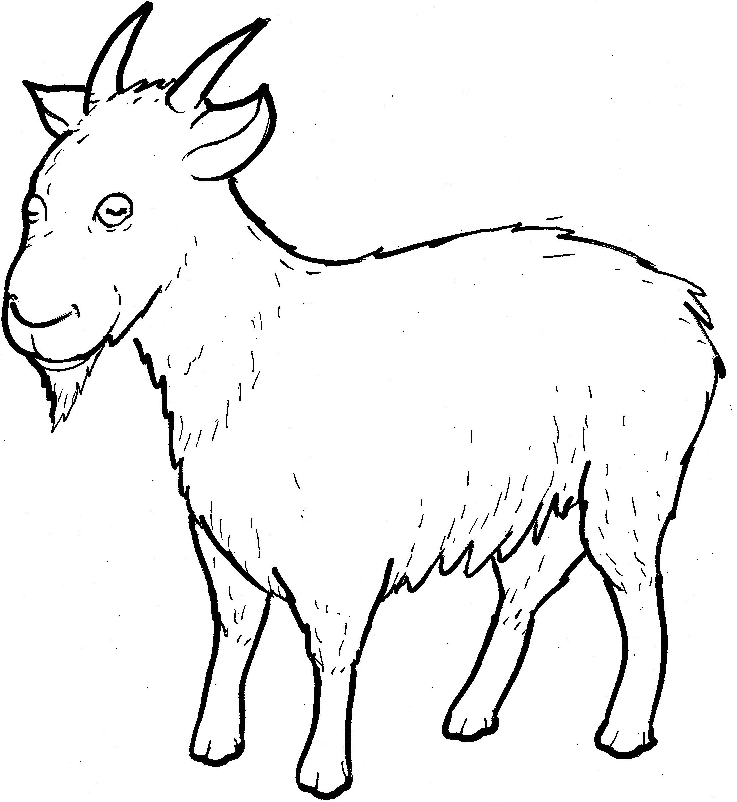
Part 4
27. The Sheep and Goats
Story in Easy Read English
Questions
Story in Phrases

Slide 2
Jesus said, “When the king returns with
his angels, he will sit on his throne.

Slide 3
Like a shepherd, he will put the sheep
on his right side.

Slide 4
He will put the goats on his left side.

Slide 5
The king will say to those on the right,
‘Come, you blessed ones, into the
kingdom.

Slide 6
For I was hungry, and you gave me
something to eat.

Slide 7
I was thirsty, and you gave me
something to drink.

Slide 8
I was a stranger, and you took me in.

Slide 9
I was without clothes, and you gave
me clothes.

Slide 10
I was sick, and you helped me.

Slide 11
I was in prison, and you came to visit
me.’

Slide 12
Those blessed ones will say, ‘Lord,
when did we see you hungry, thirsty,
a stranger, without clothes, sick, or in
prison?’

Slide 13
The king will say, ‘What you did for
the least of these brothers, you really
did for me.’

Slide 14
To those on the left, he will say,
‘Go away from me.

Slide 15
You did not help me when I was
hungry, thirsty, a stranger, without
clothes, sick, and in prison.’

Slide 16
The ones who helped will go into the
kingdom forever.

Slide 17
The ones who did not help will go
away into punishment forever.”

Slide 18
Question 1
Who are the “goats” and what will happen to them?

Slide 19
Question 2
Who are the “sheep” and what will happen to them?

Slide 20
Question 3
When we help someone who is hurting, who are we really helping as well?

Slide 21
Question 4
Who can you help and how?

Slide 22
Prayer
Dear King Jesus,
I want to help those who are hurting. Please show me who is hungry or thirsty or a stranger or without clothes or sick or in prison. When I help someone in need, I am helping you too.
Amen

Slide 23
The Sheep and Goats
Phrased for Fluency

Slide 24
Jesus said,
“When the king returns
with his angels,
he will sit
on his throne.

Slide 25
Like a shepherd,
he will put
the sheep
on his right side.

Slide 26
He will put
the goats
on his left side.

Slide 27
The king
will say
to those
on the right,

Slide 28
‘Come,
you blessed ones,
into the kingdom.

Slide 29
For I was hungry,
and you
gave me something
to eat.

Slide 30
I was thirsty,
and you gave me
something
to drink.

Slide 31
I was a stranger,
and you
took me in.

Slide 32
I was without clothes,
and you
gave me clothes.

Slide 33
I was sick,
and you
helped me.

Slide 34
I was in prison,
and you came
to visit me.’

Slide 35
Those blessed ones
will say,

Slide 36
‘Lord,
when did we
see you hungry,
thirsty,
a stranger,
without clothes,
sick,
or in prison?’

Slide 37
The king
will say,
‘What you did
for the least
of these brothers,
you really did
for me.’

Slide 38
To those
on the left,
he will say,
‘Go away
from me.

Slide 39
You did not
help me
when I was hungry,

Slide 40
thirsty,
a stranger,
without clothes,
sick,
and in prison.’

Slide 41
The ones who helped
will go
into the kingdom
forever.

Slide 42
The ones who
did not help
will go
away
into punishment
forever.”

