Slide 1
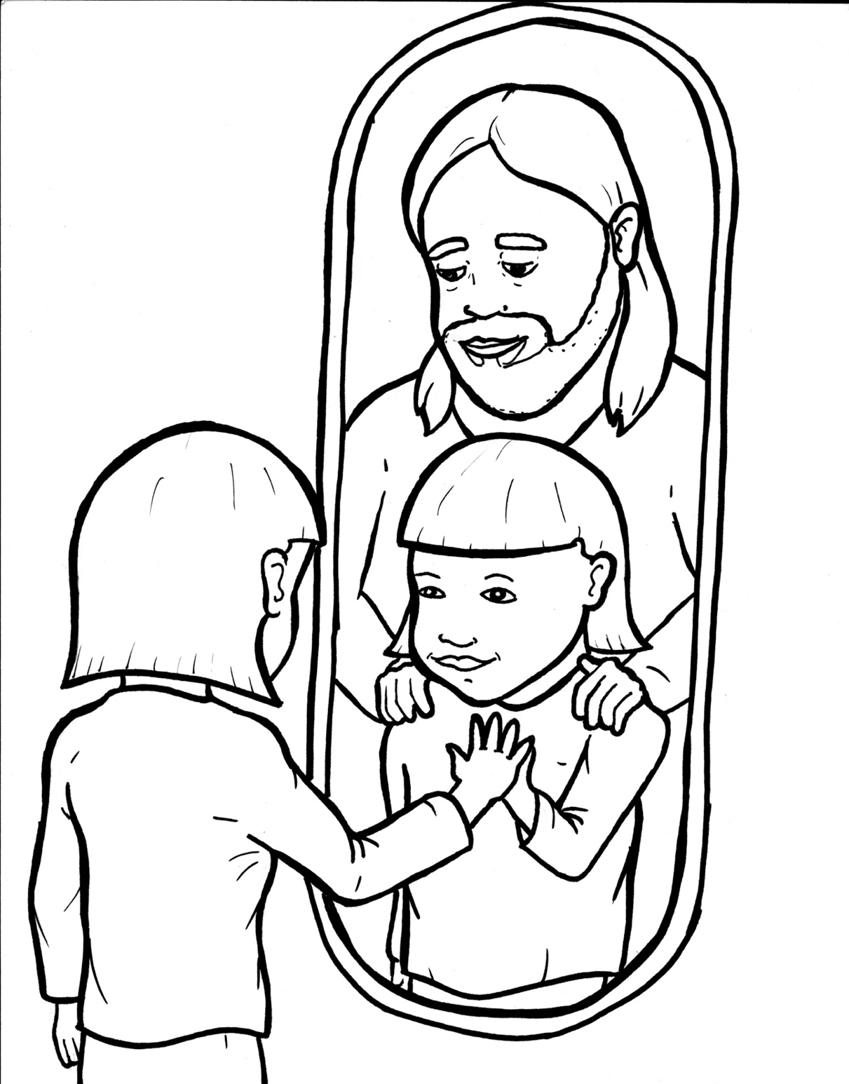
48. Wow, I'm a Christian Now!
Part 4
Story in Easy Read English
Questions
Story in Phrases

Slide 2
You just asked Jesus into your life!

Slide 3
You run to the mirror and stare into it.

Slide 4
Wait, you don't look any different.

Slide 5
You might feel excited.

Slide 6
Or you might feel normal.

Slide 7
Has anything changed?

Slide 8
Oh yes. In fact, everything has changed.

Slide 9
In a world you cannot see, angels are shouting praises!

Slide 10
Your name is written in the "Book of Life."

Slide 11
That means heaven is your new home.

Slide 12
It's like you were dead.

Slide 13
But now, you are alive!

Slide 14
You were far away, but now you are near… wrapped in your Father's arms.

Slide 15
With love, God chose you.

Slide 16
He adopted you into his forever family.

Slide 17
It was for his happiness and glory.

Slide 18
God's Holy Spirit sets you apart.

Slide 19
He lives inside you.

Slide 20
Like a newborn baby, your life starts all over.

Slide 21
Your sins are forgiven, poof! Gone.

Slide 22
This is grace.

Slide 23
God poured it out all over you.

Slide 24
God's own power is making you strong.

Slide 25
He has exciting jobs lined up for you to do.

Slide 26
You are now part of a worldwide kingdom.

Slide 27
You are a brother or sister to every believer who has ever lived.

Slide 28
From every land and tribe and language, we are all God's family now.

Slide 29
Welcome home, little Christian.

Slide 30
Enjoy this joyful journey!

Slide 31
Question 1
What happens in heaven when someone becomes a Christian?

Slide 32
Question 2
What happens in a life and heart when someone becomes a Christian?

Slide 33
Question 3
How has your life changed since you became a Christian?

Slide 34
Question 4
What jobs do you think God might have for you to do?

Slide 35
Prayer
Dear Lord Jesus,
Thank you for bringing me into your family. Thank you for forgiving me and starting me on this joyful journey.
Amen

Slide 36
Wow, I'm a
Christian Now!
Phrased for Fluency

Slide 37
You just
asked Jesus
into your life!

Slide 38
You run
to the mirror
and stare
into it.

Slide 39
Wait,
you don't look
any different.

Slide 40
You might feel
excited.

Slide 41
Or
you might
feel normal.

Slide 42
Has anything
changed?

Slide 43
Oh yes.
In fact,
everything
has changed.

Slide 44
In a world
you cannot
see,
angels
are shouting
praises!

Slide 45
Your name
is written
in the "Book of Life."

Slide 46
That means
heaven
is your
new home.

Slide 47
It's like
you were dead.

Slide 48
But now,
you are alive!

Slide 49
You were
far away,
but now
you are near…
wrapped in
your Father's arms.

Slide 50
With love,
God chose you.

Slide 51
He adopted you
into his
forever family.

Slide 52
It was for
his happiness
and glory.

Slide 53
God's Holy Spirit
sets you
apart.

Slide 54
He lives
inside you.

Slide 55
Like a newborn baby,
your life
starts
all over.

Slide 56
Your sins
are forgiven,
poof!
Gone.

Slide 57
This is grace.

Slide 58
God
poured it out
all over
you.

Slide 59
God's own power
is making
you strong.

Slide 60
He has
exciting jobs
lined up
for you
to do.

Slide 61
You
are now part
of a
worldwide kingdom .

Slide 62
You
are a brother
or sister
to every believer
who has ever
lived.

Slide 63
From every land
and tribe
and language,
we are all
God's family
now.

Slide 64
Welcome home,
little Christian.

Slide 65
Enjoy
this joyful journey!

