Slide 1

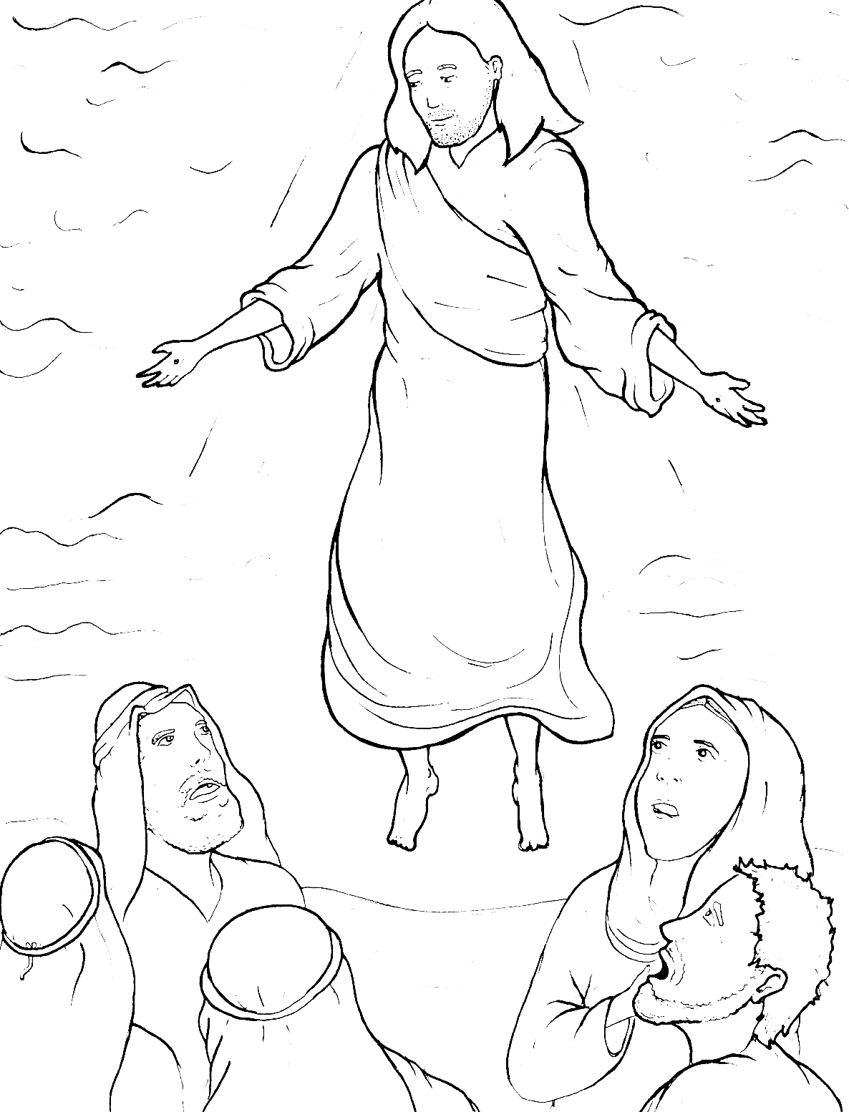
Part 5
44. Jesus Goes Back to Heaven
Vocabulary
Original Bible Story

Slide 2

Vocabulary

Slide 3
affection
(af – FEC- tion)
feeling of love

Slide 4
tend
(tend)
take care of

Slide 5
grieved
(grieved)
felt so sad

Slide 6
observed
(ob - SERVED)
obeyed

Slide 7
steadfastly
(STEAD - fast - ly)
in a constant way

Slide 8
receive
(re - CEIVE)
to accept or get something

Slide 9
Jesus Goes Back
to Heaven
From John 21, 28; Matthew 28; Acts 1
World English Bible (WEB)

Slide 10
There are also many other
things which Jesus did, which
if they would all be written,

Slide 11
I suppose that even the world
itself wouldn’t have room for the
books that would be written.

Slide 12
So, when they had eaten their
breakfast,
Jesus said to Simon Peter,

Slide 13
“Simon, son of Jonah,
do you love me
more than these?”

Slide 14
He said to him,
“Yes, Lord; you know that
I have affection for you.”

Slide 15
He said to him,
“Feed my lambs.”

Slide 16
He said to him again
a second time,

Slide 17
“Simon, son of Jonah,
do you love me?”

Slide 18
He said to him,
“Yes, Lord; you know that
I have affection for you.”

Slide 19
“Tend my sheep.”
He said to him,

Slide 20
He said to him the third time,
“Simon, son of Jonah, do you
have affection for me?”

Slide 21
Peter was grieved because he
asked him the third time,
“Do you have affection for me?”

Slide 22
He said to him,
“Lord, you know everything.

Slide 23
You know that
I have affection for you.”

Slide 24
Jesus said to him,
“Feed my sheep.”

Slide 25
“Go and make disciples
of all nations,

Slide 26
baptizing them in the name of
the Father and of the Son
and of the Holy Spirit,

Slide 27
teaching them to observe
all things that I commanded you.

Slide 28
Behold, I am with you always,
even to the end of the age.”
Amen.

Slide 29
When he had said these things,
as they were looking,
he was taken up,

Slide 30
and a cloud received him
out of their sight.

Slide 31
While they were looking steadfastly
into the sky as he went,

Slide 32
behold, two men stood by them
in white clothing, who also said,

Slide 33
“You men of Galilee,
why do you stand looking
into the sky?

Slide 34
This Jesus, who was received
up from you into the sky,

Slide 35
will come back in the same way
as you saw him going into the sky.”

