Slide 1
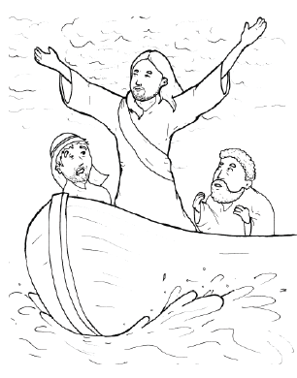
17. Jesus Stops a Storm
Part 4
Story in Easy Read English
Questions
Story in Phrases

Slide 2
Jesus and his disciples sailed at night.

Slide 3
Gentle waves rocked the boat.

Slide 4
Jesus fell asleep.

Slide 5
A bad storm blew in upon the lake.

Slide 6
Rain fell hard.

Slide 7
Strong winds tossed the boat back and forth.

Slide 8
It almost sank!

Slide 9
Huge waves crashed over the boat.

Slide 10
Cold water splashed the men…brrr.

Slide 11
But Jesus kept sleeping.

Slide 12
His disciples woke him up.

Slide 13
"Master, save us!" they cried. "We are going to drown."

Slide 14
"Why are you afraid?” Jesus asked. "Your faith is so small."

Slide 15
Jesus got up.

Slide 16
He told the soaking rain, "Stop."

Slide 17
He told the howling wind, "Be quiet."

Slide 18
He told the wild waves, "Lie down."

Slide 19
The rain stopped!

Slide 20
The wind became quiet.

Slide 21
The waves laid down.

Slide 22
All was still.

Slide 23
Now, the disciples were amazed – amazed and terrified.

Slide 24
"Who is this?" they asked. "Even the wind and the waves obey him."

Slide 25
Question 1
How did Jesus make the storm stop?

Slide 26
Question 2
How did the disciples feel about Jesus after he stopped the storm? Why?

Slide 27
Question 3
How does this miracle prove who Jesus is?

Slide 28
Question 4
If Jesus can stop the rain and the wind, how can he make problems in your life become still?

Slide 29
Prayer
Dear Jesus,
You made a scary storm stop.
This shows me that you are God.
You can do anything.
Please make this stormy problem in my life become still.
Amen

Slide 30
Jesus Stops a
Storm
Phrased for Fluency

Slide 31
Jesus
and his disciples
sailed at night.

Slide 32
Gentle waves
rocked the boat.

Slide 33
Jesus
fell asleep.

Slide 34
A bad storm
blew in
upon the lake.

Slide 35
Rain
fell hard.

Slide 36
Strong winds
tossed the boat
back and forth.

Slide 37
It almost sank!

Slide 38
Huge waves
crashed
over the boat.

Slide 39
Cold water
splashed the men
…brrr.

Slide 40
But Jesus
kept sleeping.

Slide 41
His disciples
woke him up.

Slide 42
"Master,
save us!"
they cried.

Slide 43
"We
are going
to drown."

Slide 44
"Why are you
afraid?”
Jesus asked.

Slide 45
"Your faith
is so small."

Slide 46
Jesus
got up.

Slide 47
He told
the soaking rain,
"Stop."

Slide 48
He told
the howling wind,
"Be quiet."

Slide 49
He told
the wild waves,
"Lie down."

Slide 50
The rain
stopped!

Slide 51
The wind
became quiet.

Slide 52
The waves
laid down.

Slide 53
All
was still.

Slide 54
Now,
the disciples
were amazed –
amazed and terrified.

Slide 55
"Who is this?"
they asked.

Slide 56
"Even the wind
and the waves
obey him."

