Slide 1

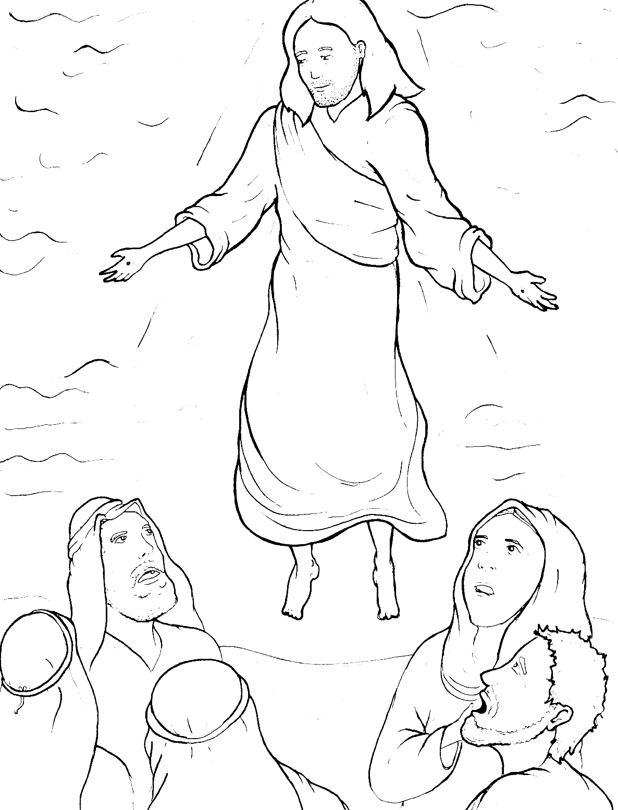
Part 3
44. Jesus Goes Back to Heaven
Syllable Divisions

Slide 2

Dividing Words
Into Syllables

Slide 3
Rabbit Words
When you see two consonants
between two vowels,
divide between the consonants.
ra it
bb
rab bit

Slide 4
af ter
after

Slide 5
writ ten
written

Slide 6
bap tize
baptize

Slide 7
Mes si ah
Messiah

Slide 8
dis ci ples
disciples

Slide 9
fol low er
follower

Slide 10
Chris tian
Christian

Slide 11
Tiger Words
When you see one consonant
between two vowels,
divide after the first vowel.
Try this pattern first.
ti er
g
ti ger

Slide 12
na tions
nations

Slide 13
e ven
even

Slide 14
Je sus
Jesus

Slide 15
Pe ter
Peter

Slide 16
be lieve
believe

Slide 17
o bey
obey

Slide 18
Camel Words
When you see one consonant
between two vowels,
divide after the first consonant.
Try this pattern second.
ca el
m
cam el

Slide 19
ev er y thing
everything

Slide 20
for ev er
forever

Slide 21
heav en
heaven

Slide 22
mir a cles
miracles

Slide 23
Turtle Words
When you see consonant-l-e,
count back three and divide.
tur
t
l
e
tur tle

Slide 24
dis ci ples
disciples

Slide 25
peo ple
people

Slide 26
mir a cles
miracles

Slide 27
Lion Words
If a word has two vowels together
that make two different sounds,
divide between the two vowels.
lion
li on

Slide 28
Mes si ah
Messiah

Slide 29

Anteater Words
These compound words are made up of two smaller words.
ant
eater
1
2
ant eater

Slide 30
in to
into

Slide 31
for ever
forever

Slide 32
world wide
worldwide

Slide 33
every thing
everything

Slide 34

Foxes Suffixes
Focus on your base word.
fox es
fox es

Slide 35
believ ers
believers

Slide 36
follow ers
followers

Slide 37
eat ing
eating

Slide 38
believ ing
believing

Slide 39
loved
loved

Slide 40
asked
asked

Slide 41
Other Syllable Divisions
Some words don’t fit so neatly
into standard syllable division patterns.

Slide 42
ang els
angels

