Slide 1
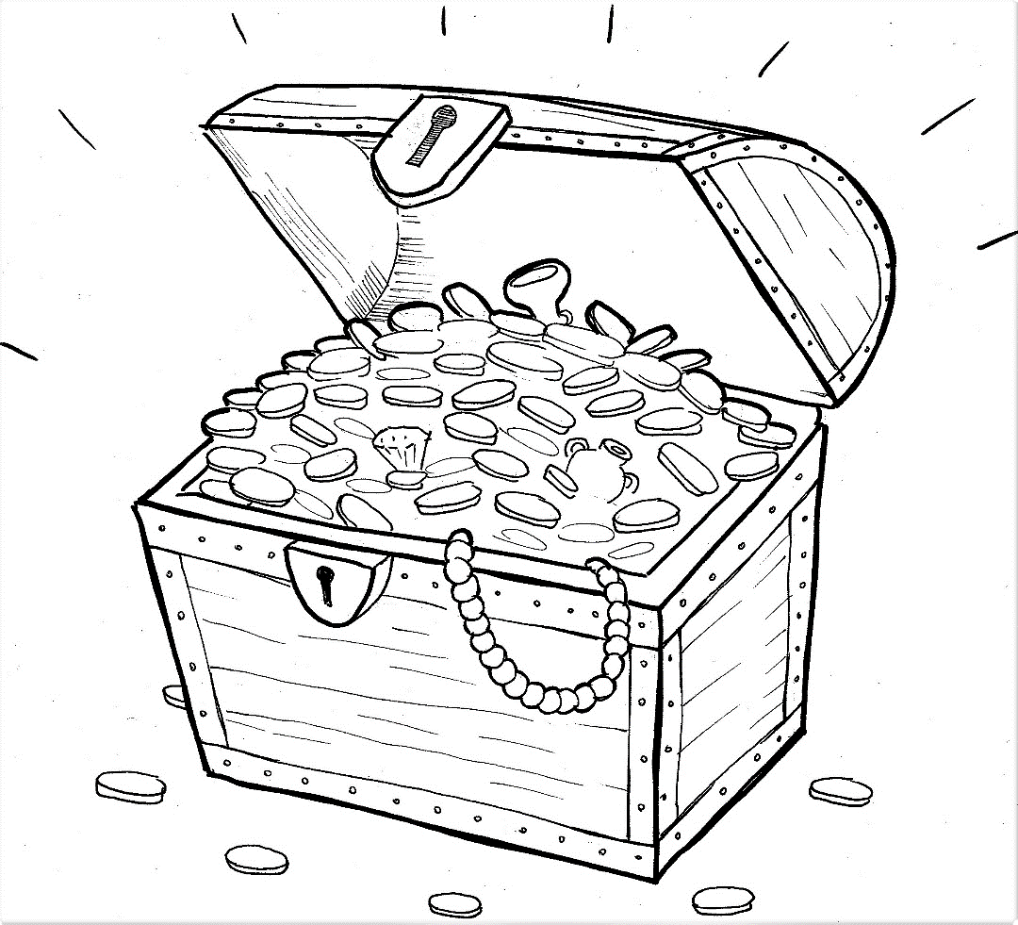
Part 1
21. Hidden Treasure and Priceless Pearl
Syllable Charts

Slide 2
Words in Syllable Types

Slide 3
Closed – Short Vowel
A closed syllable has one vowel
followed by one or more consonants,
and the vowel is short.
st
o
p
˘

Slide 4
Timing
Box
can
man
val-
had
that
-stand

Slide 5
Timing
Box
get
ev-
help
-den
went
-less

Slide 6
Timing
Box
hid-
in-
did
sil-
this
with

Slide 7
Timing
Box
lot
not
God
cost

Slide 8
Timing
Box
us
up
un-
-sus
but

Slide 9
Open – Long Vowel
An open syllable has one vowel
with no consonant after it,
and the vowel is long.
−
go

Slide 10
Timing
Box
he
we
Je sus

Slide 11
Timing
Box
no

Slide 12
Timing
Box
val u a ble

Slide 13
Timing
Box
ev er y
real ly

Slide 14
Silent e – Long Vowel
A silent e syllable has one vowel,
followed by one consonant
and a silent e at the end.
The vowel is long.
−
ca
e
v

Slide 15
Timing
Box
like
price less
in side

Slide 16
Timing
Box
home

Slide 17
Timing
Box
trea sure

Slide 18
Timing
Box
fur ni ture

Slide 19
Vowel Teams – Long Vowel
Many vowel teams follow this rule:
When two vowels get together,
the first one names its letter.
So the first vowel will make its long sound,
and the second vowel is silent.
−
e
a
t

Slide 20
Timing
Box
way
trays

Slide 21
Timing
Box
see
un seen

Slide 22
Timing
Box
real ly

Slide 23
Timing
Box
field
stor ies
bur ied

Slide 24
Timing
Box
mon ey

Slide 25
Timing
Box
knew
jew el

Slide 26
Timing
Box
great

Slide 27
Vowel Teams – Other Sounds
Sometimes vowel teams make other sounds.
oil

Slide 28
Timing
Box
took

Slide 29
Timing
Box
found
ground
house
a bout

Slide 30
Timing
Box
joy
oy ster

Slide 31
Timing
Box
trea sure

Slide 32
R - Controlled
R-controlled syllables have one or more vowels
followed by an “r.”
The “r” changes the sound of the vowel.
o
r
ange

Slide 33
Timing
Box
un der stand
sil ver
oy ster
ev er y

Slide 34
Timing
Box
fur ni ture

Slide 35
Timing
Box
for get
stor ies

Slide 36
Timing
Box
pearl

Slide 37
Timing
Box
world

Slide 38
Consonant – l-e
When you see consonant l-e at the end of a word,
count back three.
The “l-e” makes the /–le/ sound.
pur
p
l
e

Slide 39
Timing
Box
val u a ble

Slide 40
Timing
Box
jew el

Slide 41
Other Sounds – Long Vowel
These syllables or words are closed,
so the vowel should be short,
but the vowel is long.
−
cold

Slide 42
Timing
Box
told
sold
gold

Slide 43
Other Sounds – -nk/-ng
The “-nk” and “-ng”
change the sound of the vowel.
bank
thing

Slide 44
Timing
Box
king dom
some thing
every thing

Slide 45
Other Sounds – schwa
The schwa syllable has an “a” that sounds
like the /u/ in banana.
The banana is even shaped like a short u.
ba nan a

Slide 46
Timing
Box
a bout
val u a ble

