Slide 1
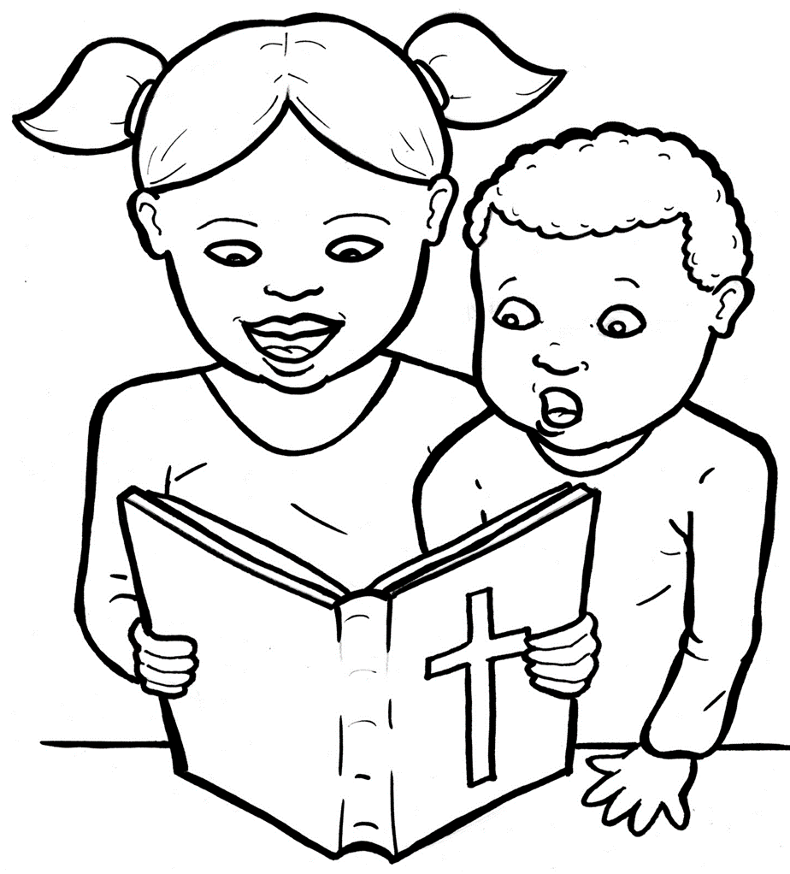
Part 2
51. I am Alive: the Bible
New Words
Rule Breakers

Slide 2
Other Sounds – Soft G
ge, gi, gy often make the soft sound
gentle
giant
gym

Slide 3
page

Slide 4
Silent Letters
John
written
write
whole

Slide 5
Possessives
God’s story
God’s family
God’s heart

Slide 6
New Words
Testament
John
Israel
Christian

Slide 7
Rule Breakers
These words do not follow phonetic patterns.

Slide 8
is
his
of
the
to
has

Slide 9
you
from
yours
four
love
were

Slide 10
what
loving
young
sorry
coming
also

Slide 11
great
are
whole
heart
talk
full

