Slide 1

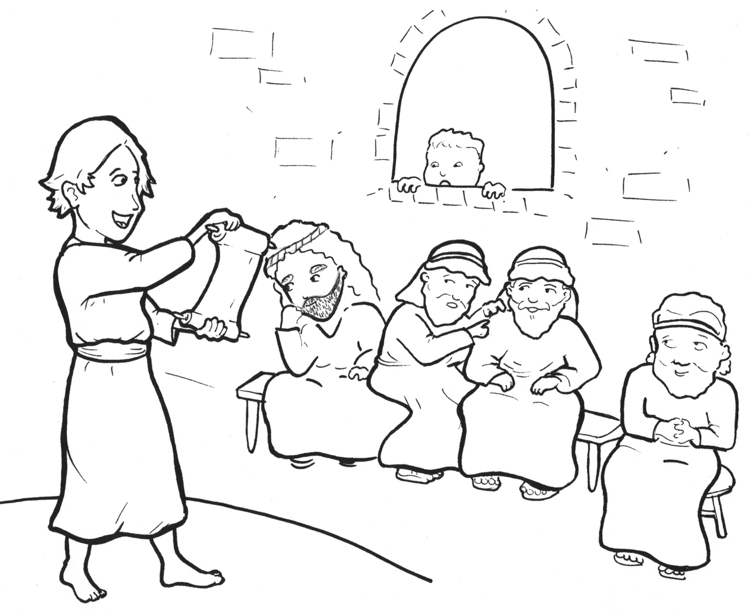
7. Jesus Gets Lost!
Part 3
Syllable Divisions

Slide 2
Dividing Words
Into Syllables

Slide 3
Rabbit Words
When you see two consonants
between two vowels,
divide between the consonants.
ra it
bb
rab bit

Slide 4
Scrip tures
Scriptures

Slide 5
un der stand
understand

Slide 6

Tiger Words
When you see one consonant
between two vowels,
divide after the first vowel.
Try this pattern first.
ti er
g
ti ger

Slide 7
Jo seph
Joseph

Slide 8
Jer u sa lem
Jerusalem

Slide 9
la ter
later

Slide 10
re turned
returned

Slide 11
fi nal ly
finally

Slide 12
Camel Words
When you see one consonant
between two vowels,
divide after the first consonant.
Try this pattern second.
ca el
m
cam el

Slide 13
trav el
travel

Slide 14
cit y
city

Slide 15
Jer u sa lem
Jerusalem

Slide 16
Mar y
Mary

Slide 17
fam i ly
family

Slide 18
Naz a reth
Nazareth

Slide 19
wag ons
wagons

Slide 20
Turtle Words
When you see consonant-l-e,
count back three and divide.
tur
t
l
e
tur tle

Slide 21
peo ple
people

Slide 22
tem ple
temple

Slide 23
Hamster Words
When you see three consonants between two vowels,
divide after the first consonant.
ha
mst
er
ham ster

Slide 24
wor ship
worship

Slide 25
Anteater Words
These compound words are made up of two smaller words.
ant
eater
1
2
ant eater

Slide 26
every where
everywhere

Slide 27
under stand
understand

Slide 28

Foxes Suffixes
Focus on your base word.
fox es
fox es

Slide 29
crowd ed
crowded

Slide 30
looked
looked

Slide 31
asked
asked

Slide 32
packed
packed

Slide 33
obeyed
obeyed

Slide 34
traveled
traveled

Slide 35
returned
returned

Slide 36
amazed
amazed

Slide 37
miss ing
missing

Slide 38
teach ers
teachers

Slide 39
final ly
finally

Slide 40
Other Syllable Divisions
Some words don’t fit so neatly
into standard syllable division patterns.
a way
away

Slide 41
Jer u sa lem
Jerusalem

Slide 42
a mazed
amazed

Slide 43
a long
along

Slide 44
a bout
about

