Slide 1
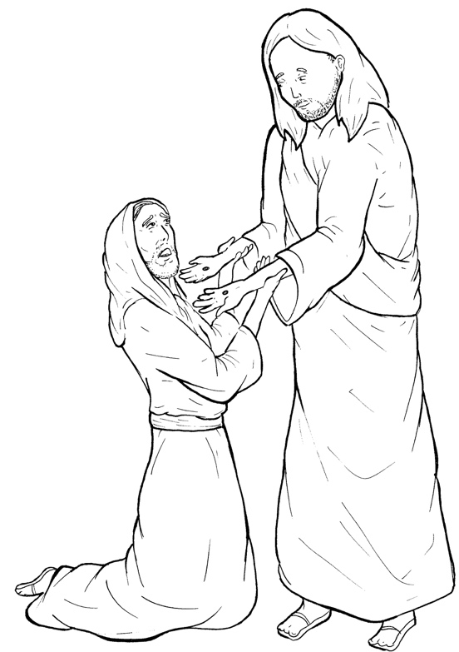
Part 2
43. Jesus Appears to Thomas
New Words
Rule Breakers

Slide 2
Other Sounds – Soft C
ce, ci, cy make the soft sound
cent
city
fancy

Slide 3
peace

Slide 4
disciples

Slide 5
Silent Letters
doubt
Thomas
knees

Slide 6
New Words
appear
among
doubt
Thomas

Slide 7
Rule Breakers
Words like these do not follow phonetic patterns.
to
you
said
could
two
f
from

Slide 8
to
are
of
was
his
one

Slide 9
the
you
put
your
who
have

Slide 10
were
doubt
said
into
been
again

Slide 11
others
Thomas
among

