Slide 1

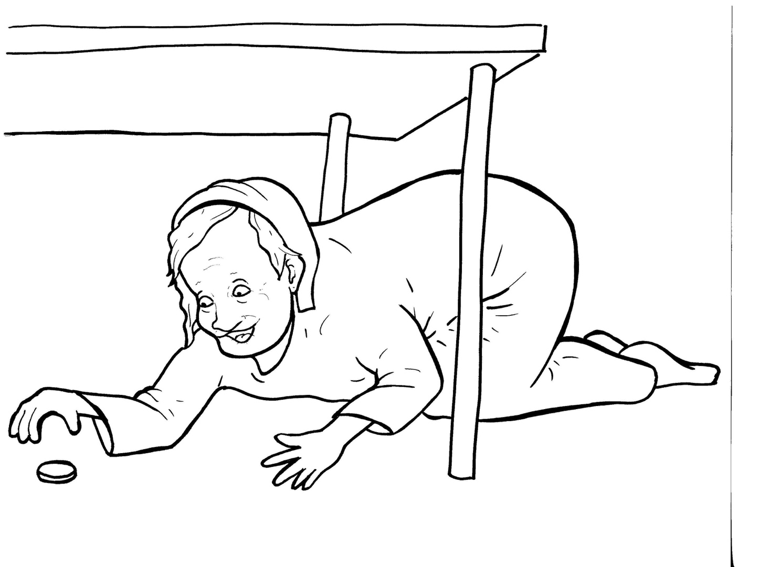
Part 3
23. The Lost Coin
Syllable Divisions

Slide 2

Dividing Words
Into Syllables

Slide 3
Rabbit Words
When you see two consonants
between two vowels,
divide between the consonants.
ra it
bb
rab bit

Slide 4
un til
until

Slide 5
sil ver
silver

Slide 6
sin ner
sinner

Slide 7
cor ner
corner

Slide 8
par ty
party

Slide 9
Tiger Words
When you see one consonant
between two vowels,
divide after the first vowel.
Try this pattern first.
ti er
g
ti ger

Slide 10
Je sus
Jesus

Slide 11
re joice
rejoice

Slide 12
re pents
repents

Slide 13
Camel Words
When you see one consonant
between two vowels,
divide after the first consonant.
Try this pattern second.
ca el
m
cam el

Slide 14
ev er y
every

Slide 15
stor y
story

Slide 16
heav en
heaven

Slide 17

Foxes Suffixes
Focus on your base word.
fox es
fox es

Slide 18
sin ner
sinner

Slide 19
miss ing
missing

Slide 20

Anteater Words
These compound words are made up of two smaller words.
ant
eater
1
2
ant eater

Slide 21
for get
forget

Slide 22
Other Syllable Divisions
Some words don’t fit so neatly
into standard syllable division patterns.

Slide 23
a bout
about

Slide 24
ang els
angels

Slide 25
neigh bors
neighbors

Slide 26
spec ial
special

