Slide 1
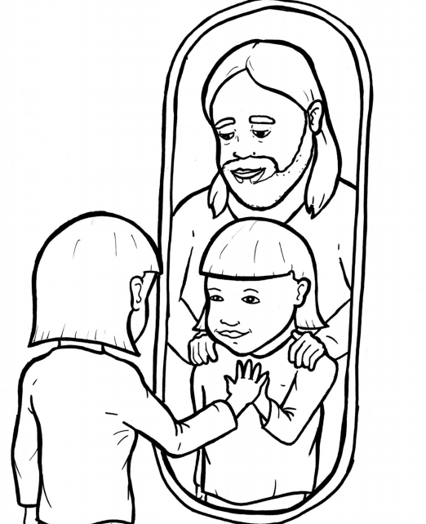
48. Wow, I’m a Christian Now!
Part 2
New Words
Rule Breakers

Slide 2
Other Sounds – Soft G
ge, gi, gy often make the soft sound
gentle
giant
gym

Slide 3
angels
language
changed

Slide 4
Other Sounds – Soft C
ce, ci, cy make the soft sound
cent
city
fancy

Slide 5
grace

Slide 6
Silent Letters
wrapped

Slide 7
Christian

Slide 8
Possessives
Father’s arms
God’s Holy Spirit
God’s family

Slide 9
Contractions
The word “contraction” means “the thing pulled together.”
The first word stays the same,
and the apostrophe takes the place of the
missing letters in the second word.
’m
=
am
I
I

Slide 10
don’t
=
do not
it’s
it is
=

Slide 11
New Words
Christian
Book of Life
adopted
kingdom

Slide 12
Rule Breakers
Words like these do not follow phonetic patterns.
to
you
said
could
two
f
from

Slide 13
is
oh
to
do
of
the

Slide 14
his
who
has
you
was
your

Slide 15
into
what
were
pour
love
live

Slide 16
from
mirror
gone
Father
Spirit
brother

Slide 17
welcome

