Slide 1

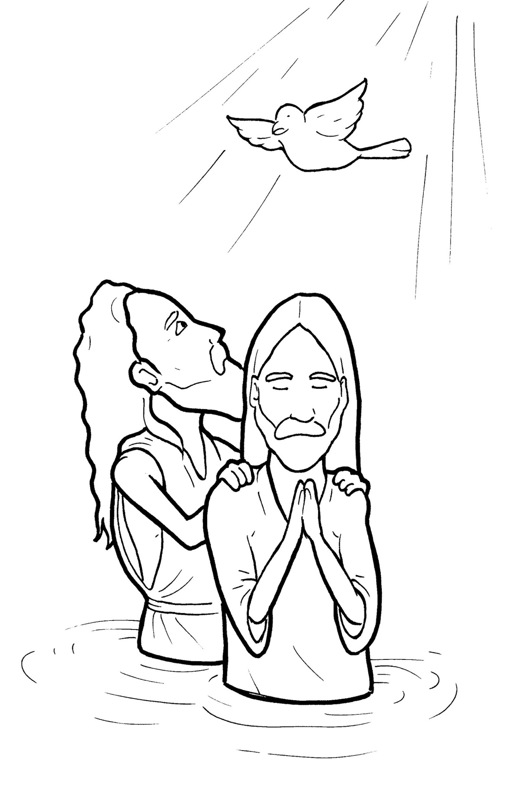
9. Jesus Gets Baptized
Part 3
Syllable Divisions

Slide 2
Dividing Words
Into Syllables

Slide 3
Rabbit Words
When you see two consonants
between two vowels,
divide between the consonants.
ra it
bb
rab bit

Slide 4
bap tize
baptize

Slide 5
Jor dan
Jordan

Slide 6
ful fill
fulfill

Slide 7

Tiger Words
When you see one consonant
between two vowels,
divide after the first vowel.
Try this pattern first.
ti er
g
ti ger

Slide 8
Je sus
Jesus

Slide 9
be gan
began

Slide 10
be gin
begin

Slide 11
cho sen
chosen

Slide 12
o pen
open

Slide 13
Camel Words
When you see one consonant
between two vowels,
divide after the first consonant.
Try this pattern second.
ca el
m
cam el

Slide 14
riv er
river

Slide 15
pres ent
present

Slide 16
Spir it
Spirit

Slide 17
heav en
heaven

Slide 18
read y
ready

Slide 19
Turtle Words
When you see consonant-l-e,
count back three and divide.
tur
t
l
e
tur tle

Slide 20
peo ple
people

Slide 21

Anteater Words
These compound words are made up of two smaller words.
ant
eater
1
2
ant eater

Slide 22
in to
into

Slide 23

Foxes Suffixes
Focus on your base word.
fox es
fox es

Slide 24
stopped
stopped

Slide 25
looked
looked

Slide 26
baptized
baptized

Slide 27
lowered
lowered

Slide 28
stayed
stayed

Slide 29
pleased
pleased

Slide 30
agreed
agreed

Slide 31
part ed
parted

Slide 32
drip ping
dripping

Slide 33
great est
greatest

Slide 34
Other Syllable Divisions
Some words don’t fit so neatly
into standard syllable division patterns.
a way
away

Slide 35
a bout
about

Slide 36
a greed
agreed

Slide 37
mis sion
mission

