Slide 1
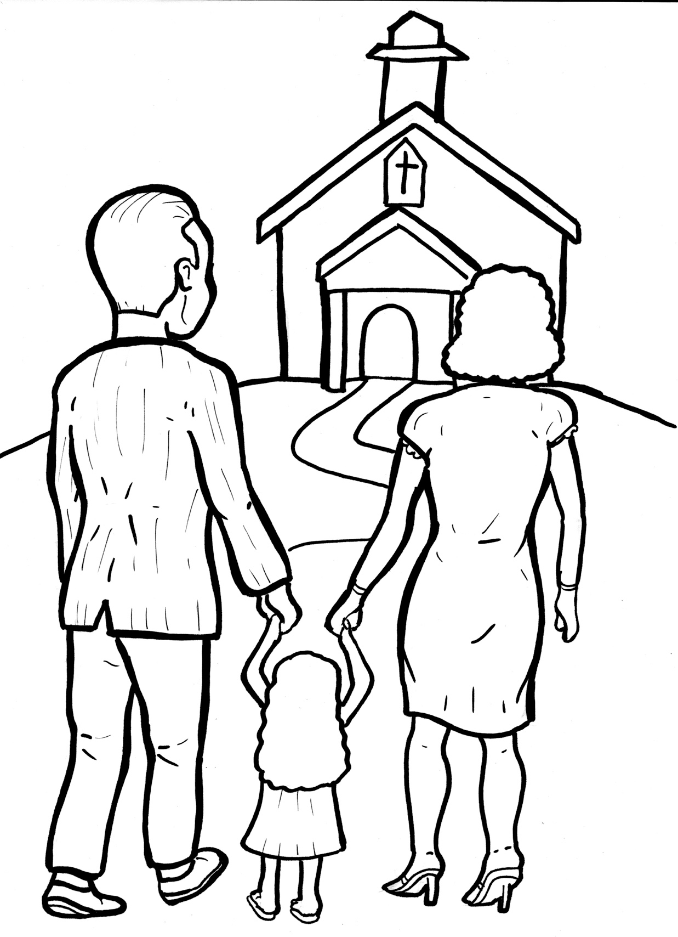
Timing
Box
Part 2
52. I Am Alive:
Church
New Words
Rule Breakers

Slide 2
Other Sounds – Soft C
ce, ci, cy make the soft sound
cent
city
fancy

Slide 3
ex ci ted

Slide 4
Silent Letters
Timing
Box
listen

Slide 5
Possessives
Timing
Box
God’s word
God’s family

Slide 6
New Words
promise
build
countries
miracles

Slide 7
Rule Breakers
Words like these do not follow phonetic patterns.
to
you
said
could
two
f
from

Slide 8
as
two
of
you
to
was

Slide 9
his
love
said
their
from
build

Slide 10
were
could
some
where
Christ
very

Slide 11
other
miracles
promise
together
Christians
are

Slide 12
beautiful

