Slide 1
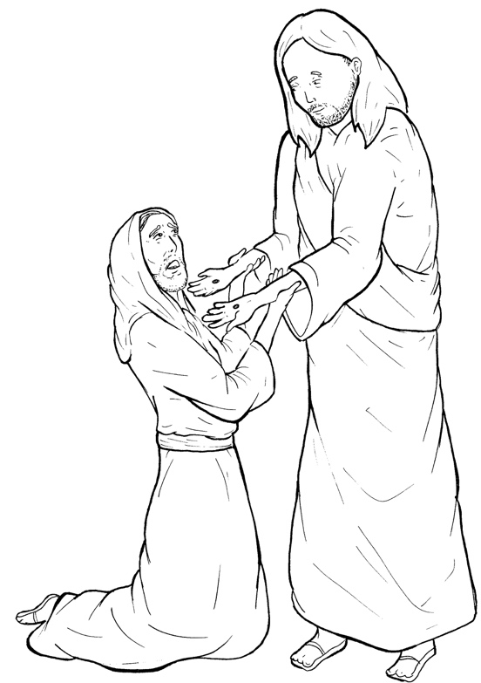
Part 1
43. Jesus Appears to Thomas
Syllable Charts

Slide 2
Words in Syllable Types

Slide 3
Closed – Short Vowel
A closed syllable has one vowel
followed by one or more consonants,
and the vowel is short.
st
o
p
˘

Slide 4
Timing
Box
had
and
hands

Slide 5
Timing
Box
yet
them
fell
-less
when
bless

Slide 6
Timing
Box
in
it
dis-
this
will
with

Slide 7
Timing
Box
God
not
lock
stop

Slide 8
Timing
Box
un-
-sus
must
but

Slide 9
Open – Long Vowel
An open syllable has one vowel
with no consonant after it,
and the vowel is long.
−
go

Slide 10
Timing
Box
la ter

Slide 11
Timing
Box
he
we
be

Slide 12
Timing
Box
Je sus
be lieve
be cause

Slide 13
Timing
Box
I
disci ples

Slide 14
Timing
Box
go

Slide 15
Timing
Box
my

Slide 16
Silent e – Long Vowel
A silent e syllable has one vowel,
followed by one consonant
and a silent e at the end.
The vowel is long.
−
ca
e
v

Slide 17
Timing
Box
came

Slide 18
Timing
Box
side
time

Slide 19
Timing
Box
those

Slide 20
Other Sounds – Long Vowel
These syllables or words are closed,
so the vowel should be short,
but the vowel is long.
−
cold

Slide 21
Timing
Box
told

Slide 22
Vowel Teams – Long Vowel
Many vowel teams follow this rule:
When two vowels get together,
the first one names its letter.
So the first vowel will make its long sound,
and the second vowel is silent.
−
e
a
t

Slide 23
Timing
Box
nail

Slide 24
Timing
Box
see
seen
week
knees

Slide 25
Timing
Box
peace
ap pear

Slide 26
Timing
Box
be lieve

Slide 27
Timing
Box
own

Slide 28
Timing
Box
room

Slide 29
Vowel Teams – Other Sounds
Sometimes vowel teams make other sounds.
oil

Slide 30
Timing
Box
a head

Slide 31
Timing
Box
stood

Slide 32
Timing
Box
doubt

Slide 33
Timing
Box
be cause

Slide 34
R - Controlled
R-controlled syllables have one or more vowels
followed by an “r.”
The “r” changes the sound of the vowel.
o
r
ange

Slide 35
Timing
Box
marks

Slide 36
Timing
Box
fing ers
la ter

Slide 37
Timing
Box
Lord

Slide 38
Consonant – l-e
When you see consonant l-e at the end of a word,
count back three.
The “l-e” makes the /–le/ sound.
pur
p
l
e

Slide 39
Timing
Box
disci ples

Slide 40
Other Sounds – -nk/-ng
The “-nk” and “-ng”
change the sound of the vowel.
bank
thing

Slide 41
Timing
Box
fing ers
doubt ing

Slide 42
Other Sounds – schwa
The schwa syllable has an “a” that sounds
like the /u/ in banana.
The banana is even shaped like a short u.
ba nan a

Slide 43
Timing
Box
a gain
a head
a mong
ap pear

