Slide 1

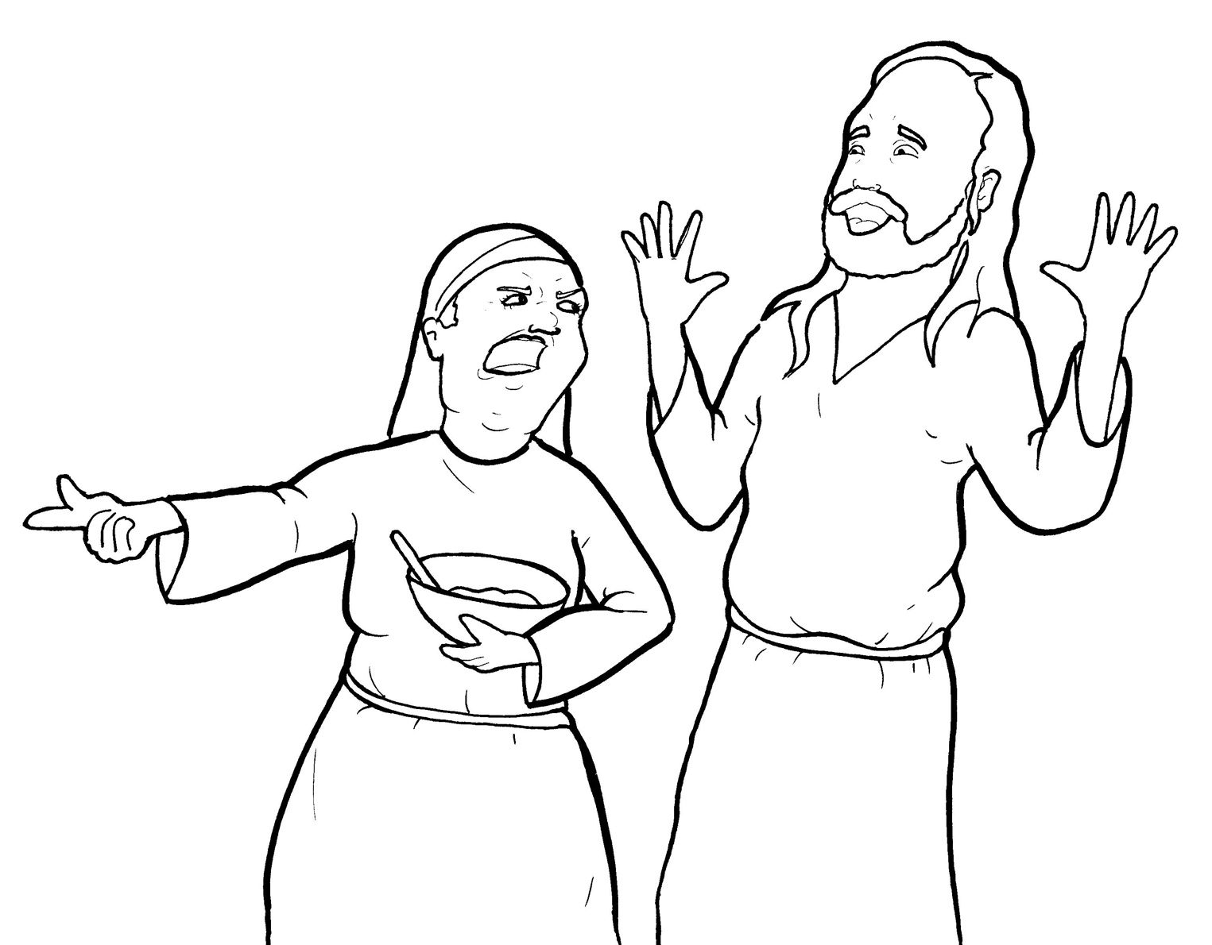
13. Martha Gets Mad
Part 3
Syllable Divisions

Slide 2
Dividing Words
Into Syllables

Slide 3
Rabbit Words
When you see two consonants
between two vowels,
divide between the consonants.
ra it
bb
rab bit

Slide 4
dis ci ples
disciples

Slide 5
vil lage
village

Slide 6
wel comed
welcomed

Slide 7
sis ter
sister

Slide 8
lis ten
listen

Slide 9
ques tions
questions

Slide 10

Tiger Words
When you see one consonant
between two vowels,
divide after the first vowel.
Try this pattern first.
ti er
g
ti ger

Slide 11
Je sus
Jesus

Slide 12
cho sen
chosen

Slide 13
Camel Words
When you see one consonant
between two vowels,
divide after the first consonant.
Try this pattern second.
ca el
m
cam el

Slide 14
Mar y
Mary

Slide 15
Turtle Words
When you see consonant-l-e,
count back three and divide.
tur
t
l
e
tur tle

Slide 16
dis ci ples
disciples

Slide 17
grum bled
grumbled

Slide 18
Hamster Words
When you see three consonants between two vowels,
divide after the first consonant.
ha
mst
er
ham ster

Slide 19
Mar tha
Martha

Slide 20
an swered
answered

Slide 21

Foxes Suffixes
Focus on your base word.
fox es
fox es

Slide 22
worr ied
worried

Slide 23
repl ied
replied

Slide 24
fried
fried

Slide 25
welcomed
welcomed

Slide 26
named
named

Slide 27
tired
tired

Slide 28
loved
loved

Slide 29
asked
asked

Slide 30
grumbled
grumbled

Slide 31
need ed
needed

Slide 32
learn ing
learning

Slide 33
serv ing
serving

Slide 34
chosen
chosen

Slide 35
taken
taken

Slide 36

Anteater Words
These compound words are made up of two smaller words.
ant
eater
1
2
ant eater

Slide 37
in to
into

Slide 38
up set
upset

Slide 39
my self
myself

Slide 40
Other Syllable Divisions
Some words don’t fit so neatly
into standard syllable division patterns.
a way
away

Slide 41
a bout
about

