Slide 1
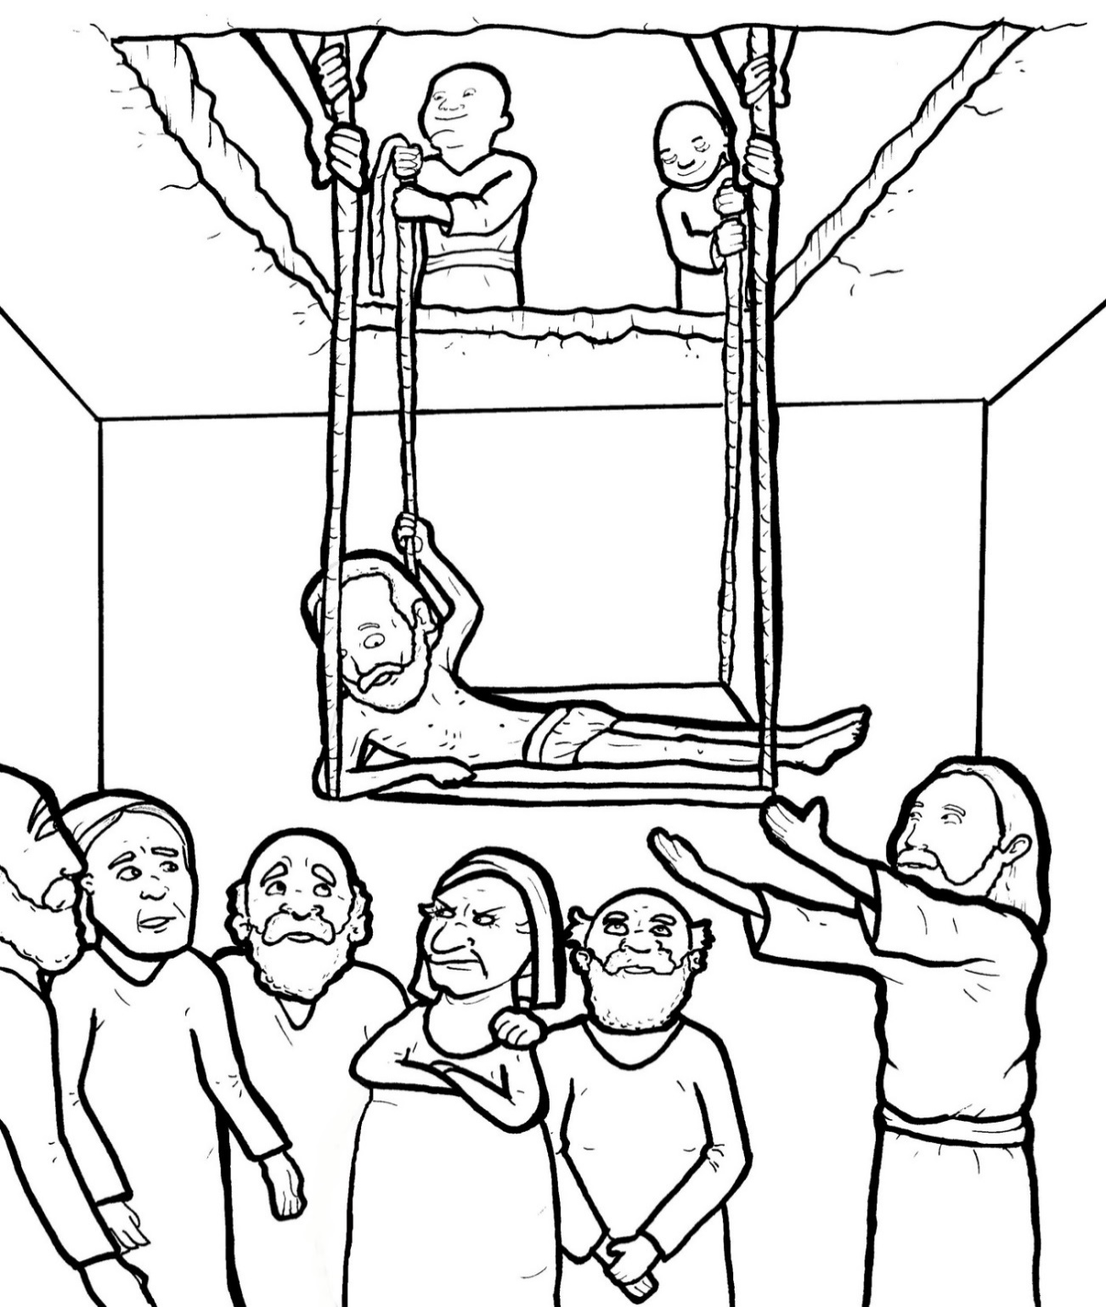
Part 4
29. Friends Bring a Crippled Man to Jesus
Story in Easy Read English
Questions
Story in Phrases

Slide 2
Jesus was teaching in a home.

Slide 3
Many people came to hear him.

Slide 4
They jammed inside.

Slide 5
Four men carried a crippled
friend on a mat.

Slide 6
He could not walk.

Slide 7
They wanted to see Jesus,
but there was no room.

Slide 8
The friends carried the crippled
man to the top of the roof.

Slide 9
The men dug and dug.

Slide 10
They made a hole in the roof.

Slide 11
With great care, they lowered
their friend down the hole -

Slide 12
right in front of Jesus.

Slide 13
Jesus saw their faith.

Slide 14
He said, “Son, your sins are
forgiven.”

Slide 15
Some teachers of the law
got mad.

Slide 16
In their minds, they said, “Who
does Jesus think he is?

Slide 17
Only God can forgive sins.”

Slide 18
Jesus knew what was in
their hearts.

Slide 19
He said, “Why are you thinking
these things?

Slide 20
I want you to know that
I can forgive sins.”

Slide 21
So, he said to the man,
“Get up, take your mat,
and go home.”

Slide 22
The crippled man jumped up,
grabbed his mat, and ran home.

Slide 23
He praised God with all his
heart.

Slide 24
Everyone was amazed.

Slide 25
They shouted, “We have
never seen anything like this!”

Slide 26
They praised God.

Slide 27
Question 1
What did the four men do for their crippled friend?

Slide 28
Question 2
What did Jesus do for the crippled man?

Slide 29
Question 3
Why do you think the men brought their friend to Jesus?

Slide 30
Question 4
Who can you bring to Jesus? How?

Slide 31
Prayer
Dear Jesus,
Thank you for being so amazing. Thank you for being a healer. I want to bring my friends to you too. Please show me how.
Amen

Slide 32
Friends Bring
a Crippled Man
to Jesus
Phrased for Fluency

Slide 33
Jesus was teaching
in a home.

Slide 34
Many people came
to hear him.

Slide 35
They jammed inside.

Slide 36
Four men
carried a crippled friend
on a mat.

Slide 37
He could not
walk.

Slide 38
They wanted
to see Jesus,
but
there was no room.

Slide 39
The friends
carried
the crippled man
to the top
of the roof.

Slide 40
The men
dug and dug.
They made
a hole
in the roof.

Slide 41
With great care,
they lowered
their friend
down the hole -
right in front
of Jesus.

Slide 42
Jesus saw their faith.
He said,
“Son,
your sins are forgiven.”

Slide 43
Some teachers
of the law
got mad.

Slide 44
In their minds,
they said,
“Who
does Jesus
think he is?

Slide 45
Only God
can forgive sins.”

Slide 46
Jesus
knew
what was in
their hearts.

Slide 47
He said,
“Why are you thinking
these things?

Slide 48
I want you to know
that I can
forgive sins.”

Slide 49
So,
he said
to the man,
“Get up,
take your mat,
and go home.”

Slide 50
The crippled man
jumped up,
grabbed his mat,
and ran home.

Slide 51
He praised God
with all his heart.

Slide 52
Everyone
was amazed.

Slide 53
They shouted,
“We have never
seen anything
like this!”

Slide 54
They praised God.

