Slide 1

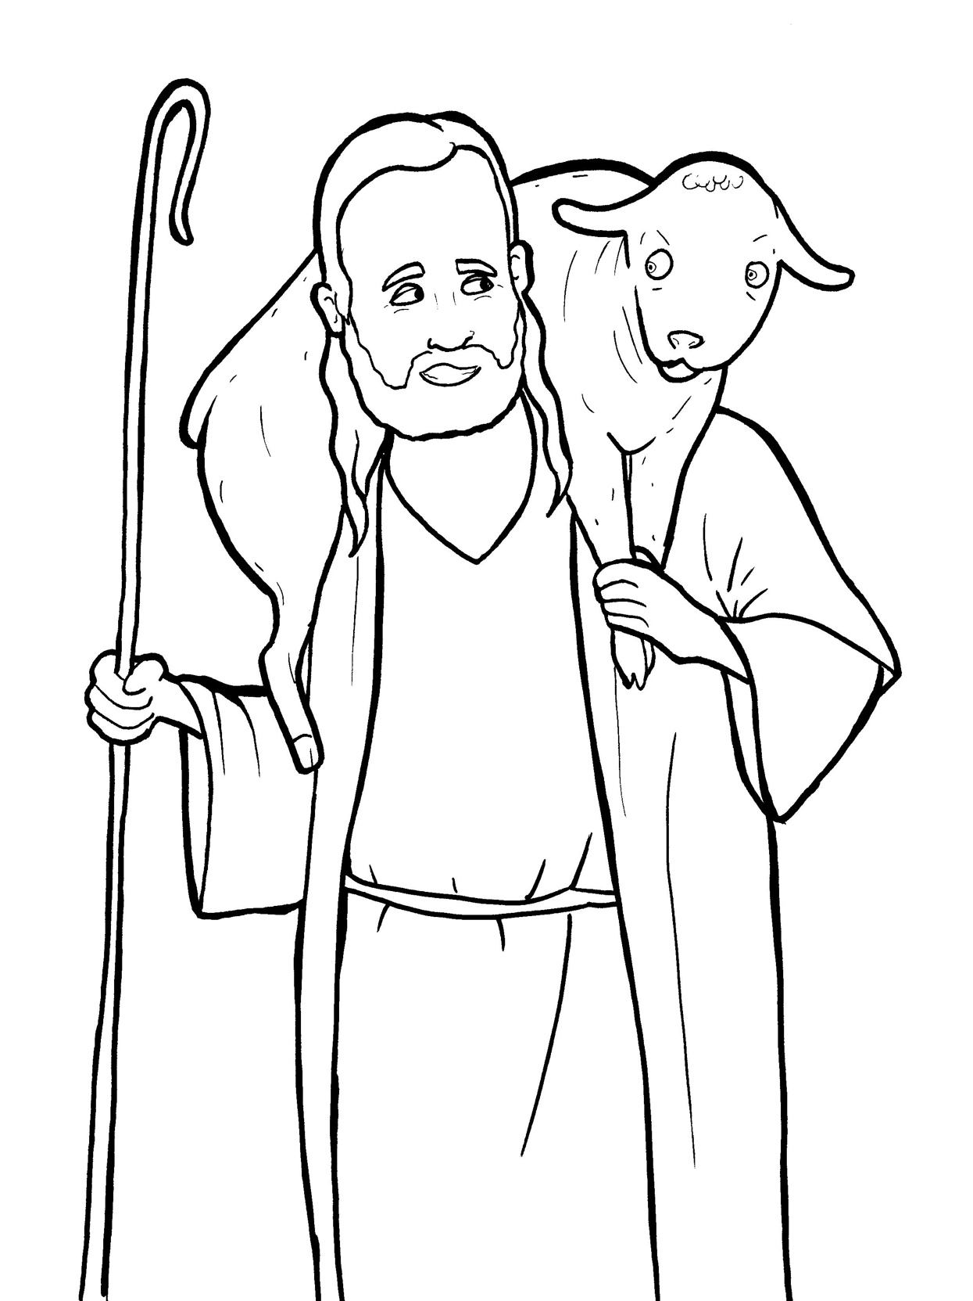
Part 5
22. The Lost Sheep
Vocabulary
Original Bible Story

Slide 2

Vocabulary

Slide 3
Pharisee
(PHAR - i - see)
a Jewish leader in the days of Jesus

Slide 4
scribe
(scribe)
a person who copied the Scriptures

Slide 5
parable
(PAR - a - ble)
a story on earth about
things in heaven

Slide 6
murmur
(MUR - mur)
to whisper a
complaint

Slide 7
repent
(RE – pent)
to be sorry for something you did wrong

Slide 8
righteous
(RIGHt - eous)
being a good person who follows the rules

Slide 9
The Lost
Sheep
Luke 15:1-7;10
World English Bible (WEB)

Slide 10
Now all the tax collectors and sinners were
coming close to him to hear him.

Slide 11
The Pharisees and the scribes murmured,
saying,
“This man welcomes sinners, and eats with
them.”

Slide 12
He told them this parable.
“Which of you men, if you had one hundred
sheep, and lost one of them,

Slide 13
wouldn’t leave the ninety-nine in the
wilderness, and go after the one that was
lost, until he found it?

Slide 14
When he has found it, he carries it on his
shoulders, rejoicing.

Slide 15
When he comes home, he calls together his
friends and his neighbors, saying to them,

Slide 16
‘Rejoice with me,
sheep which was lost!’
for I have found my

Slide 17
I tell you that even so there will be more
joy in heaven over one sinner who
repents,

Slide 18
than over ninety-nine righteous people
who need no repentance.

Slide 19
Even so, I tell you,
the angels of God
there is joy in the presence of
over one sinner repenting.”

