Slide 1
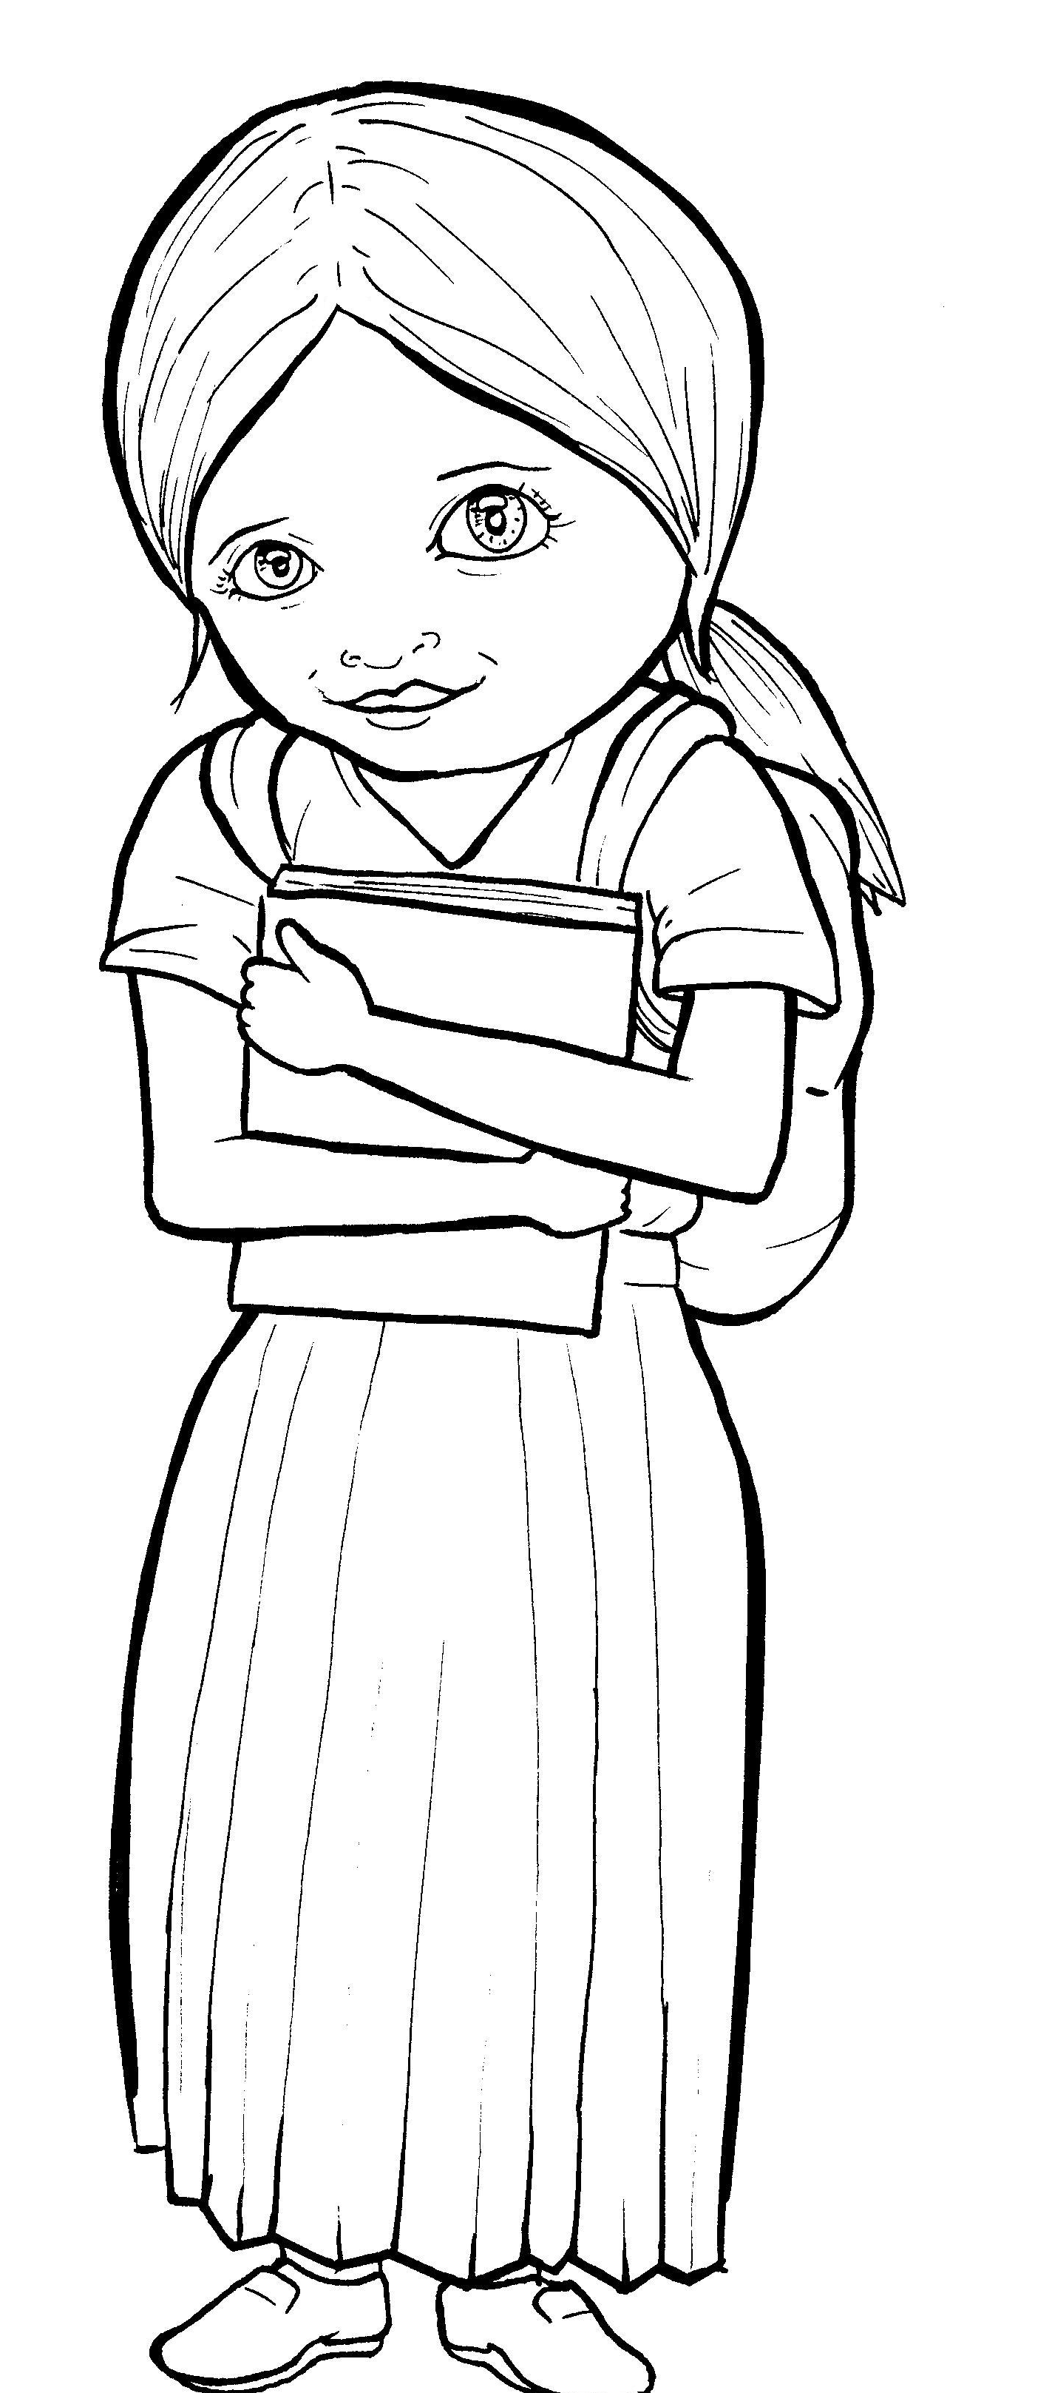
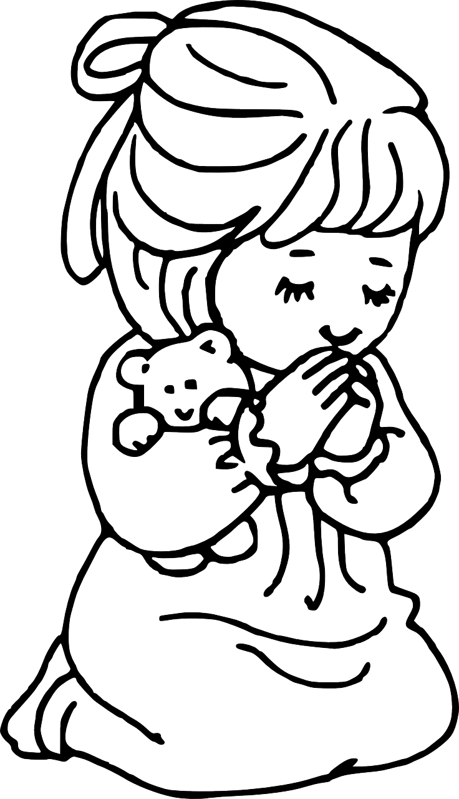
Part 2
49. Growing as a Christian
New Words
Rule Breakers

Slide 2
Silent Letters
know
Christian
talk

Slide 3
Possessives
Jesus’ life

Slide 4
Contractions
The word “contraction” means “the thing pulled together.”
The first word stays the same,
and the apostrophe takes the place of the
missing letters in the second word.
’m
=
am
I
I

Slide 5
can’t =
can not
isn’t =
is not

Slide 6
New Words
probably
through
believers

Slide 7
Rule Breakers
Words like these do not follow phonetic patterns.
to
you
said
could
two
f
from

Slide 8
is
who
to
the
do
you

Slide 9
your
their
eyes
there
give
want

Slide 10
what
other
friends
Father
loving
brothers

Slide 11
Christian
anywhere
through

