Slide 1
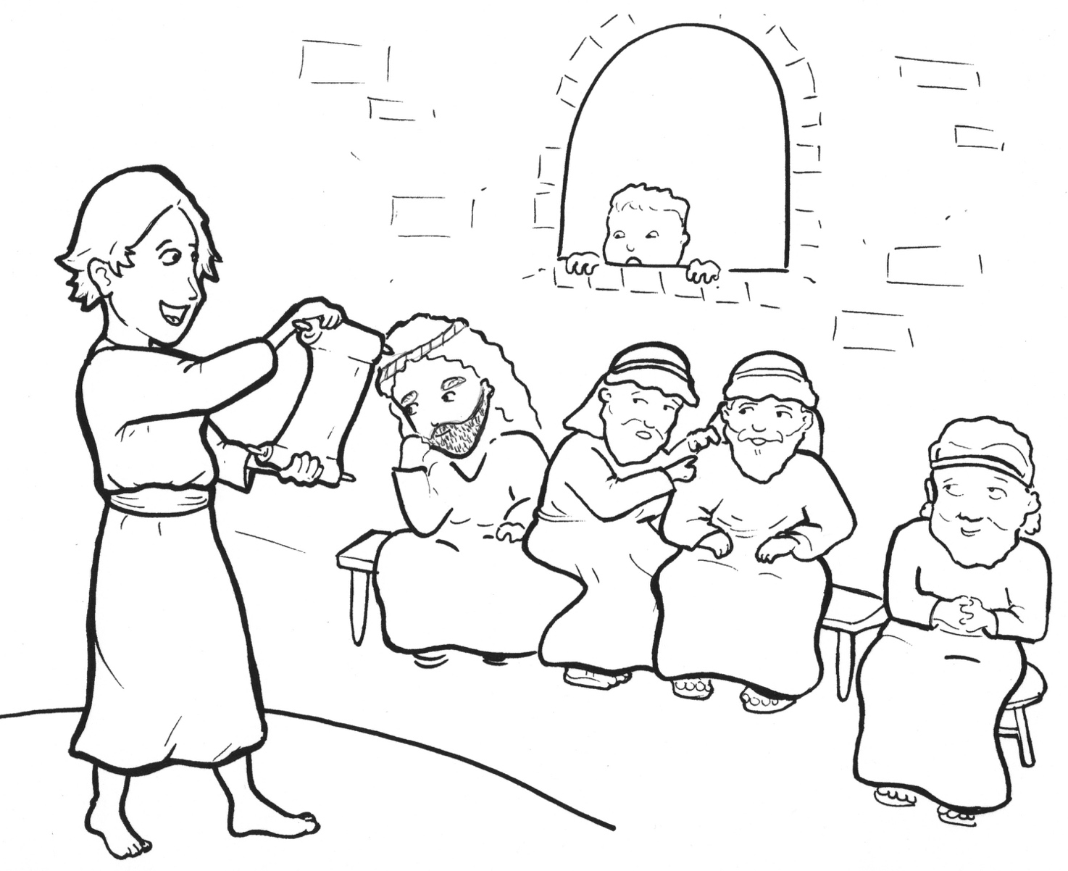
7. Jesus Gets Lost!
Part 5
Vocabulary
Original Bible Story

Slide 2
Vocabulary

Slide 3
feast
(feast):
a party with food

Slide 4
company
y):
(COM -
pan -
with them

Slide 5
anxiously
(an -
XIOUS -
ly):
in a fearful way

Slide 6
custom
(CUS -
tom):
a habit

Slide 7
relative
relative
tive):
a family member
(REL -
a -

Slide 8
acquaintance
tence):
(ac -
QUAINT -
a person you know a little

Slide 9
Jesus Gets Lost!
Luke 2:41-51
World English Bible (WEB)

Slide 10
His parents went every year to Jerusalem at the feast of the Passover.
When he was twelve years old, they went up to Jerusalem according to the custom of the feast,

Slide 11
and when they had fulfilled the days, as they were returning, the boy Jesus stayed behind in Jerusalem.
Joseph and his mother didn’t know it, but supposing him to be in the company,

Slide 12
they went a day’s journey, and they looked for him among their relatives and acquaintances.
When they didn’t find him, they returned to Jerusalem, looking for him.

Slide 13
After three days, they found him in the temple, sitting in the middle of the teachers, both listening to them, and asking them questions.

Slide 14
All who heard him were amazed at his understanding and his answers.
When they saw him, they were astonished, and his mother said to him,

Slide 15
“Son, why have you treated us this way? Behold, your father and I were anxiously looking for you.”
He said to them, “Why were you looking for me? Didn’t you know that I must be in my Father’s house?”

Slide 16
They didn’t understand the saying which he spoke to them. And he went down with them, and came to Nazareth.
He was subject to them, and his mother kept all these sayings in her heart.

