Slide 1

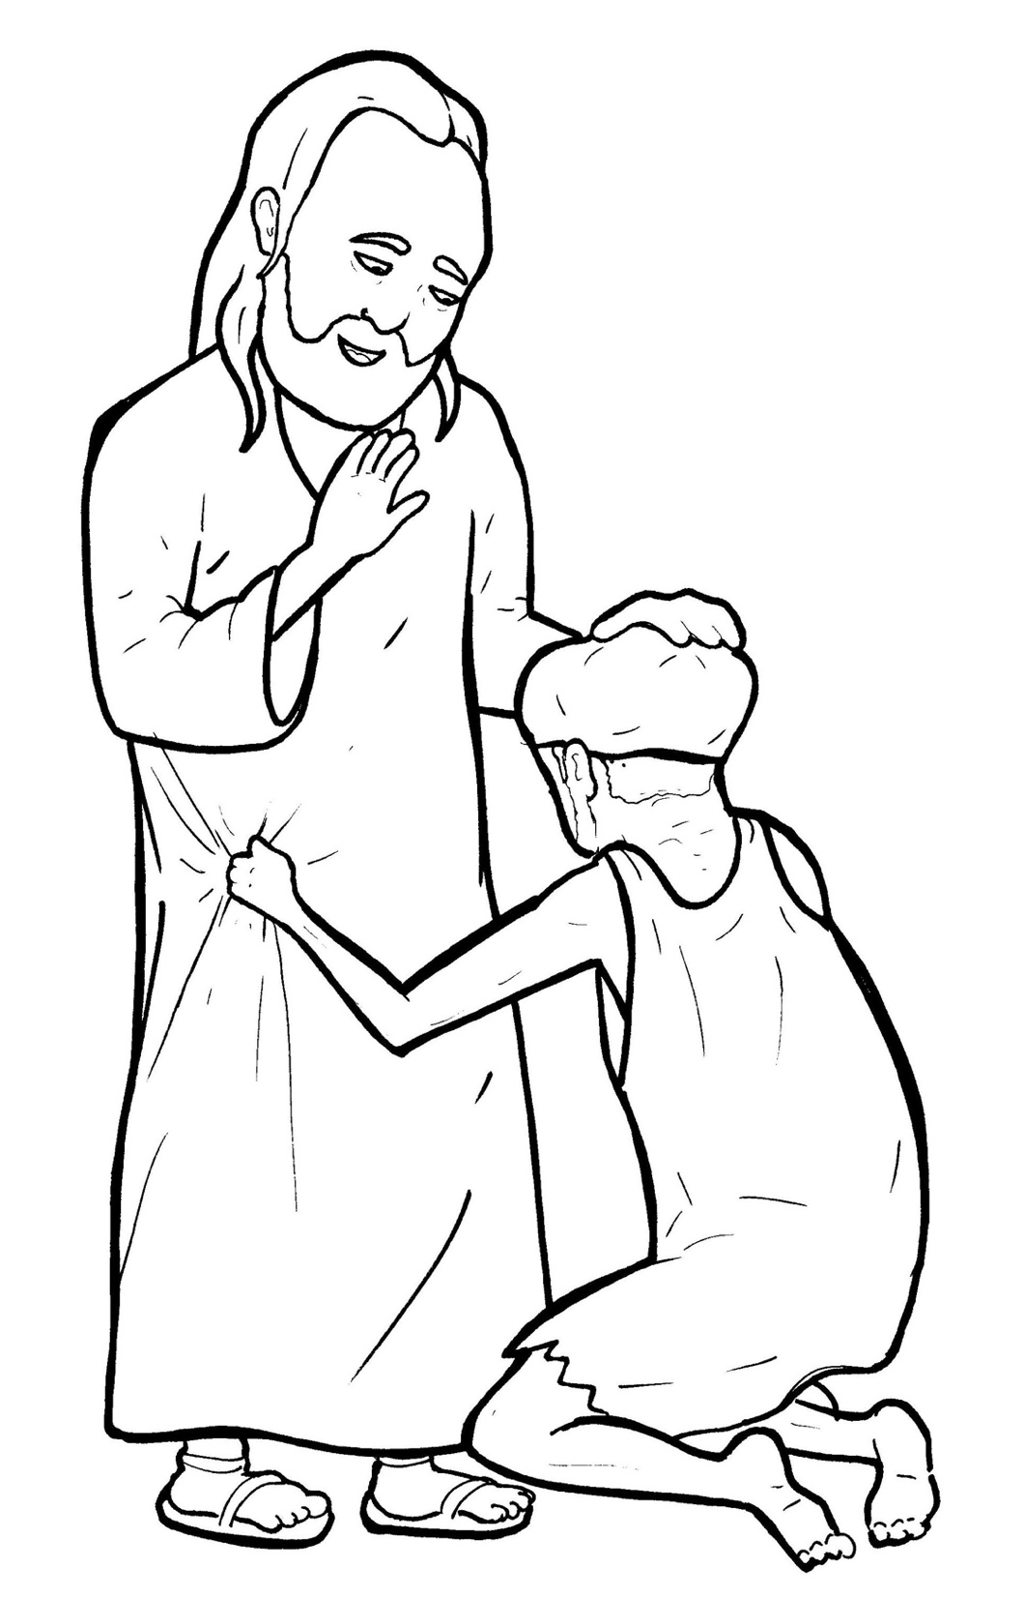
Part 3
31. A Blind Man Asks to See
Syllable Divisions

Slide 2

Dividing Words
Into Syllables

Slide 3
Rabbit Words
When you see two consonants
between two vowels,
divide between the consonants.
ra it
bb
rab bit

Slide 4
Bar timaeus
Bartimaeus

Slide 5
hap py
happy

Slide 6
hap pening
happening

Slide 7
mer cy
mercy

Slide 8
fol low
follow

Slide 9
Tiger Words
When you see one consonant
between two vowels,
divide after the first vowel.
Try this pattern first.
ti er
g
ti ger

Slide 10
Je sus
Jesus

Slide 11
o pen
open

Slide 12
Camel Words
When you see one consonant
between two vowels,
divide after the first consonant.
Try this pattern second.
ca el
m
cam el

Slide 13
Bartim aeus
Bartimaeus

Slide 14
Hamster Words
When you see three consonants between two vowels,
divide after the first consonant.
ha
mst
er
ham ster

Slide 15
hun dreds
hundreds

Slide 16
chil dren
children

Slide 17
Turtle Words
When you see consonant-l-e,
count back three and divide.
tur
t
l
e
tur tle

Slide 18
peo ple
people

Slide 19
lit tle
little

Slide 20

Anteater Words
These compound words are made up of two smaller words.
ant
eater
1
2
ant eater

Slide 21
foot steps
footsteps

Slide 22
be came
became

Slide 23

Foxes Suffixes
Focus on your base word.
fox es
fox es

Slide 24
run ning
running

Slide 25
happen ing
happening

Slide 26
pass ing
passing

Slide 27
call ing
calling

Slide 28
voic es
voices

Slide 29
hous es
houses

Slide 30
loud er
louder

Slide 31
shout ed
shouted

Slide 32
followed
followed

Slide 33
stumbled
stumbled

Slide 34
cried
cried

Slide 35
praised
praised

Slide 36
yelled
yelled

Slide 37
begged
begged

Slide 38
stopped
stopped

Slide 39
jumped
jumped

Slide 40
asked
asked

Slide 41
Other Syllable Divisions
Some words don’t fit so neatly
into standard syllable division patterns.

Slide 42
a long
along

Slide 43
a way
away

