Slide 1
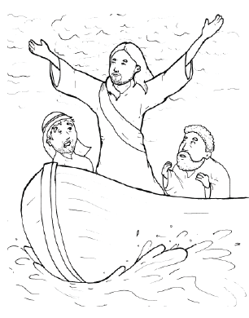
17. Jesus Stops a Storm
Part 1
Syllable Charts

Slide 2
Words in Syllable Types

Slide 3
at
mas-
bad
crashed
asked
splashed

Slide 4
men
kept
fell
-et

Slide 5
him
still
wind

Slide 6
rocked
stop
stopped

Slide 7
up
but
us

Slide 8
Open – Long Vowel
An open syllable has one vowel
with no consonant after it,
and the vowel is long.
−
go

Slide 9
he
Je sus
we
e ven
be came

Slide 10
qui et

Slide 11
so
o ver
go ing
o bey

Slide 12
dis ci ple

Slide 13
why

Slide 14
Silent e – Long Vowel
A silent e syllable has one vowel,
followed by one consonant
and a silent e at the end.
The vowel is long.
−
ca
e
v

Slide 15
lake
be came
save
a mazed
wave

Slide 16
woke

Slide 17
huge

Slide 18
Vowel Teams – Long Vowel
Many vowel teams follow this rule:
When two vowels get together,
the first one names its letter.
So the first vowel will make its long sound,
and the second vowel is silent.
−
e
a
t

Slide 19
rain
laid
sailed
a fraid
faith

Slide 20
sleep

Slide 21
lie
terrified
cried

Slide 22
night

Slide 23
boat
soak ing

Slide 24
blew

Slide 25
Vowel Teams – Other Sounds
Sometimes vowel teams make other sounds.
oil

Slide 26
now
down
drown
howl ing

Slide 27
all
small

Slide 28
R - Controlled
R-controlled syllables have one or more vowels
followed by an “r.”
The “r” changes the sound of the vowel.
o
r
ange

Slide 29
hard

Slide 30
forth
storm

Slide 31
o ver
mas ter

Slide 32
Consonant – l-e
When you see consonant l-e at the end of a word,
count back three.
The “l-e” makes the /–le/ sound.
pur
p
l
e

Slide 33
dis ci ple

Slide 34
gen tle

Slide 35
Other Sounds – Long Vowel
These syllables or words are closed,
so the vowel should be short,
but the vowel is long.
−
cold

Slide 36
told

Slide 37
al most

Slide 38
wild

Slide 39
Other Sounds – -nk/-ng
The “-nk” and “-ng”
change the sound of the vowel.
bank
thing

Slide 40
sleep ing
go ing

Slide 41
strong

Slide 42
sank

Slide 43
Other Sounds – schwa
The schwa syllable has an “a” that sounds
like the /u/ in banana.
The banana is even shaped like a short u.
ba nan a

Slide 44
a sleep
a mazed
a fraid

