Slide 1
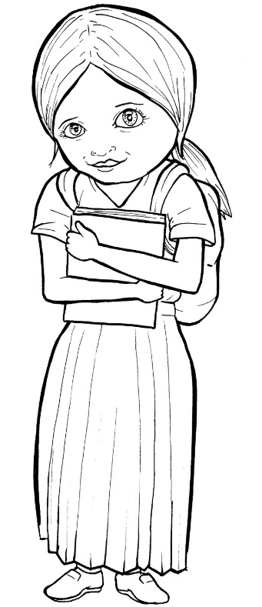
49. Growing as
a Christian
Part 4
Story in Easy Read English
Questions
Story in Phrases

Slide 2
A new Christian is like a
fresh plant that needs air,
sunshine, soil, and rain.

Slide 3
Without these, it will not grow.

Slide 4
Believers need to do this
to grow:

Slide 5
1) Pray.
2) Read the Bible.
3) Meet with other Christians.

Slide 6
4) Give to others.
5) Tell the Good News.

Slide 7
You talk to God through
prayer.

Slide 8
Pray to God anywhere,
anytime.

Slide 9
Pray with your eyes open
or closed.

Slide 10
God can even hear
silent prayers.

Slide 11
Isn't that cool?

Slide 12
God talks to you through
the Bible.

Slide 13
Read it each day.

Slide 14
Start in Mark.

Slide 15
This short book tells about
Jesus' life.

Slide 16
Christians need to be with
their believing brothers and
sisters.

Slide 17
If you can't go to church, ask
God for Christian friends and
Bible teachers.

Slide 18
God's heart is to give to
those in need.

Slide 19
Churches help the needy,
and you can too.

Slide 20
Open your eyes to see hurts.

Slide 21
What can you share with
others?

Slide 22
There are probably children
in your life who do not know
God.

Slide 23
Tell your friends, "Jesus came
into my life!

Slide 24
Want to meet him?"

Slide 25
This is called the "Good
News."

Slide 26
Growing takes time and
effort.

Slide 27
God is your loving Father.

Slide 28
He will teach you and help
you grow up.

Slide 29
Question 1
How is a new Christian like a plant?

Slide 30
Question 2
What does a new Christian need to grow?

Slide 31
Question 3
How many ways are you growing?

Slide 32
Question 4
What part of growing do you need help with?

Slide 33
Prayer
Dear Lord Jesus,
I love you. I want to grow as a Christian.
I want you to be proud of me. Please help
me grow to be a good disciple. Help me
to get what I need to grow. Thank you.
Amen

Slide 34
Growing as a Christian
Phrased for Fluency

Slide 35
A new Christian is like
a fresh plant that needs air,
sunshine, soil, and rain.

Slide 36
Without these, it will not grow.

Slide 37
Believers need to do this
to grow:

Slide 38
1) Pray.
2) Read the Bible.
3) Meet with other Christians.

Slide 39
4) Give to others.
5) Tell the Good News.

Slide 40
You talk to God through prayer.

Slide 41
Pray to God
anywhere, anytime.

Slide 42
Pray with
your eyes open
or closed.

Slide 43
God can
even hear
silent prayers.

Slide 44
Isn’t that cool?

Slide 45
God talks to you
through the Bible.

Slide 46
Read it
each day.

Slide 47
Start in
Mark.

Slide 48
This short book
tells about
Jesus’ life.

Slide 49
Christians
need to be
with their believing
brothers and sisters.

Slide 50
If you can’t
go to church,
ask God
for Christian friends
and Bible teachers.

Slide 51
God’s heart
is to give
to those
in need.

Slide 52
Churches help
the needy,
and you can too.

Slide 53
Open your eyes
to see hurts.

Slide 54
What can you
share
with others?

Slide 55
There are probably
children
in your life
who do not
know God.

Slide 56
Tell your friends,
“Jesus came into
my life!
Want to meet him?”

Slide 57
This is called
the “Good News.”

Slide 58
Growing takes
time
and effort.

Slide 59
God
is your
loving Father.

Slide 60
He
will teach you
and help you
grow up.

