Slide 1

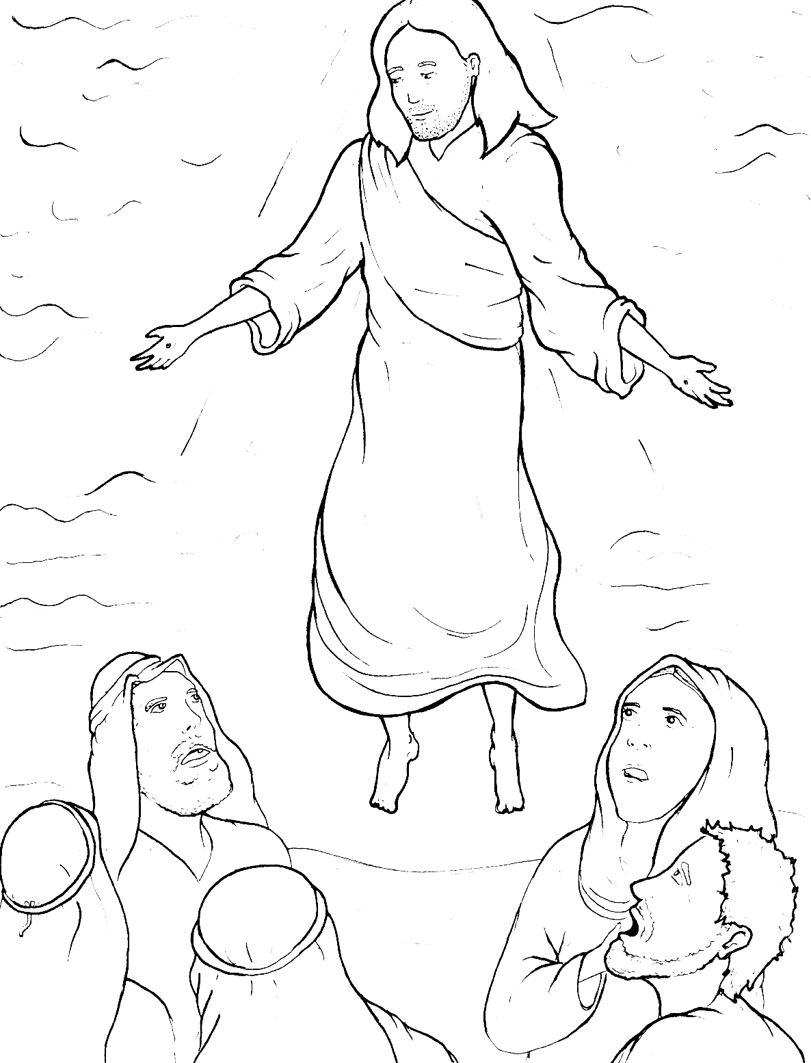
Part 4
44. Jesus Goes Back to Heaven
Story in Easy Read English
Questions
Story in Phrases

Slide 2
After Jesus rose from the dead,
more than 500 people saw him.

Slide 3
He did many miracles for 40 days.

Slide 4
If you wrote them down,
the world could not hold
all the books!

Slide 5
These were written that we
might believe

Slide 6
that Jesus is the Messiah,
the Son of God.

Slide 7
By believing, we have life –
real life, forever life.

Slide 8
The disciples were eating fish
on a beach together.

Slide 9
Jesus asked Peter,
“Do you love me?”

Slide 10
“Yes,” Peter said.
“You know that I love you.”

Slide 11
“Then take care of my sheep,”
Jesus said.

Slide 12
This meant that Peter was to
take care of the believers.

Slide 13
Jesus told all his followers,
“You must love each other

Slide 14
in the same way that I have
loved you.”

Slide 15
“Go,” Jesus said,
“Make disciples of all nations.

Slide 16
Baptize the believers.

Slide 17
Teach them to obey
everything that I told you.

Slide 18
I will be with you always,
even to the end.”

Slide 19
Then Jesus went up into heaven.

Slide 20
A cloud hid him from their sight.

Slide 21
Two angels said, “Jesus will
come back again.”

Slide 22
The disciples felt great joy.

Slide 23
This was the start of the
worldwide Christian church.

Slide 24
Question 1
What did Jesus do in the 40 days that he was back on earth after he rose from the dead?

Slide 25
Question 2
What commands did Jesus leave us?

Slide 26
Question 3
Did the disciples obey him? How do we know?

Slide 27
Question 4
Which believers can you love? Who can you teach?

Slide 28
Prayer
Dear Jesus,
Thank you for giving me eternal life. Thank you for living inside me. Help me to tell the world who you are and what you said. Help me to love others in the way that you loved me.
Amen

Slide 29
Jesus Goes Back
to Heaven
Phrased for Fluency

Slide 30
After Jesus
rose
from the dead,
more than 500 people
saw him.

Slide 31
He did
many miracles
for 40 days.

Slide 32
If you
wrote them down,
the world
could not hold
all the books!

Slide 33
These were written
that we might believe
that Jesus
is the Messiah,
the Son of God.

Slide 34
By believing,
we have life –
real life,
forever life.

Slide 35
The disciples
were eating fish
on a beach together.

Slide 36
Jesus asked Peter,
“Do you love me?”

Slide 37
“Yes,”
Peter said.
“You know
that I love you.”

Slide 38
“Then take care
of my sheep,”
Jesus said.

Slide 39
This meant
that Peter
was to take care of
the believers.

Slide 40
Jesus told
all his followers,

Slide 41
“You must
love each other
in the same way
that I
have loved you.”

Slide 42
“Go,”
Jesus said,
“Make disciples
of all nations.

Slide 43
Baptize the believers.
Teach them
to obey everything
that I told you.

Slide 44
I will be
with you always,
even to the end.”

Slide 45
Then Jesus
went up
into heaven.

Slide 46
A cloud
hid him
from their sight.

Slide 47
Two angels said,
“Jesus will
come back again.”

Slide 48
The disciples
felt great joy.

Slide 49
This was the start
of the worldwide
Christian church.

