Slide 1
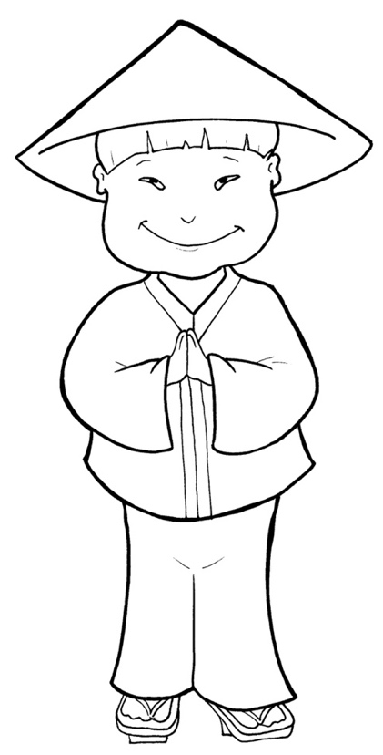
Timing
Box
Part 3
53. I Am Alive: Tell the World
Syllable
Divisions

Slide 2
Dividing Words
Timing
Box
Into Syllables

Slide 3
Rabbit Words
When you see two consonants
between two vowels,
divide between the consonants.
ra it
bb
rab bit

Slide 4
Timing
Box
sor ry
sorry

Slide 5
Timing
Box
bap tize
baptize

Slide 6
Timing
Box
dis ci ples
disciples

Slide 7
Timing
Box
won der ful
wonderful

Slide 8
Tiger Words
When you see one consonant
between two vowels,
divide after the first vowel.
Try this pattern first.
ti er
g
ti ger

Slide 9
Timing
Box
be came
became

Slide 10
Timing
Box
be fore
before

Slide 11
Timing
Box
be liev ers
believers

Slide 12
Timing
Box
o bey
obey

Slide 13
Timing
Box
de mons
demons

Slide 14
Timing
Box
na tions
nations

Slide 15
Timing
Box
Pe ter
Peter

Slide 16
Camel Words
When you see one consonant
between two vowels,
divide after the first consonant.
Try this pattern second.
ca el
m
cam el

Slide 17
Timing
Box
giv en
given

Slide 18
Timing
Box
trav eled
traveled

Slide 19
Timing
Box
heav en
heaven

Slide 20
Timing
Box
pow er
power

Slide 21
Timing
Box
Spir it
Spirit

Slide 22
Turtle Words
When you see consonant-le,
count back three and divide.
tur
t
l
e
tur tle

Slide 23
Timing
Box
peo ple
people

Slide 24
Timing
Box
dis ci ples
disciples

Slide 25
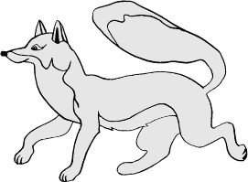
Foxes Suffixes
Focus on your base word.
fox es
fox es

Slide 26
Timing
Box
sad ness
sadness

Slide 27
Timing
Box
a ma zing
amazing

Slide 28
Timing
Box
believ ers
believers

Slide 29
Timing
Box
church es
churches

Slide 30
Timing
Box
wonder ful
wonderful

Slide 31
Timing
Box
filled
filled

Slide 32
Timing
Box
asked
asked

Slide 33
Timing
Box
raised
raised

Slide 34
Timing
Box
healed
healed

Slide 35
Timing
Box
prayed
prayed

Slide 36
Timing
Box
baptized
baptized

Slide 37
Anteater Words
These compound words are made up of two smaller words.
ant
eater
1
2
ant eater

Slide 38
Timing
Box
in side
inside

Slide 39
Timing
Box
for given
forgiven

Slide 40
Timing
Box
our selves
ourselves

Slide 41
Other Syllable Divisions
Some words don’t fit so neatly
into standard syllable division patterns.

Slide 42
Timing
Box
a bout
about

Slide 43
Timing
Box
a ma zing
amazing

Slide 44
Timing
Box
thou sands
thousands

