Slide 1
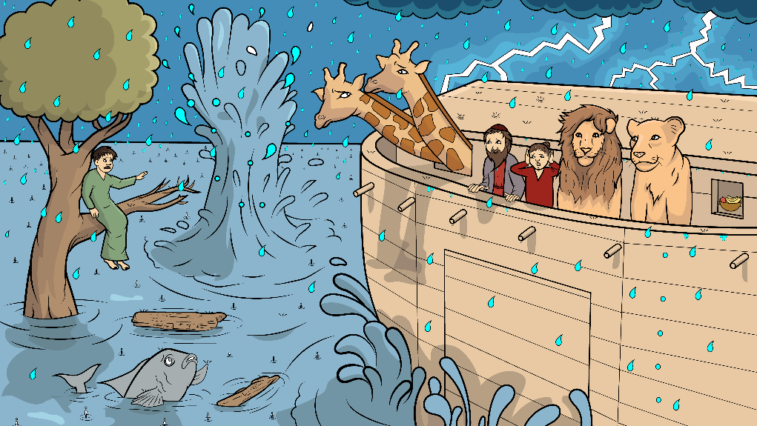
Song 1.7
Splish Splash
Noah’s Ark, Part 1
Genesis 6 – 7 (sh)

Slide 2
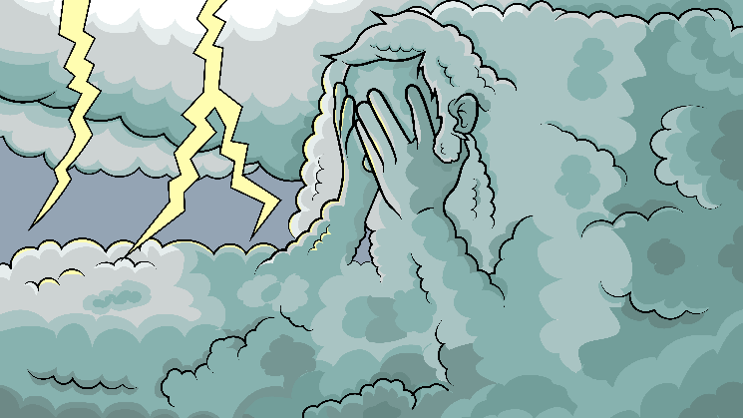
God was so sad;
man had been bad.

Slide 3
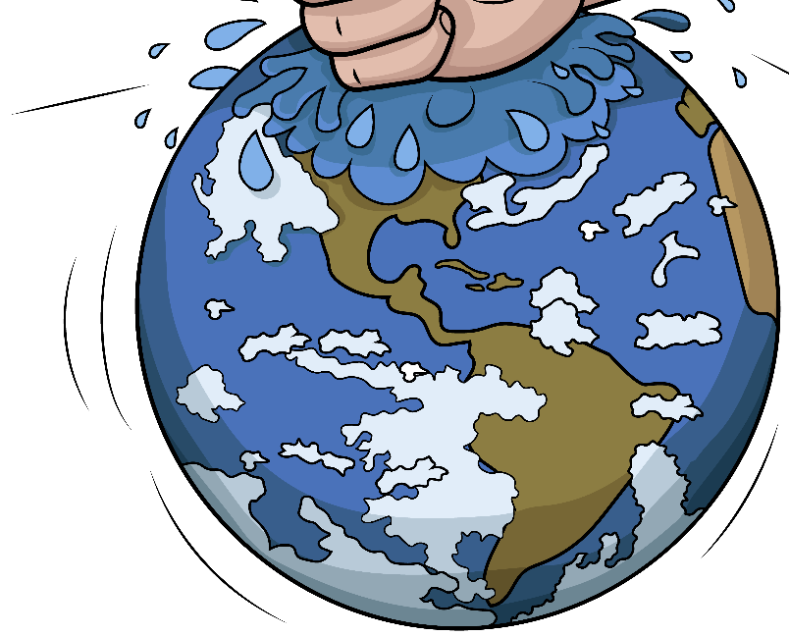
“I’ll begin fresh. I am so mad.”

Slide 4
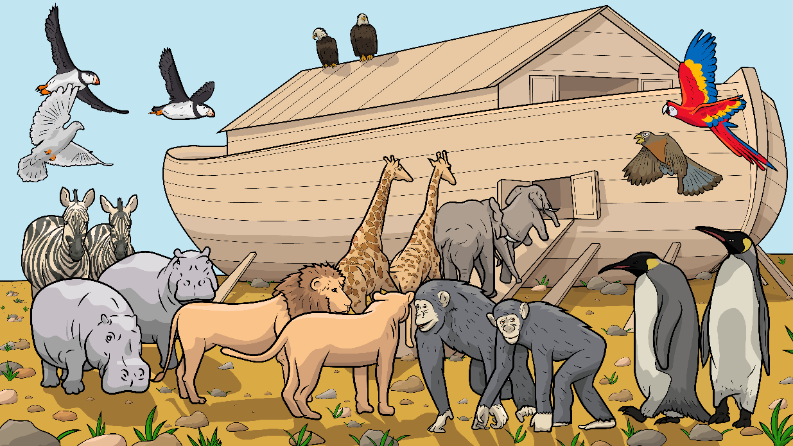
The animals did rush up that ship.
And the animals did rush up that ship.

Slide 5
And the animals did rush up.
And the animals did rush up.

Slide 6
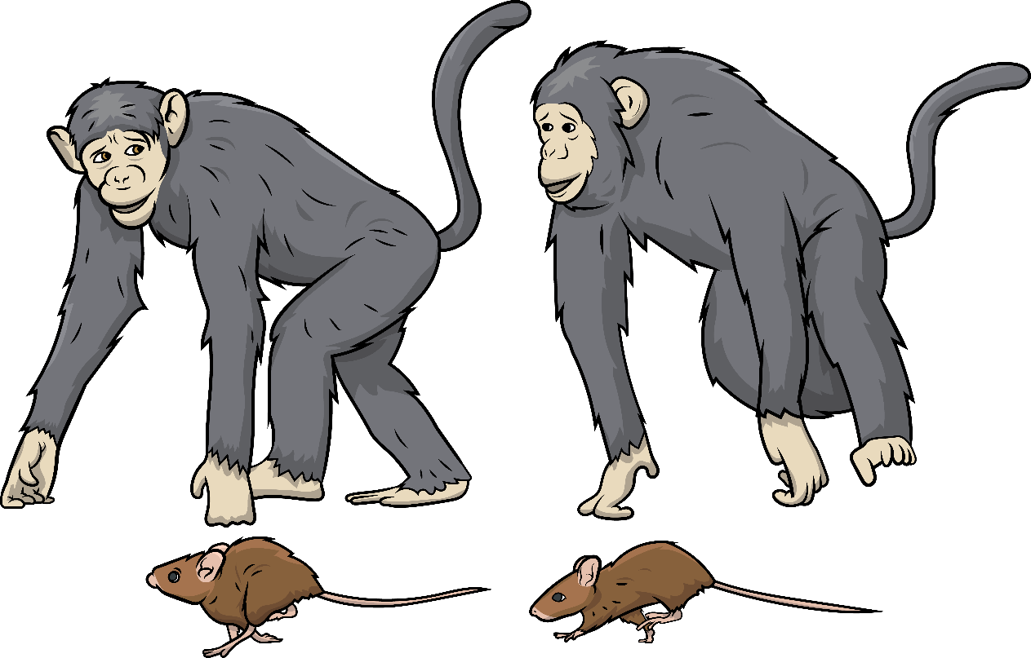
We must
all dash.

Slide 7
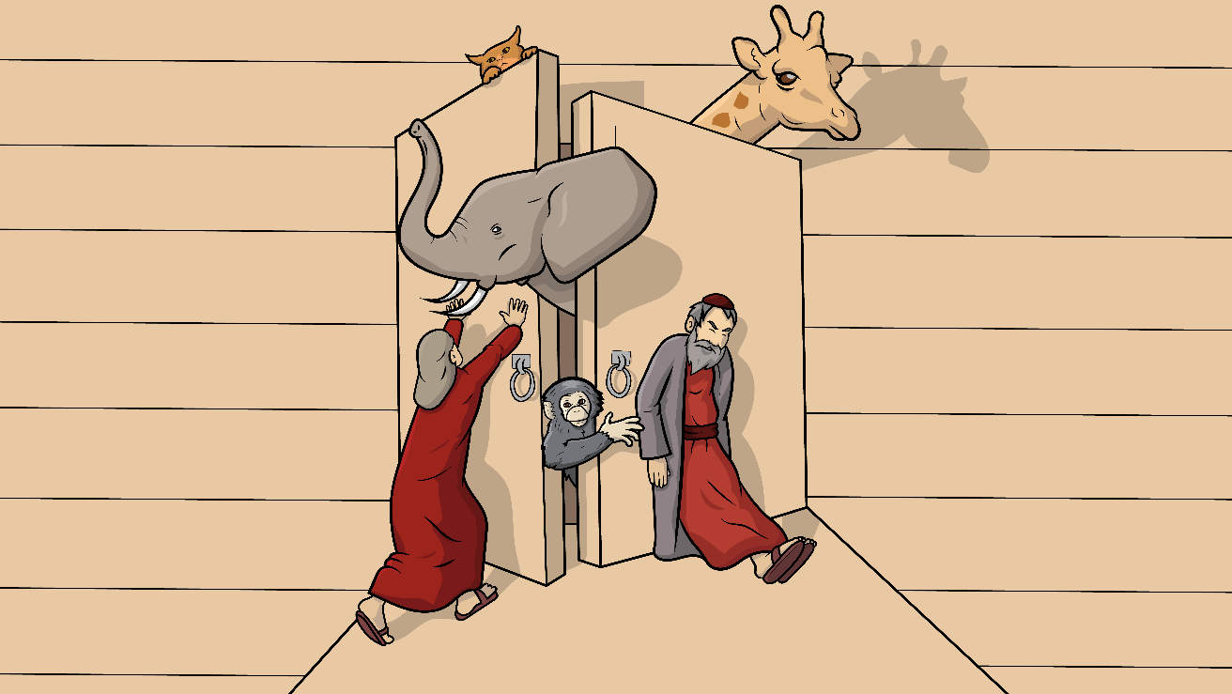
Get in,
let’s stash.

Slide 8
I see a flash…
and then a CRASH!

Slide 9
The animals did rush up that ship.
The animals did rush up that ship.

Slide 10
The animals did rush up.
The animals did rush up.

Slide 11
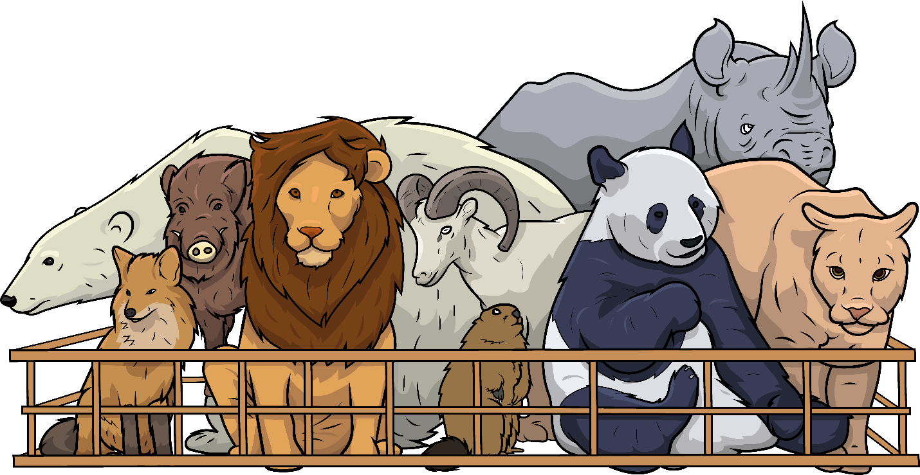
We have to squish.

Slide 12
I have a wish…

Slide 13
to be a fish and splash and splish.

Slide 14
The animals did rush up that ship.
And the animals did rush up that ship.

Slide 15
And the animals did rush up.
And the animals did rush up.

Slide 16
Drip,
drop
then
GUSH!

Slide 17
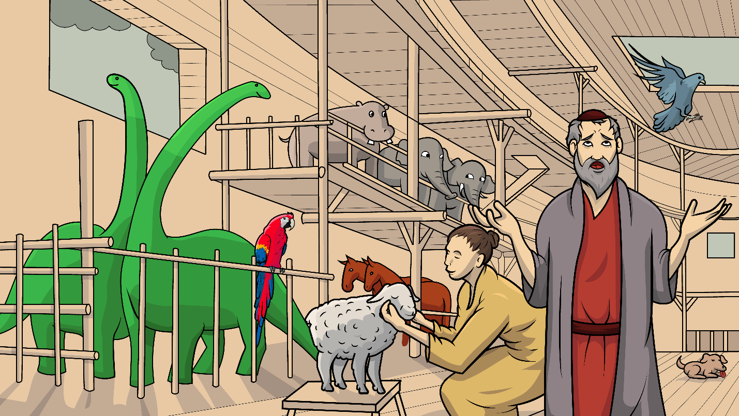
Get in, let’s rush.

Slide 18
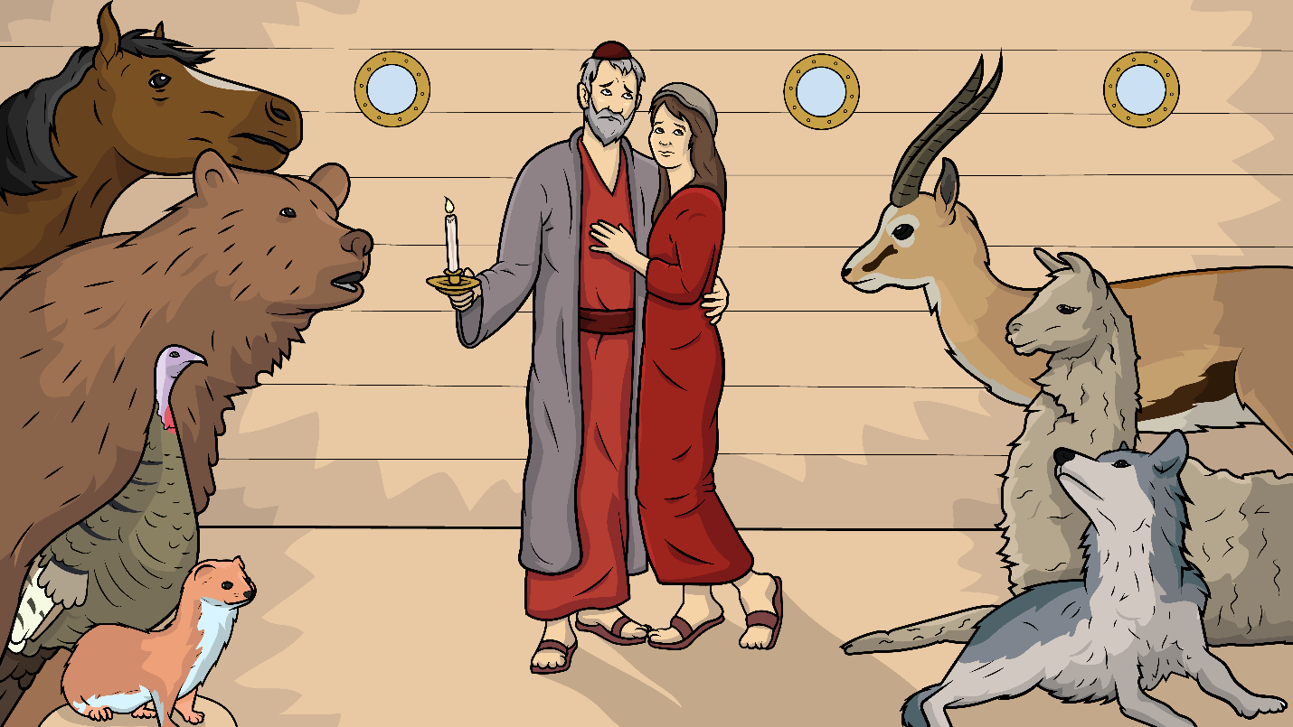
No need to crush and then the….
HUSSsshhhh.

Slide 19
The animals did rush up that ship.
And the animals did rush up that ship.

Slide 20
And the animals did rush up.
And the animals did rush up.

Slide 21
Oh, the animals did rush up.

Slide 22
The End

Slide 23
Song lyrics and melody: Carol Hale
Song arrangements and singer: Steffi VornBerger
Illustrations: Ivan Mader
Power Point arrangements: Steve March
www.EasyReadEnglish.com
www.EZReadEnglish.org/Lower-Levels

