Slide 1

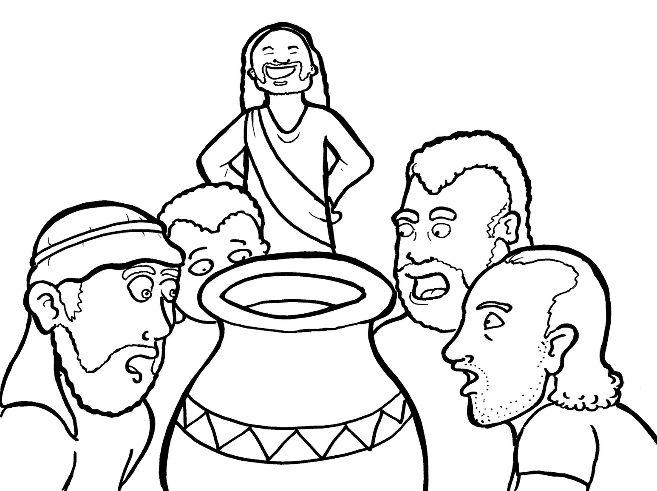
15. Jesus Saves a Wedding
Part 3
Syllable Divisions

Slide 2
Dividing Words
Into Syllables

Slide 3
Rabbit Words
When you see two consonants
between two vowels,
divide between the consonants.
ra it
bb
rab bit

Slide 4
dis ciple
disciple

Slide 5
wed ding
wedding

Slide 6
hap py
happy

Slide 7
hap pen
happen

Slide 8
ser vant
servant

Slide 9
per son
person

Slide 10

Tiger Words
When you see one consonant
between two vowels,
divide after the first vowel.
Try this pattern first.
ti er
g
ti ger

Slide 11
Je sus
Jesus

Slide 12
mu sic
music

Slide 13
Ca na
Cana

Slide 14
o bey
obey

Slide 15
be lieve
believe

Slide 16
Camel Words
When you see one consonant
between two vowels,
divide after the first consonant.
Try this pattern second.
ca el
m
cam el

Slide 17
ev er
ever

Slide 18
glor y
glory

Slide 19
Mar y
Mary

Slide 20
giv en
given

Slide 21
Turtle Words
When you see consonant-l-e,
count back three and divide.
tur
t
l
e
tur tle

Slide 22
disci ple
disciple

Slide 23
peo ple
people

Slide 24
mir a cle
miracle

Slide 25

Foxes Suffixes
Focus on your base word.
fox es
fox es

Slide 26
loved
loved

Slide 27
obeyed
obeyed

Slide 28
believed
believed

Slide 29
filled
filled

Slide 30
turned
turned

Slide 31
showed
showed

Slide 32
played
played

Slide 33
danced
danced

Slide 34
torch es
torches

Slide 35
glow ing
glowing

Slide 36
soft ly
softly

Slide 37
Hamster Words
When you see three consonants between two vowels,
divide after the first consonant.
ha
mst
er
ham ster

Slide 38
chil dren
children

Slide 39

Anteater Words
These compound words are made up of two smaller words.
ant
eater
1
2
ant eater

Slide 40
in to
into

Slide 41
Other Syllable Divisions
Some words don’t fit so neatly
into standard syllable division patterns.
a round
around

Slide 42
emp ty
empty

