Slide 1
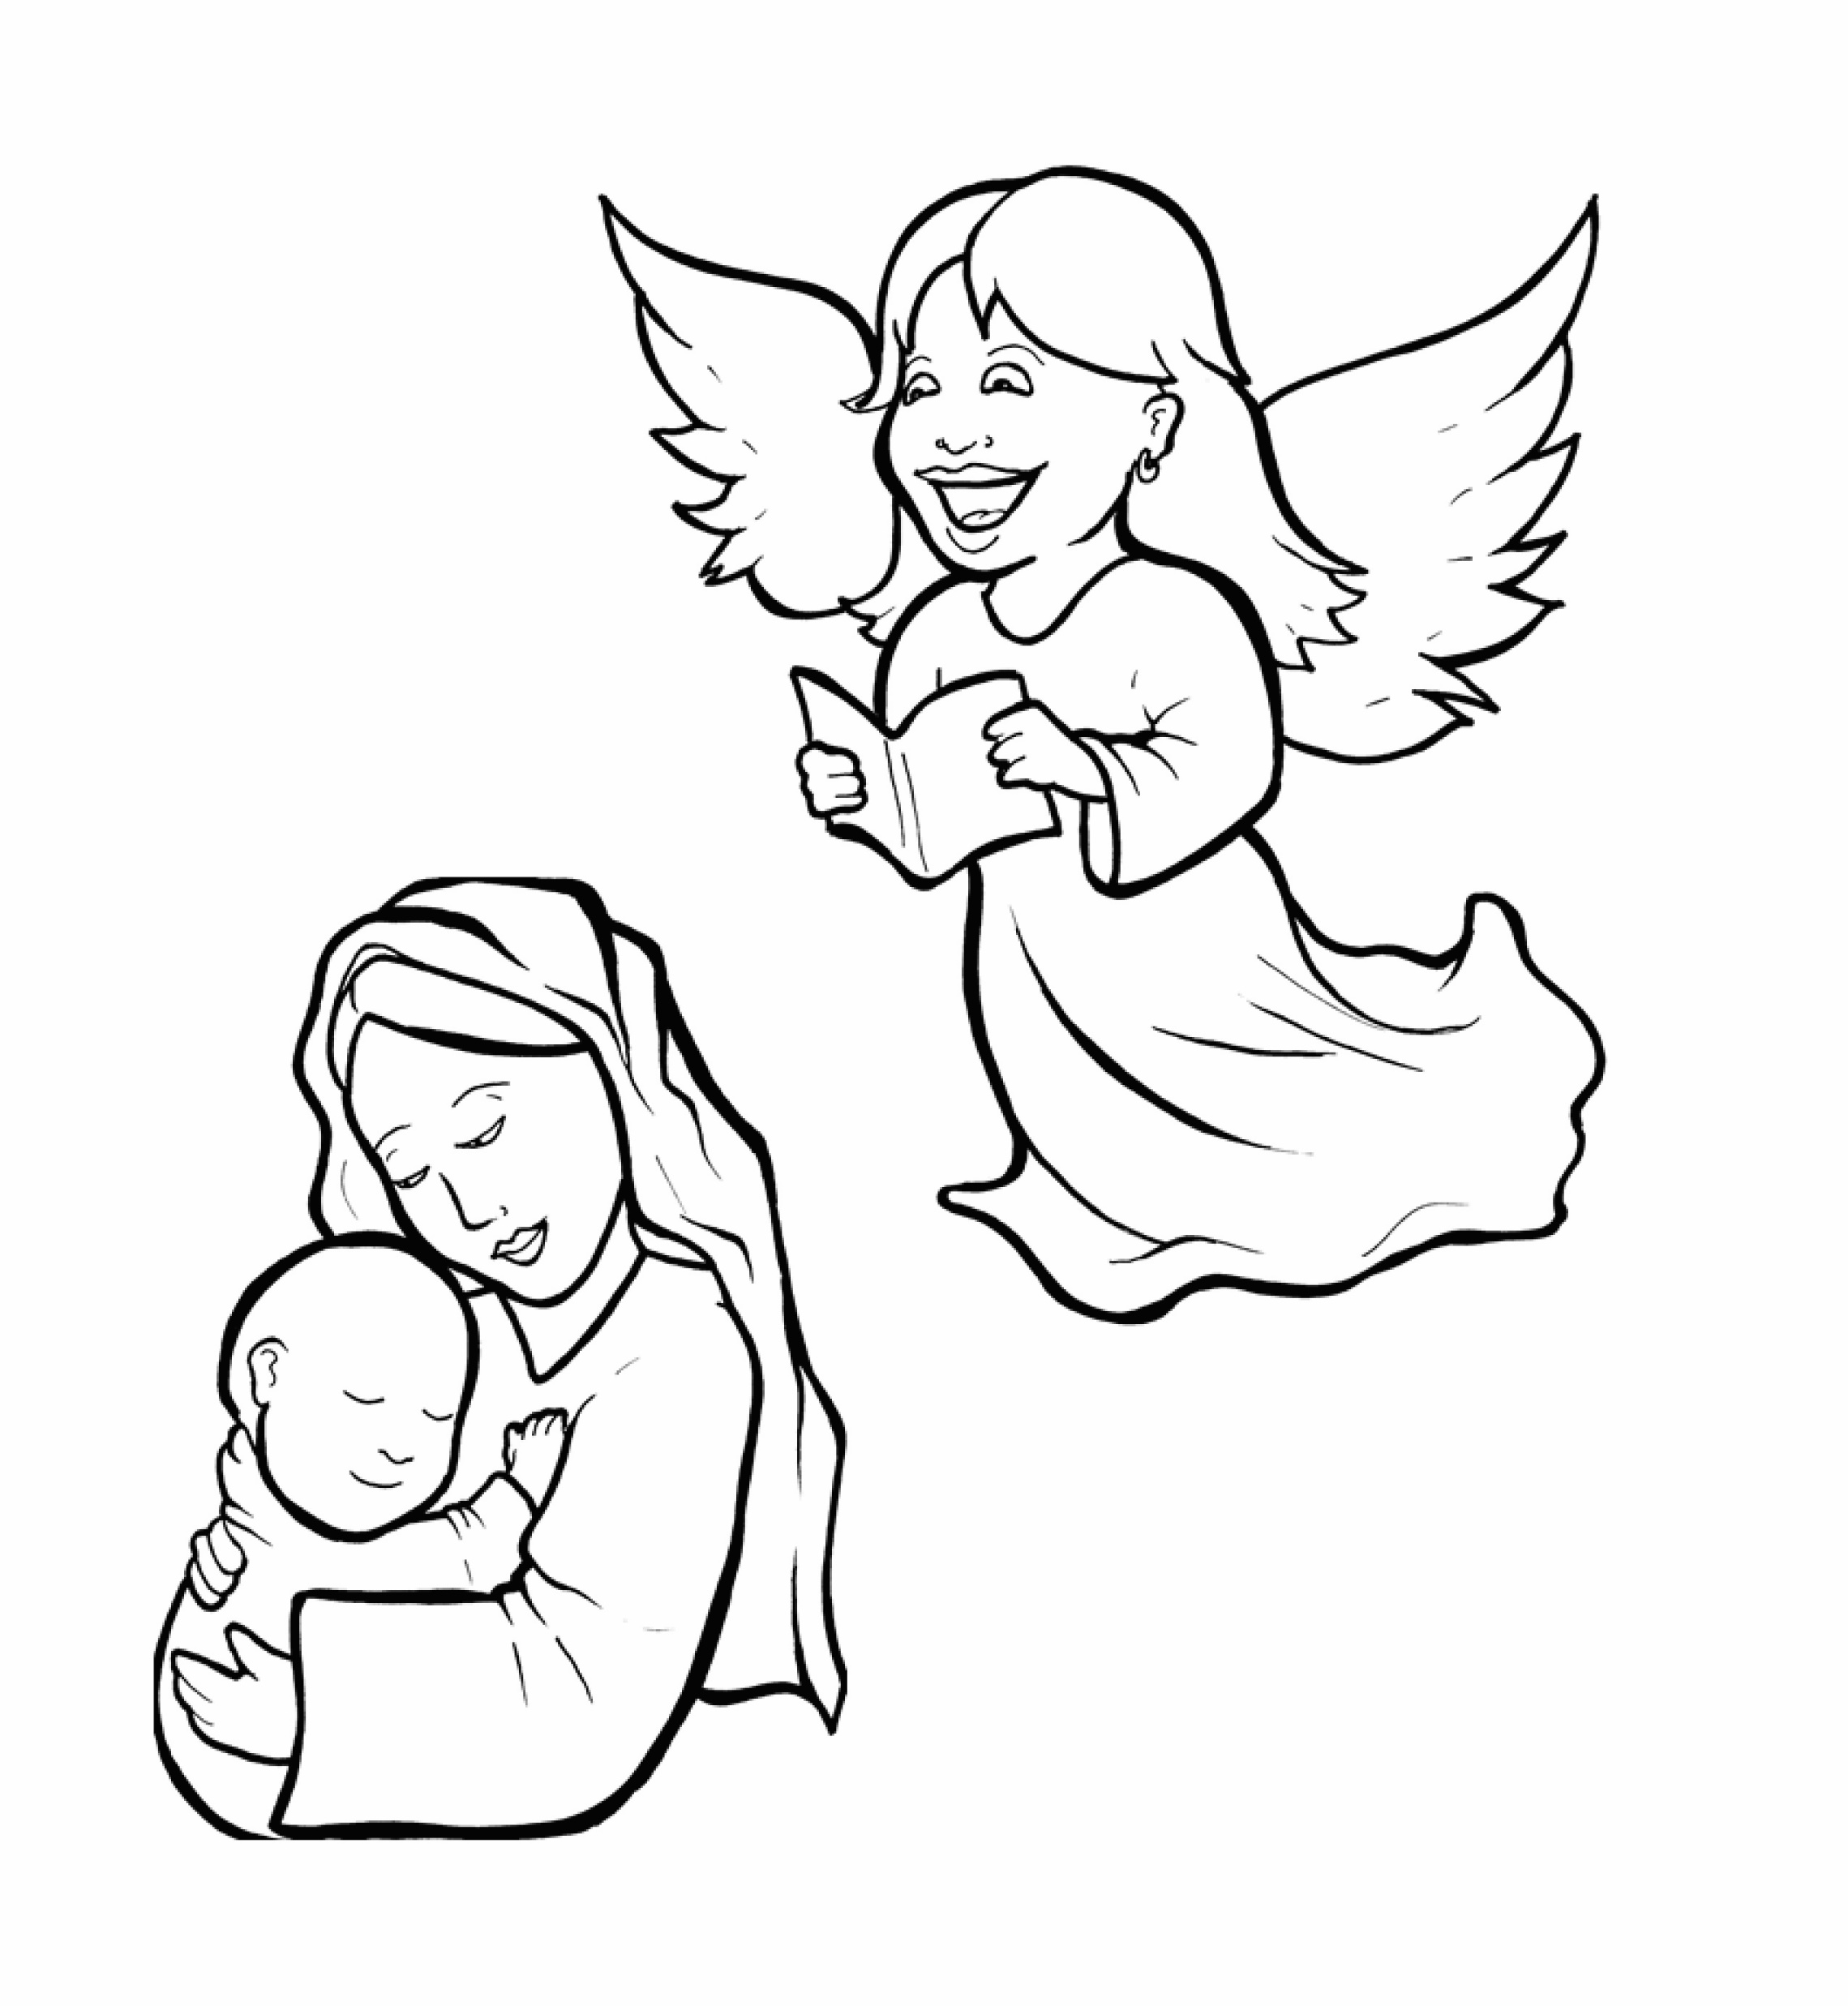
1.Will Mary Say Yes to God?
Part 1
Syllable Charts

Slide 2
Words in Syllable Types

Slide 3
Closed – Short Vowel
A closed syllable has one vowel
followed by one or more consonants,
and the vowel is short.
st
o
p
˘

Slide 4
at
that
hap-
Naz-

Slide 5
yes
-reth
bless
tell
-seph
left

Slide 6
will
with
this
him

Slide 7
God
job

Slide 8
up
must
us

Slide 9
Open – Long Vowel
An open syllable has one vowel
with no consonant after it,
and the vowel is long.
−
go

Slide 10
ba by
Ga briel

Slide 11
me
Je sus
she
re joice

Slide 12
go ing
Jo seph
o ver

Slide 13
ba by
might y
hap py

Slide 14
Silent e – Long Vowel
A silent e syllable has one vowel,
followed by one consonant
and a silent e at the end.
The vowel is long.
−
ca
e
v

Slide 15
in side

Slide 16
Vowel Teams – Long Vowel
Many vowel teams follow this rule:
When two vowels get together,
the first one names its letter.
So the first vowel will make its long sound,
and the second vowel is silent.
−
e
a
t

Slide 17
a fraid

Slide 18
say

Slide 19
high
might y

Slide 20
soon

Slide 21
grew

Slide 22
Vowel Teams – Other Sounds
Sometimes vowel teams make other sounds.
oil

Slide 23
a bout

Slide 24
how

Slide 25
re joice

Slide 26
R - Controlled
R-controlled syllables have one or more vowels
followed by an “r.”
The “r” changes the sound of the vowel.
o
r
ange

Slide 27
Lord

Slide 28
her
ser vant
o ver
won der ful

Slide 29
Consonant – l-e
When you see consonant l-e at the end of a word,
count back three.
The “l-e” makes the /–le/ sound.
pur
p
l
e

Slide 30
impossi ble

Slide 31
Other Sounds – Long Vowel
These syllables or words are closed,
so the vowel should be short,
but the vowel is long.
−
cold

Slide 32
told

Slide 33
most

Slide 34
child

Slide 35
Other Sounds – -nk/-ng
The “-nk” and “-ng”
change the sound of the vowel.
bank
thing

Slide 36
king
go ing

Slide 37
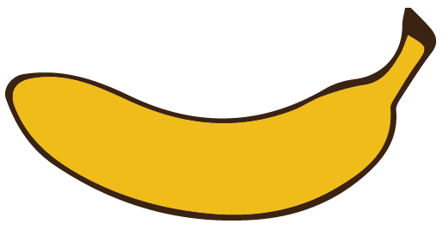
Other Sounds – schwa
The schwa syllable has an “a” that sounds
like the /u/ in banana.
The banana is even shaped like a short u.
ba nan a

Slide 38
a fraid
Naz a reth
a bout

