Slide 1
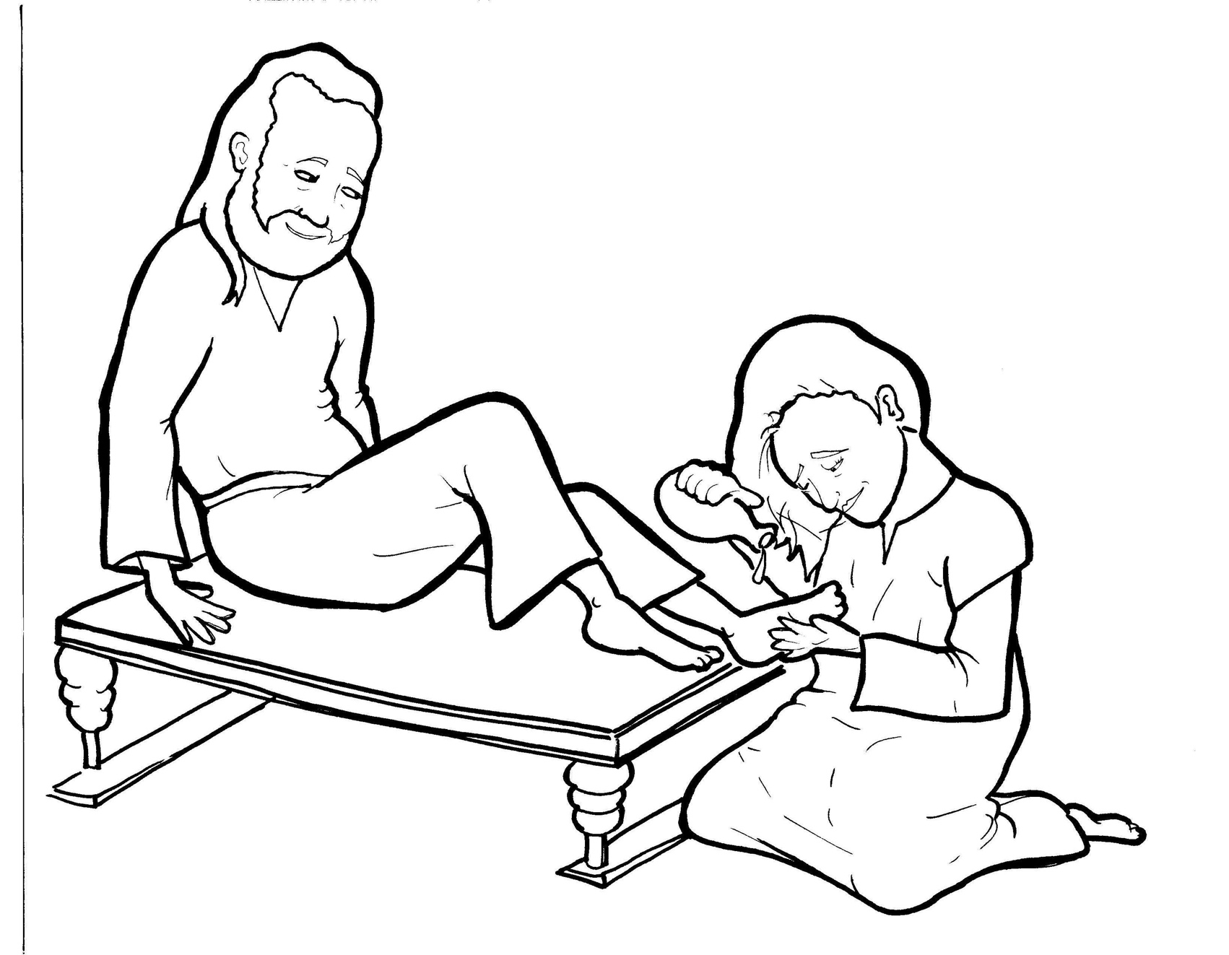
13
14. A Woman Washes Jesus’ Feet
Part 1
Syllable Charts

Slide 2
Words in Syllable Types

Slide 3
Closed – Short Vowel
A closed syllable has one vowel
followed by one or more consonants,
and the vowel is short.
st
o
p
˘

Slide 4
15
an
and
that
-tant

Slide 5
22
get
-en
then
yell
smell
felt

Slide 6
22
im-
kiss
din-
with
dis-
giv-

Slide 7
4
got
not
lot
cost

Slide 8
2
but
-sus

Slide 9
Open – Long Vowel
An open syllable has one vowel
with no consonant after it,
and the vowel is long.
−
go

Slide 10
4
be
Je sus
she
re plied

Slide 11
3
dis ci ple

Slide 12
4
Ju das
tru ly

Slide 13
1
cry

Slide 14
4
tru ly
read y

Slide 15
Silent e – Long Vowel
A silent e syllable has one vowel,
followed by one consonant
and a silent e at the end.
The vowel is long.
−
ca
e
v

Slide 16
4
came
ate
care

Slide 17
1
wiped

Slide 18
3
whole
a lone

Slide 19
1
per fume

Slide 20
Vowel Teams – Long Vowel
Many vowel teams follow this rule:
When two vowels get together,
the first one names its letter.
So the first vowel will make its long sound,
and the second vowel is silent.
−
e
a
t

Slide 21
1
al ways

Slide 22
1
hair

Slide 23
1
feet
sweet

Slide 24
4
leave
rea son
tears

Slide 25
1
die
cried

Slide 26
1
own

Slide 27
Vowel Teams – Other Sounds
Sometimes vowel teams make other sounds.
oil

Slide 28
4
house
a bout
a round

Slide 29
1
read y

Slide 30
R - Controlled
R-controlled syllables have one or more vowels
followed by an “r.”
The “r” changes the sound of the vowel.
o
r
ange

Slide 31
4
her
per fume
din ner
o ver

Slide 32
4
for
im por tant

Slide 33
1
world

Slide 34
Consonant – l-e
When you see consonant l-e at the end of a word,
count back three.
The “l-e” makes the /–le/ sound.
pur
p
l
e

Slide 35
4
dis ci ple
peo ple

Slide 36
Other Sounds – Long Vowel
These syllables or words are closed,
so the vowel should be short,
but the vowel is long.
−
cold

Slide 37
1
told
sold

Slide 38
Other Sounds – -nk/-ng
The “-nk” and “-ng”
change the sound of the vowel.
bank
thing

Slide 39
1
getting

Slide 40
1
long

Slide 41
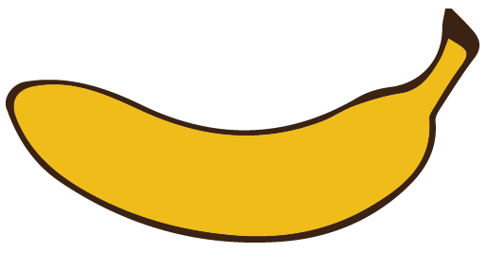
Other Sounds – schwa
The schwa syllable has an “a” that sounds
like the /u/ in banana.
The banana is even shaped like a short u.
ba nan a

Slide 42
4
a bout
a round
a lone

